Slide 1
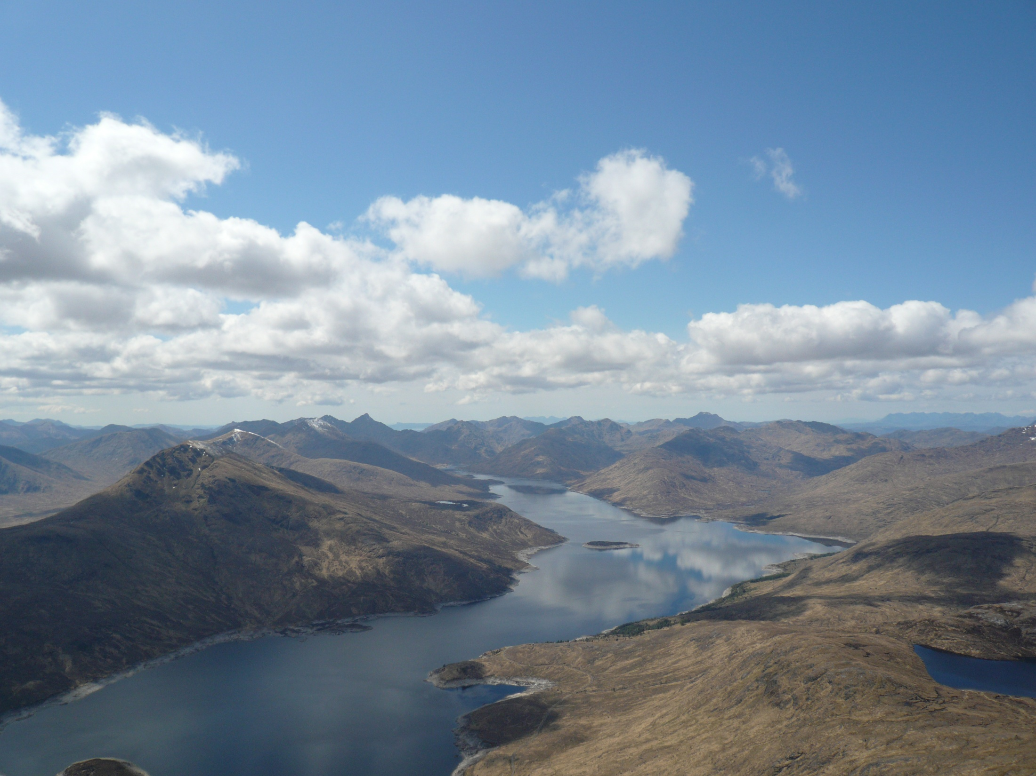
Exploring the Mountains-Part 1
An Introduction to the building blocks of mountain soaring
Notes:
Loch Quoich (To the NNW of Fort William)
What’s it all about

Slide 2
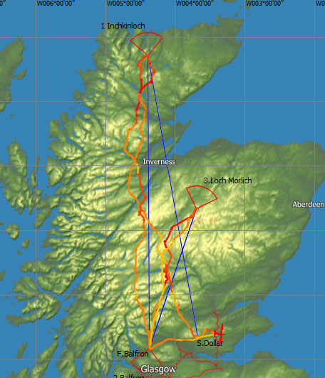
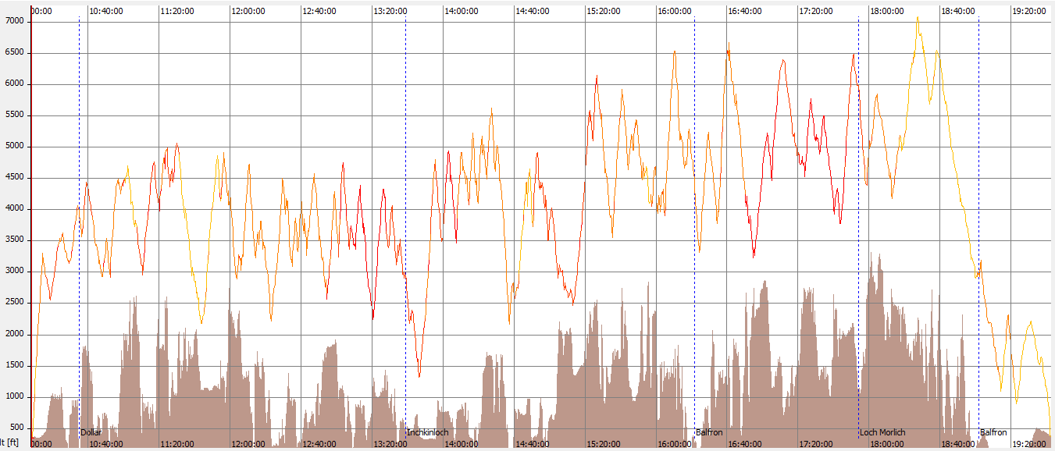
John Williams
Antares 20E
758km 88.9kph/78.9kphHC
Flight Time 9hrs 33min
Task Time 8.26
Leg Speed
DOL - INK 81.3kph
INK - BAL 93.86kph
BAL – LMO 82.52kph
LMO – BAF 113.25kph
16/05/2018
DOL-INK-BAF-LMO-BAF
Notes:
John used a convergence to get to the finish with which otherwise he would not have completed the task.
From Portmoak on the day:
2 500k+ (Z actually got more points……..!! I think it’s the first FAI 500km triangle done in a STD class glider in Scotland)
1 400k+
2 300k+
1 200k +

Slide 3
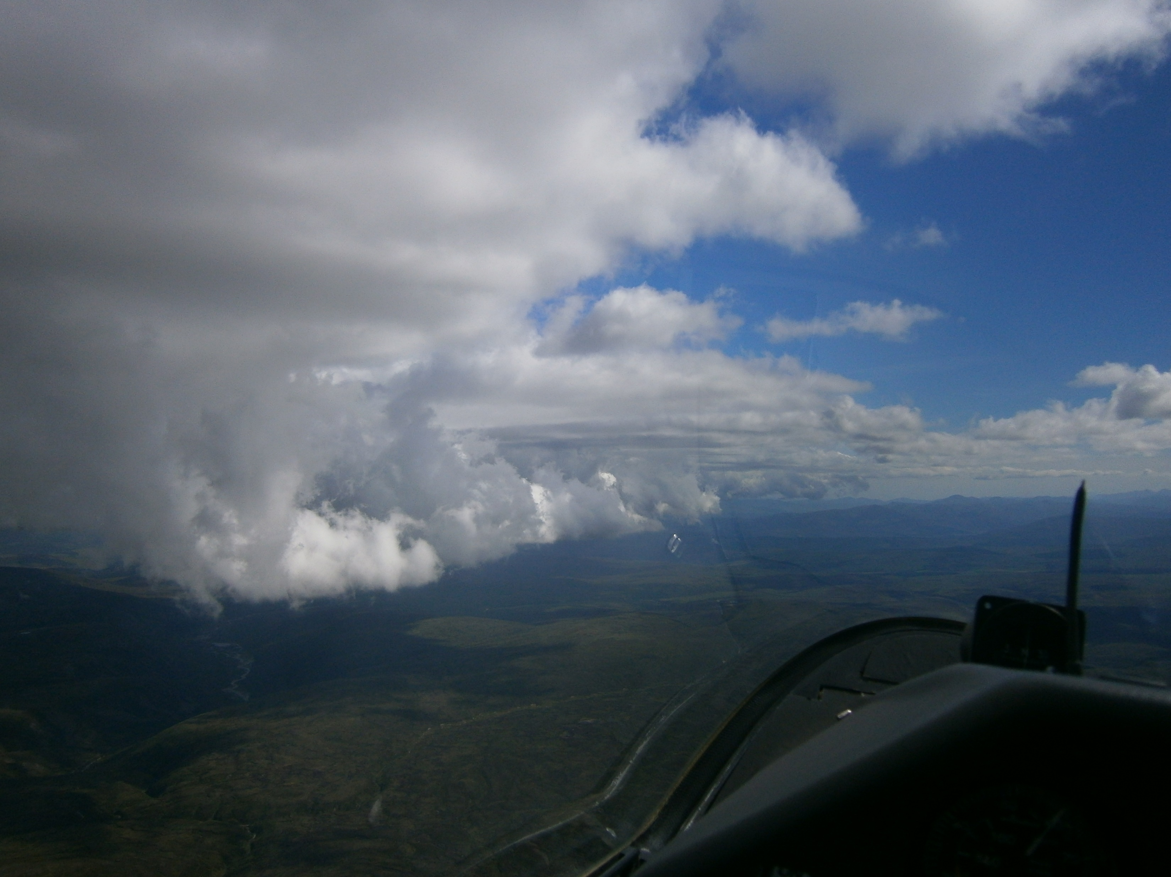
Why do it?
The requirements
The Right Mindset
Notes:
Why do it?
For me:
The stunning scenery.
The good soaring conditions compared to the flatlands
The frisson of it all
The requirements:
The time to do it
Pilot skills – the ability to stay up without a ridge for at least three hours – getting to and from the mountains
Equipment & glider including trailer.
Retrieves: When has any club member been left in a field
The right weather.
MOST IMPORTANT: THE RIGHT MINDSET

Slide 4
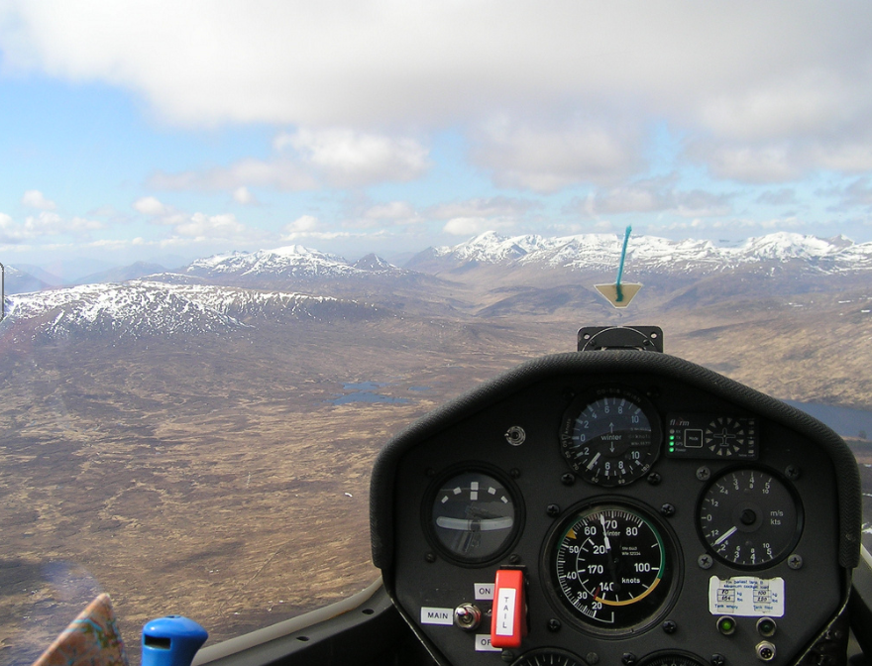
Rannoch Moor : 19/04/2013
John Williams & Kate Byrne
Notes:
PCS-LOQ-RNI-PCS 425.4KM @ 65.7 km @ 65.7kph/67kph HC.
Kate & John to discuss with Kate giving her observations first and John follows.

Slide 5
Setting Boundaries
Land out options:
Our mountains consist mainly of a plateau of low relief gouged out with numerous glaciated valleys. This can making land out options more problematic.
Risk management: ALWAYS have an escape option.
Basic Rule: THAT MEANS ALWAYS be within safe gliding distance of a field..
Self-sustainers They are the means to get to
Self Launchers get to and from the lift.
They are NOT an escape route.
Notes:
Mountains: An ancient range affected by a long period of glaciation from the last ice age.
Risk assessment :
This is dependant on your level of competence and most importantly your confidence level.
How does one gain confidence?
MAXIM: “If you do not land out at least 2 times a year you are not trying hard enough”
Gaining experience of thermal soaring in easier settings; e.g. Hus Bos
Discuss?

Slide 6
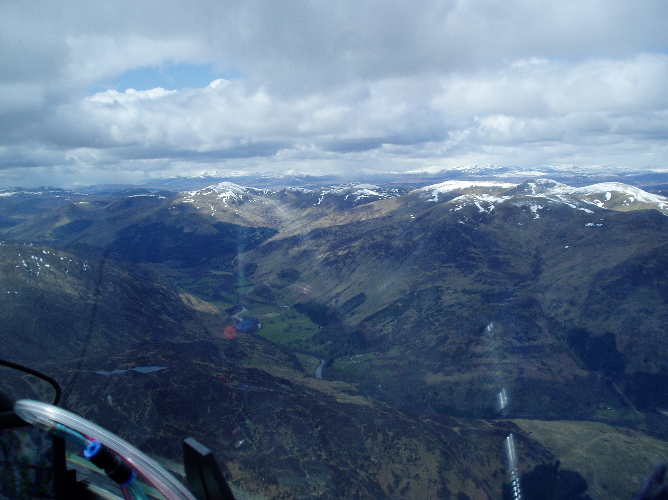
Field landings
Notes:
27 04 16 Glen Lyon
This where Phil Dolan chips in for his bit and discusses the field landing database and any salient points

Slide 7
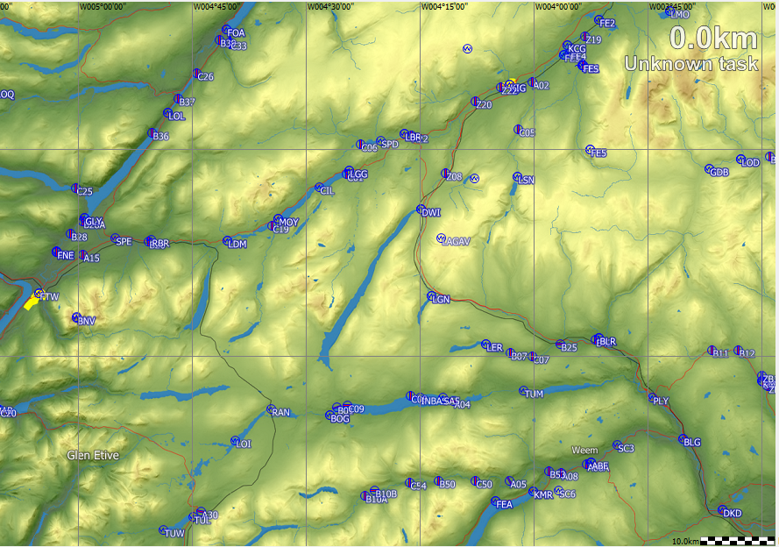
Area 2
Notes:
Discussion of Area 2 as it is the easiest entry route into the mountains

Slide 8
Notes:
Over the plateau to the SW of Feshie with the sea breeze front extending past Comrie.
Sea breeze coming in from left; land air coming in from right

