Slide 1
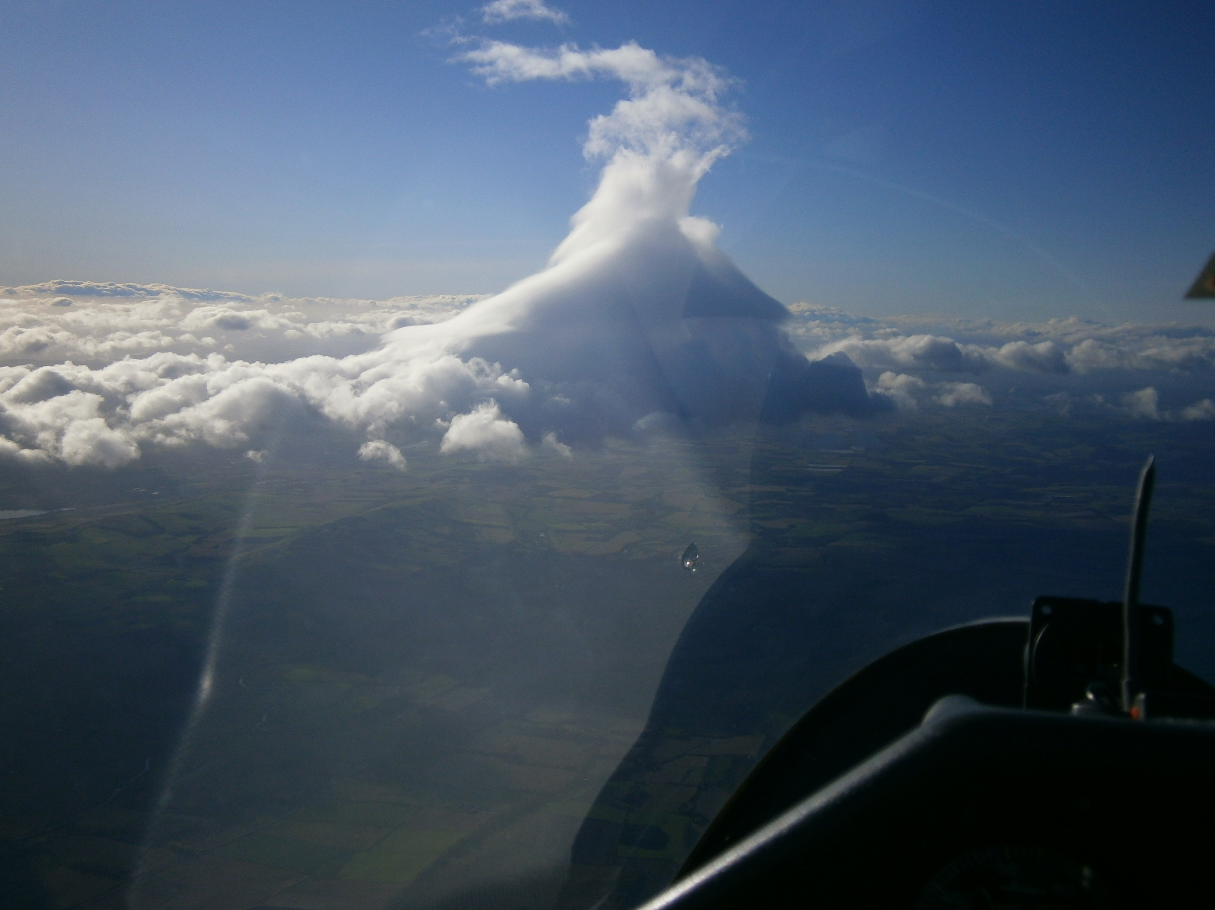
Part 1 – Overview
: Our playground
: Setting boundaries
: Aircraft performance
Flying Wave in Scotland
-Fast & Far-
12 11 17 – MVN-SC2-EDZ-CRI-EDZ-MVN
: 509.8km@149.5kph/152.6kph (HC)
:Discus 1 bT : No water ballast
Notes:
South of Glenclova; Forfar on the left
Discussion of the wave : incredibly rough
Lift of 15kts Wind of 40kts @3000’ educing to 15-20kts at 8000’
Methven-*SC2 Between Killin & Crianlarech)-Edzell-Crianlarech-Methven

Slide 2
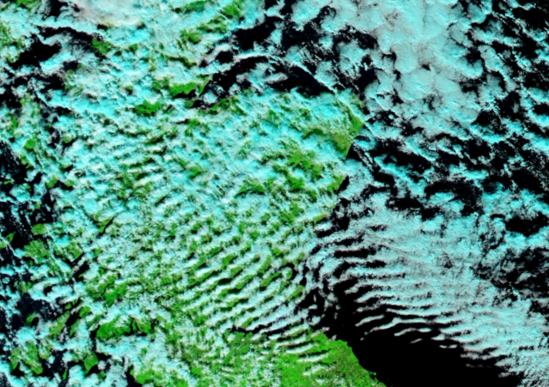
HGC
CGC
DGC
Our Playground
SGU
05 10 17
DGGC
Notes:
Wave starts around Torridon
Discussion of the wave system leading to the foehn effect

Slide 3
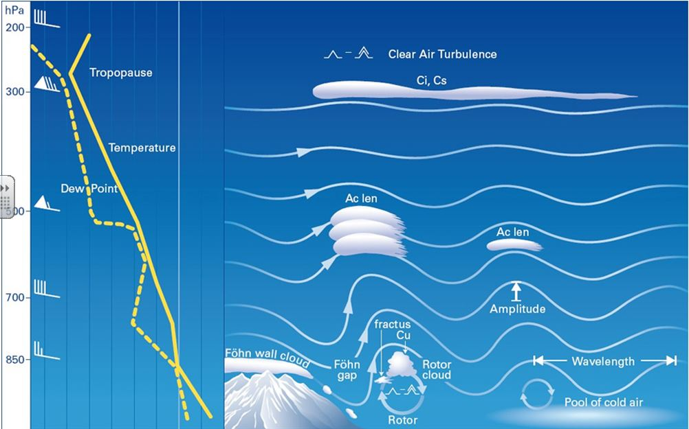
Cross Section of a Wave System
Notes:
Wavelenght affected by windspeed
Amplitude to a large degree by wind profile & temperature
Wavelength Formula
Λ (lamda)
Wavelenght = WV- 10
6

Slide 4
05 10 17
Notes:
Wave starts around Torridon
Note how it extends out to sea – JDW has used to effect
Discussion of the wave system
Satellite photos only give a snapshot of the day

Slide 5
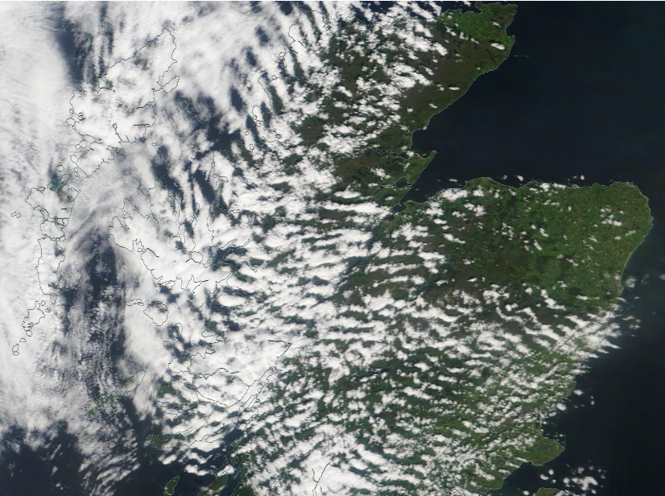
Southerly /SW Wave
Wind Direction
23 07 19
Notes:
Wind Directions
Aboyne gets wave from SSE to N
Classic warm sector with the depression off to the west , high to the east

Slide 6
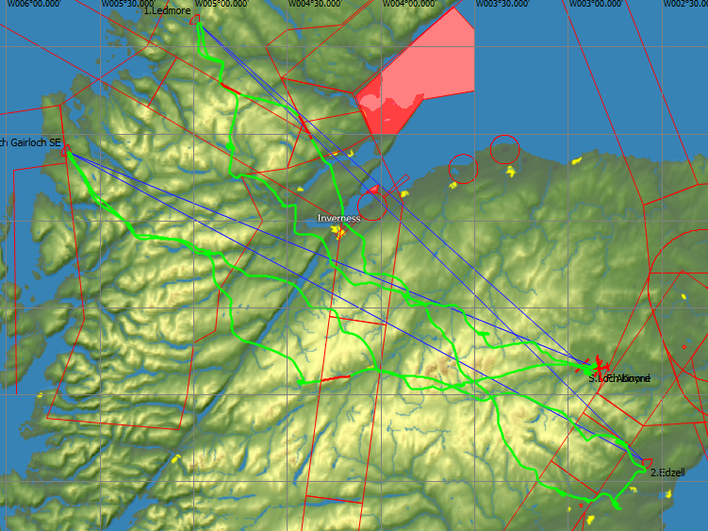
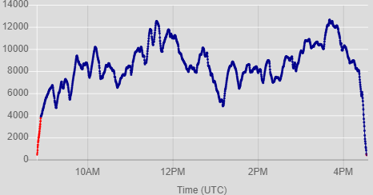
Roy Wilson : 23/07/2019 :
: LOK-LMR-EDZ-LOG-ABO
: ASH31Mi:755km@107.4kph/93.4kph(HC)
: No water ballast
Notes:
Click to get rid of description
Loch Kinord-Ledmore-Edzell-Loch Gairloch-Aboyne
Discuss Airspace
N560/Y906
R610A

Slide 7
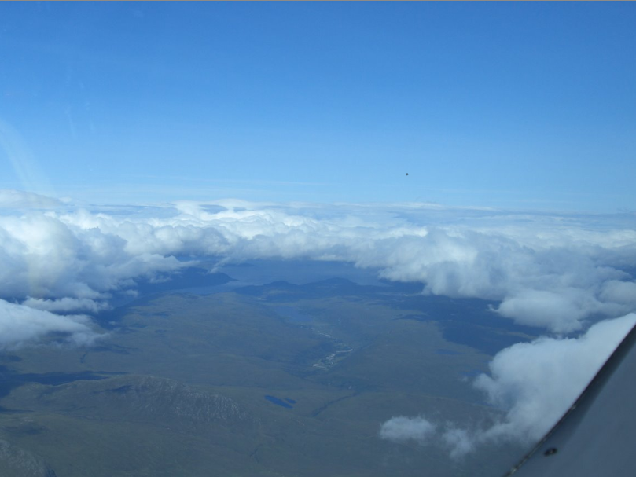
Roy approaching Ledmore on the West Coast
Wind Direction
Notes:
Discussion of wave
Really important to note that we automatically understand as a wonderful wave sky isn't a bit like text book smooth stuff - can be lines of ragged scruffy cu and working like a bandit.

Slide 8
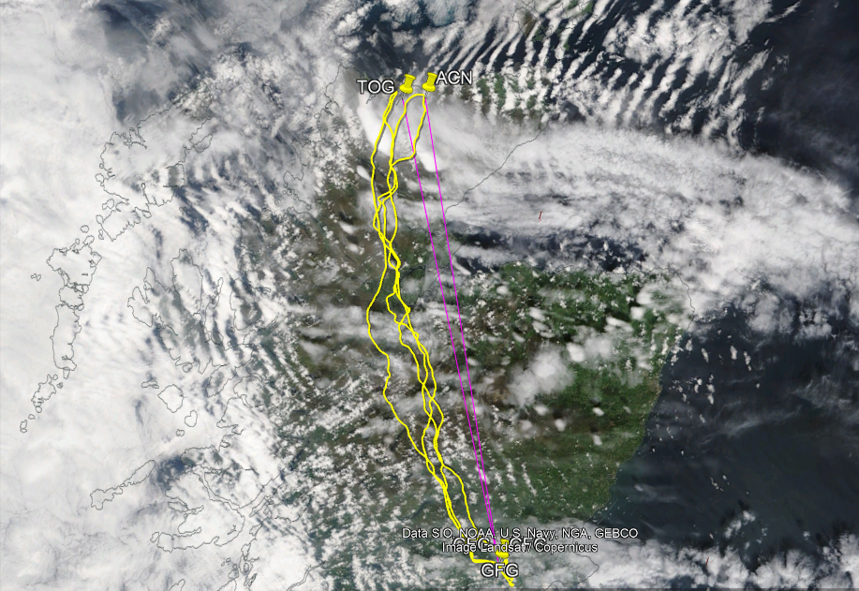
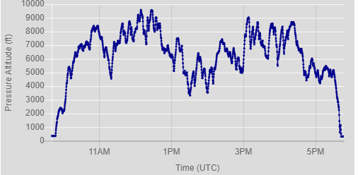
Westerly Wave
05 07 2015
John Williams
:GFG-TOG-GFG-ACN-GFG
1002.9k
: 135.1kph/118.5kph
:Antares 20E
: Water ballasted
Notes:
Fasted 1000k that JDW has down; Got the 500k O/R speed record out of it 152.77kph
All done below 10000’ lowest 3300’
Never went above 10,000’ compared to 18,000’ in 2007
John encountered more cloud than the sat photo shows; again its just a snapshot

Slide 9
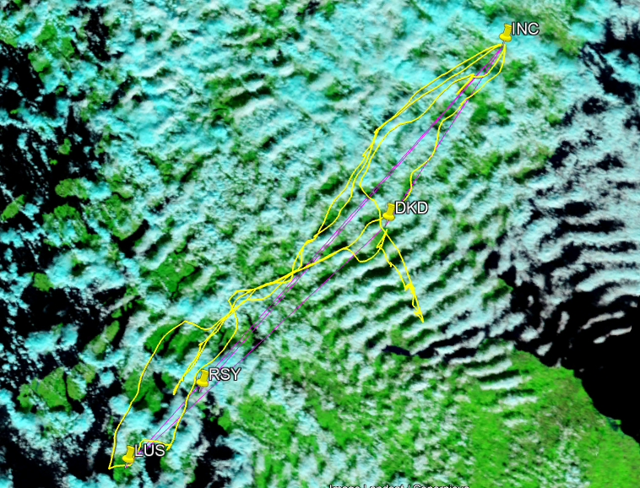
Ed Downham
:DKD-LUS-INC-RSY-INC-DKD
:1003.6km
:126.4kph/109.0kph (HC)
:EB28:No Water
*SC8
INV
05 10 17
Notes:
DKD DUNKELD-LUS LUSSA LOCH S-INC INSCH-RSY ROTHESAY-lNC INSCH-DKD DUNKELD
ED got the Wakefield trophy for that
Talk a bit about planning.
JDW had calculated on what he though was possible.
I was going for maximum ladder points

Slide 10
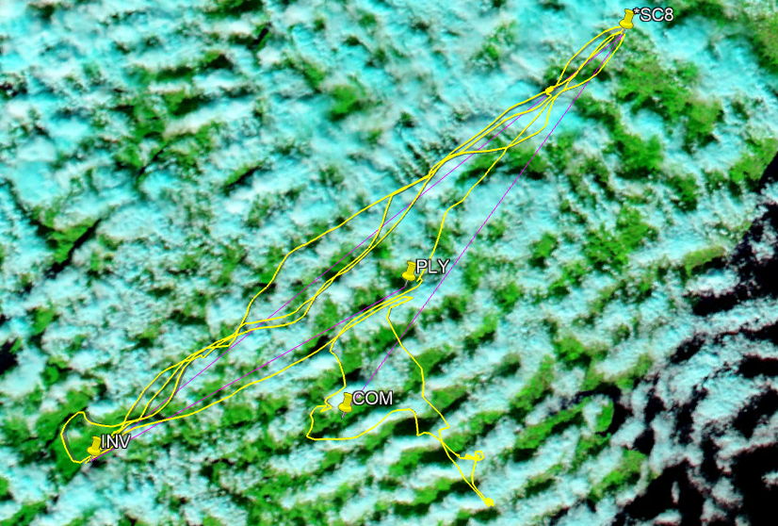
ED :1003.6km @126.4kph/109.0kph : 6255points
JDW: 903.4km @153.0kph/134.2kph : 6584point
SC : 782.km @145.1kph/148.1kph : 7135points
Sant Cervantes
:COM-*SC8-INV-*SC8-INV-PLY
:782.km
:145.1kph/148.1kph (HC)
:Discus1bT: Water ballasted
Notes:
COM COMRIE-*SC8 RNI NORTH-INV INVERARY-*SC8 RNI NORTH-INV INVERARY-PLY PITLOCHRY
I was going for maximum ladder points.
I was flying in the “strongest area”.
Number of wave bars from Portmoak to Loch Tay

Slide 11
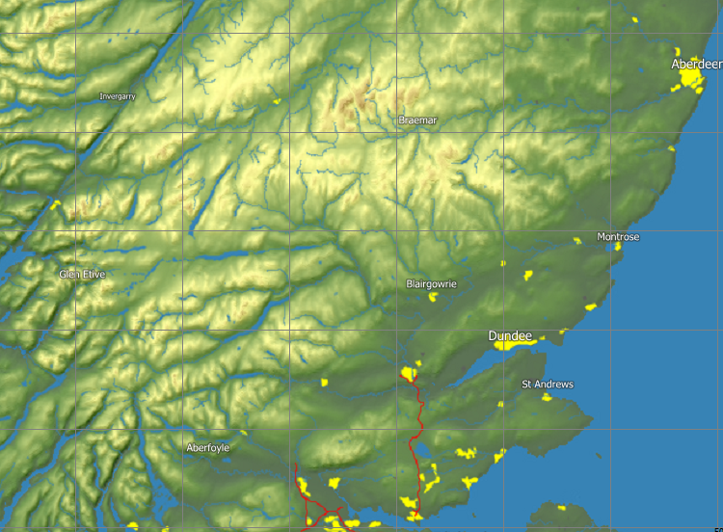
PMK Local Primary (Instigator) Wave Areas
(NW wind direction)
18nm
28nm
15nm
18nm
22nm
Notes:
For example, in light winds
Also describe W to SW to South conditions wind conditions
Which brings us to setting boundaries

Slide 12
Setting Boundaries
Risk management: ALWAYS have an escape option.
Self-sustainers They are purely the means to
Self Launchers get to and from the lift.
They are NOT an escape route
Land out options: Mountains are of low relief making
land out options more problematic.
Basic Rule: If not in lift by 6000’ be within safe gliding distance of a field.
Notes:
On land-out options, talk about early exploration following lift and discovering land out options
Using the A9/Dee valley for out-landings.
When coming to descending through cloud discuss how safe the Vale of Strathmore is.

Slide 13
Setting Boundaries
Land out options: Mountains are of low relief making
land out options more problematic.
Risk management: ALWAYS have an escape option.
Basic Rule: If not in lift by 6000’ be within safe gliding distance of a field.
Self-sustainers They are the means to get to
Self Launchers get to and from the lift.
They are NOT an escape route

Slide 14
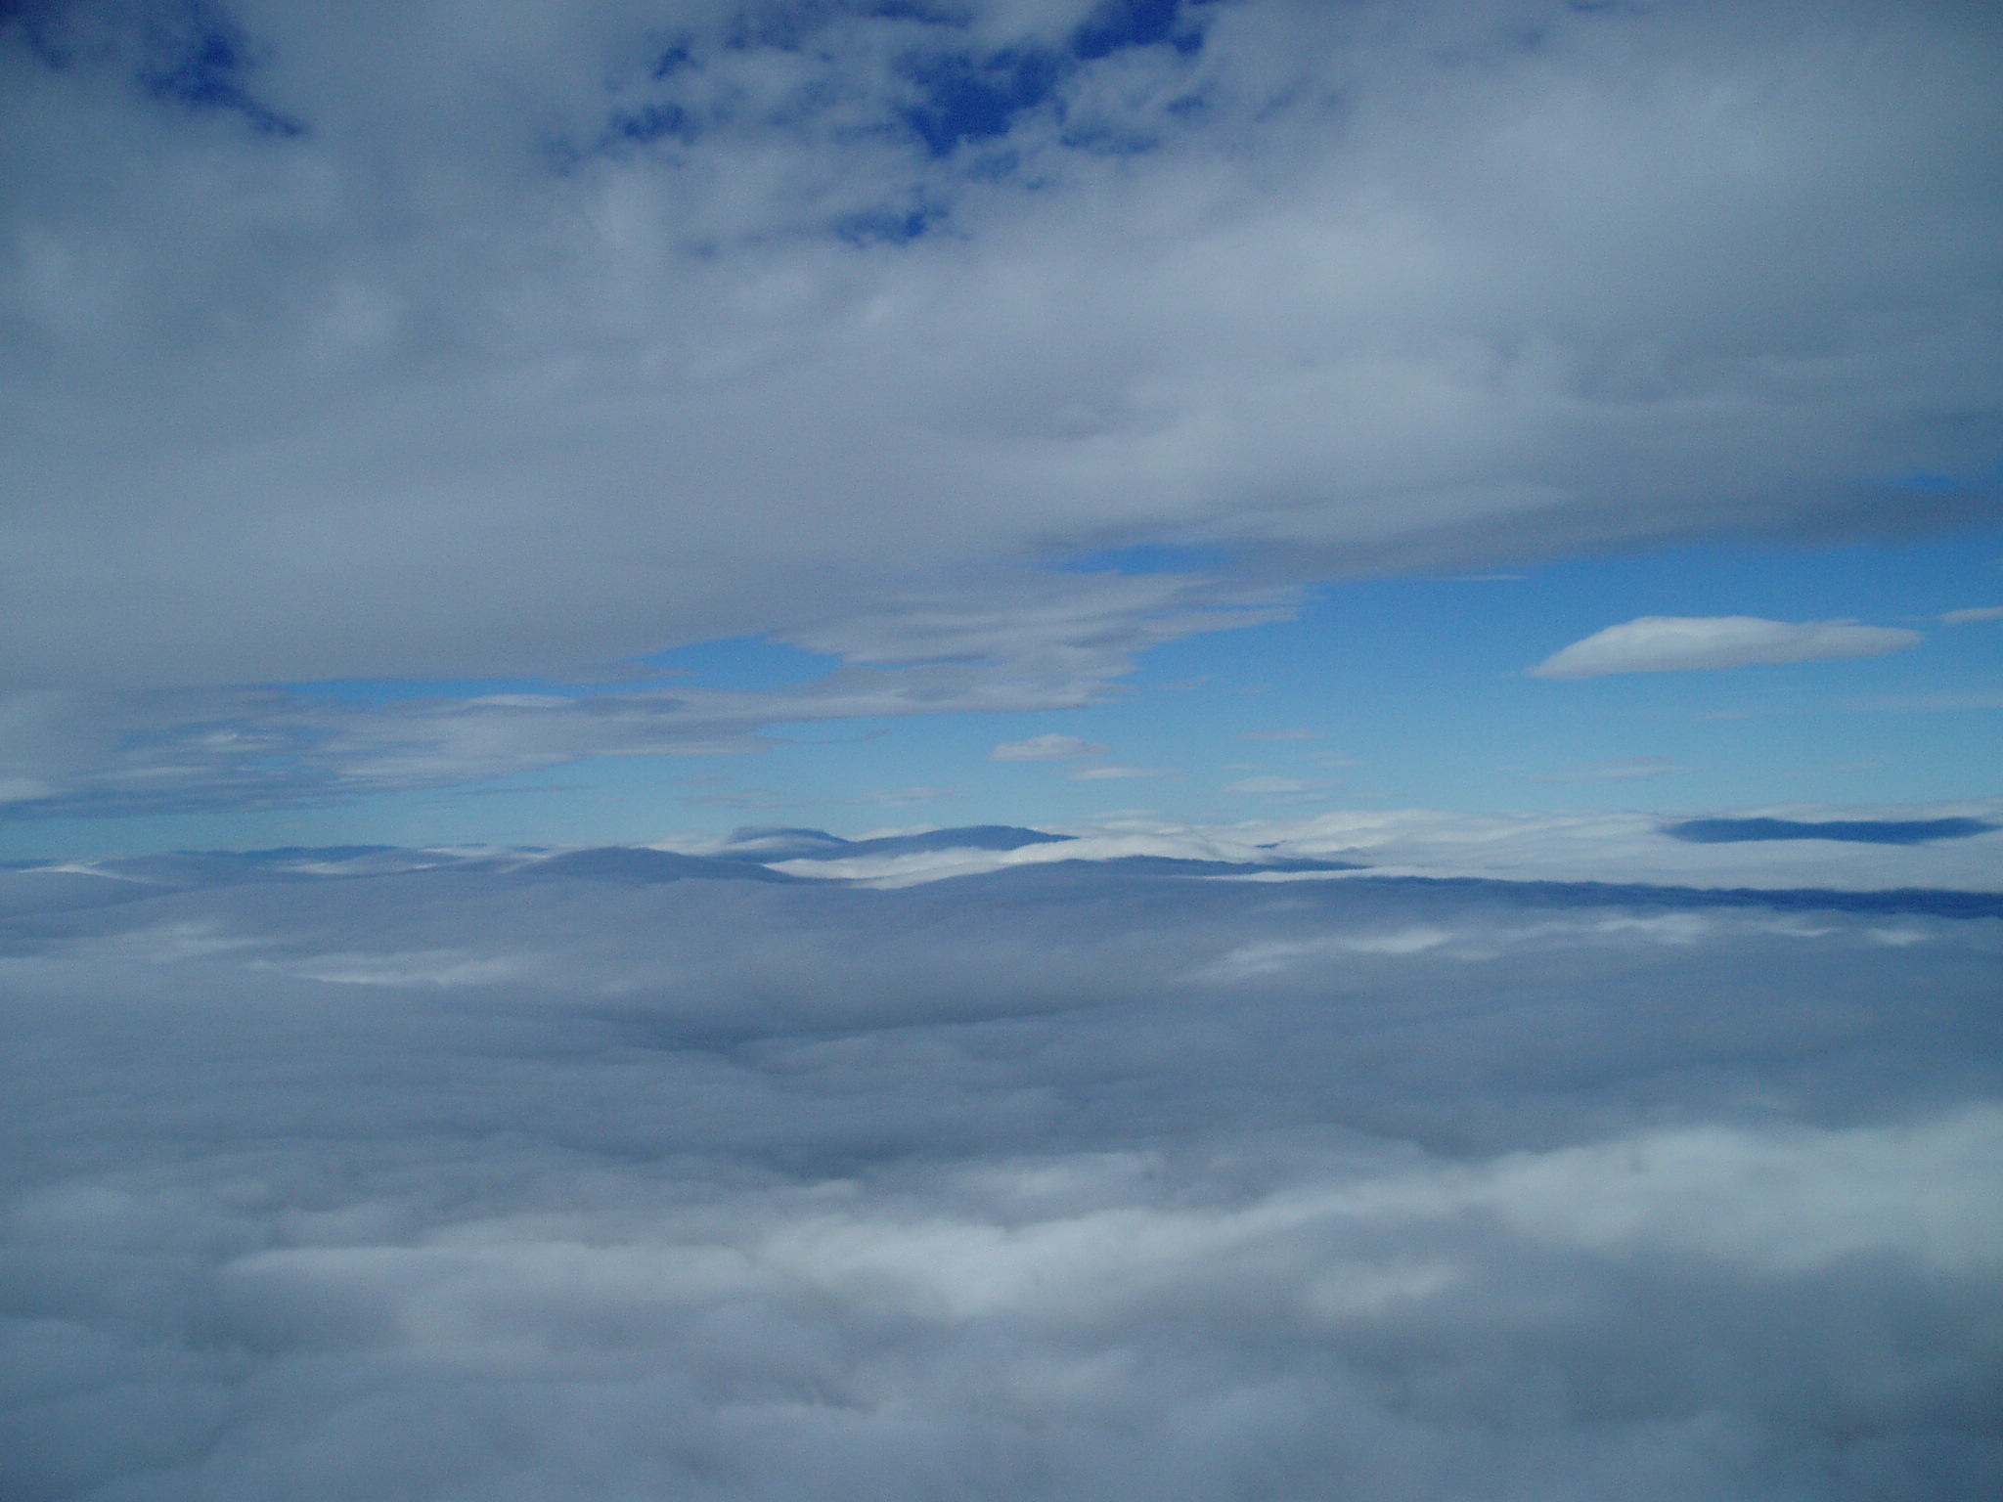
Setting Boundaries
Last of all : Dealing with Cloud
Fly to a safe place to descend
:Controlled decent
:Benign Spiral
Be aware of wind strength
29 08 2011
Notes:
This was a classic N/Westerly flow with a big high off the SW of Ireland. in This was a 600km undeclared task.
This was at the start of the day looking to west and as usual clear to the East Later I were able to get to LLT
Weak wave slot in foreground and wave in the distance.
The point about this photo is that there are no fronts impinging and likely to have a negative effect on the weather.

Slide 15
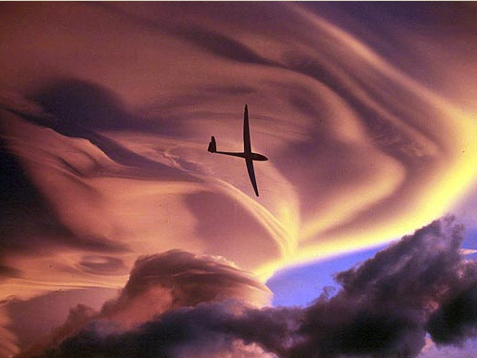
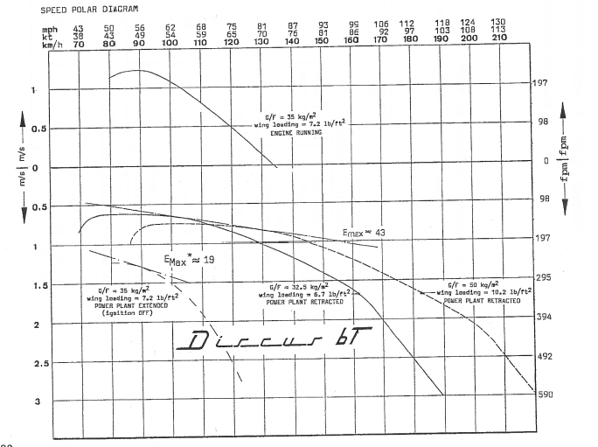
Aircraft Perfomance
84kts & 95kts (157kph & 176kph)
Glide Angle:
84kts = 1 : 28.8
95kts = 1 : 32.6
With a 60kt x/wind at 90°:
84kts = G/S of 71kts (131kph). Drift 38°
95kts = G/S of 81kts (150kph) Drift 35°
Antares 110kts = 1:37.75 G/A
GS of 95kts (176kph)
At 95kts has G/A of 1:43
Notes:
Based on a 3kt rate of descent

Slide 16
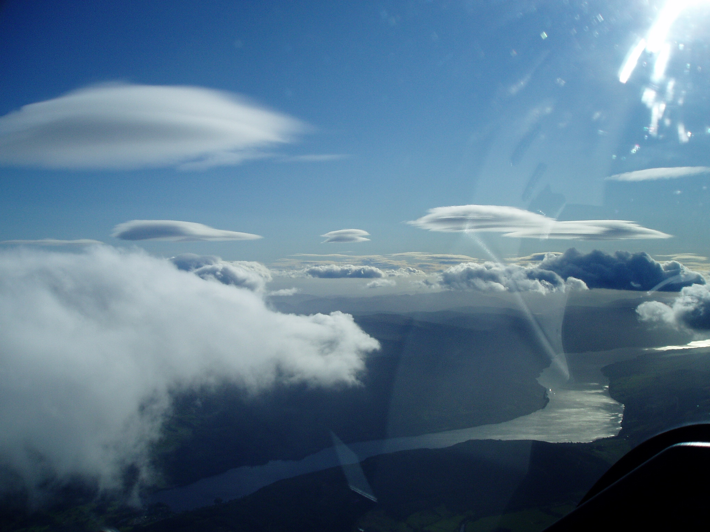
End of Part 1
Overview –
Any Questions?
07 10 2011
Notes:
Text Book wave at Loch Tay looking SW
Actually quite rare conditions.
07 10 2011 592km

