Slide 1

Tephigrams
how to spot a good soaring day
(part 2)

Slide 2
Tephigrams – what do they do?
Two separate functions…
Display air temperature and dew-point “data” versus height above a given location at a given time
    wind velocity with height is shown as well
    always check the location, time and date
Permit quick, basic assessment of thermal activity via calculating curves
    also useful for spotting potential wave days
Notes:
An important slide
Tephigrams have two separate functions;
Displaying atmospheric data (so what?)
Doing some basic assessment of soaring potential using that data (ahh!)
The wind data is not used in the calculations but is displayed for convenience (the thermal calculations take no account of the wind).
They were originally developed many years ago, before numerical computer models, to understand convective (thermal) activity, particularly thunderstorms.
For glider pilots, thermal activity means….are there any thermals? what height will they rise to? will the thermals form cumulus cloud or will they be blue? what height will the cumulus cloudbase be? will there be spread-out present?
A key piece of meteo info; they should be used with other info – routine forecasts (e.g. Met Office, MSLP, rain radar, satellite pics, RASP soaring maps,etc) and look at several tpgrams at turnpoints
(btw air temperature is some times called the environmental temp or worse, the environmental lapse rate)

Slide 3
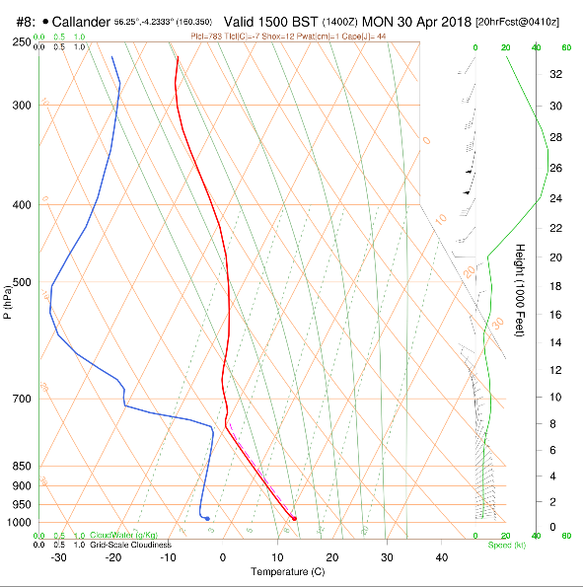
Tephigram from RASP
Air temp
Wind info
Dewpoint temp
Height
Temp
Notes:
Tephigram from RASP showing the data lines in colour.
Geek alert
On the right is the pressure axis and this has an inverse logarithmic scale (as pressure drops with height in a roughly exponential manner) – this scaling means the height axis is linear (normal). Pressure lines are not displayed evenly in RASP (odd interval selection…?). Pressure is used by meteorologists; let’s just stay with the height axis on the left.
The temperature lines slope for three reasons. One is presentational in that the DALR and SALR lines (or “adiabats” or “potential temperature” lines – see the slide further on) tend to be squeezed together and not easy to use on a normal plot so skewing or slanting the temperature lines spreads the DALR lines out. Secondly this also levels out the pressure (height) lines to become more user-friendly. Finally, when the temperature lines are more perpendicular to the adiabats, any bounded area on the tephigram better represents potential (heat) energy– this has one direct use in calculating a quantity called CAPE (convective available potential energy) which is a measure of the instability and thunderstorm potential in the atmosphere which is what these diagrams were initially developed for. Hence the term “Skew-T”.

Slide 4
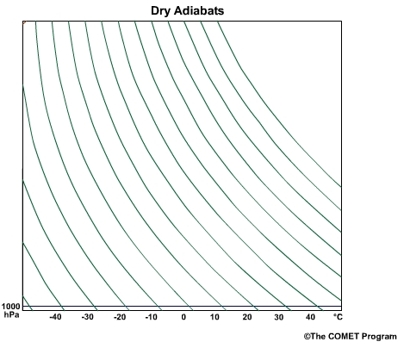
Tephigrams
Dry Adiabatic Lapse Rate Curves – these apply in clear air
Notes:
Need to identify these curves on the tephigram – these are the DALR curves. They show how clear rising air cools. Not going to use them just yet.

Slide 5
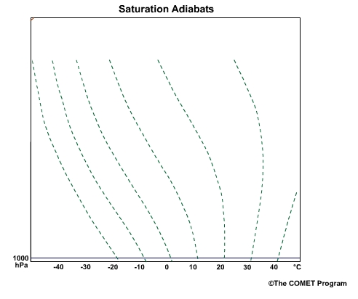
Tephigrams
Saturated Adiabatic Lapse Rate Curves – these apply in clouds
Notes:
Used in clouds – different curves are needed because of the pronounced effect that water, as it condenses, has on the way air cools as it rises.

Slide 6
Tephigrams – stability, what’s that?
Atmospheric stability is a very important factor in the formation of thermals and wave as they depend upon the right degree of stability (or instability)
In the atmosphere, stability means that if a parcel of air is displaced up or down from an initial height, the parcel will tend to return to that initial height.
What makes a parcel of air return to the level it came from?
  As a parcel of air rises it expands and cools. This cooling is caused by the expansion and is not due to the surrounding air
  If the temperature of the parcel drops so that it is the same or less than the surrounding air it will stop rising and start to descend as it will be more dense than the surrounding air
  And vice versa for air descending from its initial height
  For this to happen the change in the parcel temperature with height must be more than the change in the surrounding air temperature with height
Notes:
A stable system is one which;
Remains unchanging with time and/or
Resists being changed and/or
If disturbed returns to its initial state or position
A pendulum being an obvious case of a stable system. Interestingly if it is put in motion is stays in motion for a long time as it tries to lose energy and return to its stable low-energy state. A guitar string is another example.
A parcel of air is a small discrete volume of air which is free to expand/compress according to the ambient pressure. It does not mix with the surrounding air nor receive or transfer heat to the surrounding air.
The atmosphere is generally stable. Unstable bits are thunderstorms, showers, low pressure systems, hurricanes.
A lee wave system needs the air to be stable so that it can “bounce up and down”
But thermals need a layer of nearly unstable air so they can persist. Too much instability leads to showers/thunderstorms

Slide 7
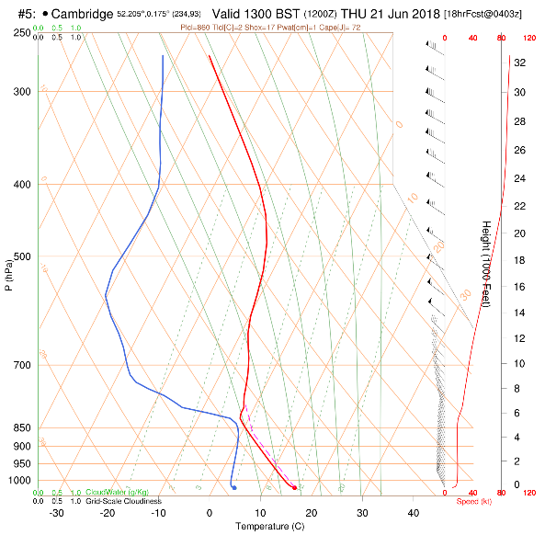
Tephigrams - stability
Stable layer
Notes:
This is a stable layer.
The air temp line is leaning to the right a bit – as you go up the line its temperature is not falling as fast as if it would if it was leaning to the left.
The air temperature line is also more vertical and right-leaning than the DALR and SALR lines in the background.
As you ascend the air temp line crosses the DALR and SALR lines from left to right. This is a stable region. Why? Find out in part 2.
At the base and the top the air temperature lines follow either the DALR and SALR respectively these are on the border of being unstable. In the low layer this allows thermals to form and rise.

Slide 8
Tephigrams - a good thermal day
Lower air temperature profile follows dry (clear air) curves from the ground up (well mixed layer)
A stable layer / inversion at a reasonable height (top of thermal)
Cloudbase present at a reasonable height (not blue thermals)
Dry air above cloud level to minimise cumulus spread-out
Low wind speed (<15kts) within thermalling layer
No or thin upper cloud cover
Notes:
Doesn’t require much of a temperature increase to create thermal.
Stable layer stops unstable convection – showers, etc.
Need thermal activity to start early and finish late
Cloud base (saturation point) must be below the point where dry line hits air temp and inversion or stable layer

Slide 9
Tephigram – a good thermal day
Air temp
Wind info
Dewpoint temp
4.Dry air
Height
2.Inversion
3. Cumulus cloud?
1.Well-mixed layer
5. Low windspeed
Temp
Notes:
Previous tephigram from RASP.
This is a good thermal day.
No obvious cloud layers. Light winds. Freezing level at 4000’, -10C at ~8000’
4 key things;
A well-mixed layer low down. The air temp profile matches the DALR, this means that thermals will form and rise. RASP shows this as a dashed red line following the DALR line. The only time you will have thermals is when the air temp profile upwards from the surface is like this.
Just before the inversion it looks like the thermal cools to its dew-point – the dashed line shows a slight kink. This is good because it means thermals will be marked by cumulus clouds (yay!). In this example it’s not immediately clear if cloud will form – could be blue thermals. Cloud depth won’t be great as air is too stable above the inversion so unlikely to have showers.
3. An inversion (or isothermal layer, or stable layer) at a reasonable height. The air temperature line now crosses the DALR and SALR lines from left to right (so rising air will find itself surrounded by equally warm air at some point). This will stop the thermal and its cloud from developing too much (showers etc). Thermals stop at 8000’ around.
4. Dry and stable air above the inversion. Spread-out will occur when a thermal/cumulus cloud stops rising at the inversion. The dry air above helps the cloud to disperse. The stable air puts a stop to any upper-level instability (towering cumulus, etc)
Features 1, 2, and 4 create a “wine-glass” shape (ignoring stuff high up)

Slide 10
Tephigrams - a good wave day
Wind speed > 10-15kts at hill tops (~3-4000’) and gradually increasing with height
    Not too windy at cruising level (<50kts)
Wind direction relatively constant with height and from SW to N (at Portmoak)
Inversion or isothermal layer present at height of hill tops/ridges
Stable, relatively dry air above and below the inversion
    too dry – blue wave
    too moist – cloud filled (and possibly convective/conditionally unstable)
Notes:
May get wave if some of these factors are present.
Main difference between good wave and good thermal is windspeed. Can have both present – usually interfering with one another – result can be good or bad for soaring.
Stable –> air temp line crosses DALR and SALR curves from left to right (doesn’t matter higher up)
Isothermal layer or inversion at hill/ridge level not strictly necessary just air temp less than DALR. Guitar anaolgy!

Slide 11
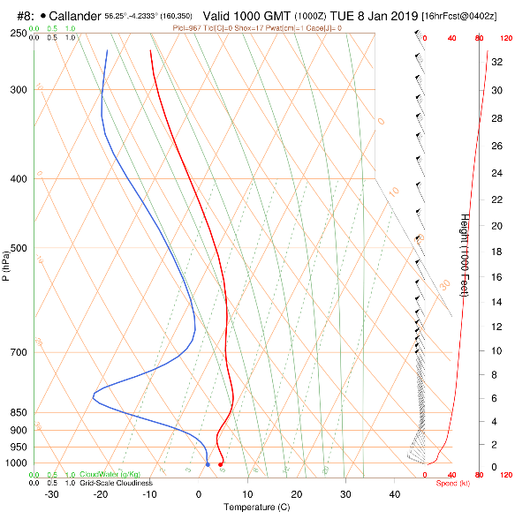
Tephigrams – a good wave day
6.Stable layer
1&2. Wind Profile
5.Dry air
3.Inversion
4.Stable layer
Notes:
Looks sort of familiar – similar to a good thermal day except we have wind
Stable atmosphere – temperature line cuts across dry (DALR) and wet (SALR) lines from left to right as we move up the diagram
A favourable wind profile – winds above 15kts in lower layers, gradually increasing with height, blowing across upwind wave triggers,
Reasonably constant direction with height (or direction changes a little (<30 degrees) and gradually). At Portmoak classic wave days are W to NNW wind directions.
Inversion – a strongly stable layer at the mountain/ridge height!
Stable surface layers – limited convection to disrupt low-level flow
Dry air limits the amount of cloud created by the wave
Stable layer above the inversion again to suppress convection (especially being kicked off by the wave)
You can get wave any day the wind is blowing strong enough from pretty much any direction (e.g. E’ly wave at Portmoak) as the atmosphere is generally stable anyway.

Slide 12
Tephigrams
ANY QUESTIONS SO FAR?

Slide 13
Tephigrams – the calculating curves
Just what are we calculating??
Will there be any thermals?
How high will they rise?
Will it form a cumulus cloud or will the thermals be blue?
What will the cloud base be?
Where is the top of the cloud?
Is there a risk of spread-out?
Is there a risk of showers?
(Will there be breaking wave?)
Notes:
This next bit is more technical and quantitative bit.

Slide 14
Tephigrams – a few terms
Dry air means air with no liquid water droplets (mist, fog, cloud). It does contain water vapour but the air is clear. Its temperature must be greater than its dewpoint.
Saturated air contains microscopic liquid water droplets i.e. it is cloud! This air must be at its dewpoint temperature.
A parcel of air is a hypothetical, small volume of air which does not mix or interact with the surrounding air.
As this parcel of air rises it will expand and it will cool of its own accord.
  It does not gain or lose heat from/to the surrounding air and it does not mix with the surrounding air. This is called an adiabatic process.
  The cooling is caused by expansion alone.
  A thermal acts (almost) like a parcel of air.
Notes:
Dry air isn’t really dry, it contains water vapour which is invisible. Air over the polar regions, deserts and high altitudes can be very dry.
Meteorologists talk about a parcel of air. This is a hypothetical, small, separate volume of air which retains its identity; it doesn’t mix with surrounding air and has no heat transfer to or from the surrounding air. The pressure in the parcel does follow the ambient air pressure and this causes the cooling when it rises (the cooling occurs due to expansion of the parcel and not by heat transfer to the surrounding air).
This is a reasonably valid assumption for a parcel as big as a thermal e.g. ~200m diameter – otherwise we wouldn’t get thermals(!). Let’s use the word thermal interchangeably with parcel.
The concept of a parcel is very useful and important to understand. A parcel can move/rise through the atmosphere as a discrete volume of air.
A parcel of air at ground level will warm in contact with the ground.
As it warms it will expand and become less dense than the surrounding air and tend to rise.
When this parcel of warm air leaves the ground it is no longer heated.
As the parcel rises it expands because the atmospheric pressure decreases with height.
Because it expands without heat being added, it cools. It does not cool because the air around it is cool.
The parcel does not mix with or transfer heat with its surroundings, i.e. no heat or mass transfer takes place. This is an adiabatic process.
The amount of cooling can be calculated from the basic properties of air and some simple (!) physics.

Slide 15
Tephigrams – the calculating curves
Three calculating curves;
DALR – dry adiabatic lapse rate curves
    used to calculate the temperature of a parcel of dry air (clear air which is above its dew point) as it rises through the atmosphere
SALR – saturated adiabatic lapse rate curves
    used to calculate the temperature of a parcel of saturated air (air at its dew point – which is cloud!) as it rises through the atmosphere
Mixing ratio lines (amount of water vapour in the air)
    used to calculate the dew point of a parcel of dry air as it rises through the atmosphere and indicates the point at which the SALR lines are to be used
Notes:
Three technical terms – need to know these as they are an integral part of the diagram. Based on fundamental laws of physics – ideal gas law, 1st law of thermodynamics, plus the empirical Equation of State for water. These curves never change and are applicable anywhere and at anytime on planet Earth.
The application to thermals is that if we know the temperature and pressure of a thermal at the surface, we can calculate its temperature at any other pressure (height). In fact it’s more general than that…..for a parcel at any given temperature and pressure we can calculate the temperature at another pressure.
GEEK ALERT! Background technical stuff – not essential!
The curves arise from a combination of two fundamental laws of physics, the ideal gas law and the 1st law of thermodynamics. The ideal gas law is a simple relationship between the Pressure, Volume, and Temperature of a fixed quantity of gas; fortunately for us dry air acts almost like an ideal gas at terrestrial conditions. The 1st law of thermodynamics is in effect a re-statement of the law of conservation of energy.
The DALR curve (equation) is based on the ideal gas law and 1st law of thermodynamics which are combined to give the adiabatic expansion expression below,
$P^{(1−k)}$. $T^{k}$=constant
where k is specific heat capacity ratio which is equal to 1.4 for both oxygen and nitrogen and therefore air. This equation produces the DALR lines and it lets you calculate the temperature of a gas at a certain pressure if you know its temperature at another pressure assuming an adiabatic (no heat or mass transfer) change. This works anywhere in the atmosphere (deserts, arctic regions, top of Mount Everest, etc.) except in a cloud!
The SALR lines include the effect of water via the Equation of State for water which relates the equilibrium quantities of water vapour, liquid water (droplets in our case) and ice alongwith the latent heat when water changes it’s state (melts, evaporates, etc)
When plotted on a pressure versus temperature chart this equation produces a set of curves called adiabats – these are the DALR & SALR lines. You can check this yourself by reading off the P and T at a couple of points on one of the DALR lines and plugging the numbers into the above equation – you’ll get the same answer for the constant – and that is why these lines are calculating lines as they save you the bother of solving the equation for Temperature at a given height (or Pressure).
The mixing ratio lines are based on the Equation of State for water. The EoS is an empirical formulation of the behaviour of water vapour and liquid water or ice mixtures at various temperatures and pressures.

Slide 16
Tephigrams – the calculating curves
1. DALR – dry adiabatic lapse rate curves (clear air curves)
Notes:
The formula on the previous slides generates this set of curves. The curves use a nominal starting pressure of 1000hPa and a series of temperatures (-10, 0 , 10, 20, etc.) so just plugging in a new pressure every, say, 100hPa increment (900, 800, …) into the formula will give you the temperature at that pressure or altitude.

Slide 17
Tephigrams - DALR and temperature lines
Notes:
A parcel of clear air, starting at any one of the starting temperatures and rising through the atmosphere, will just track along the DALR line. It will cool as it rises and its temperature at any height can be read off the temperature grid lines on the full tephigram. Any other starting temperature can be worked by interpolation.

Slide 18
DALR lines in use –simple example
Temp -40 C
21,000’
Temp -10 C
10,000’
Initial temp 20 C
Surface
Notes:
Dry adiabatic lapse rate lines are used to calculate the temperature of a parcel of dry (clear) air as it rises, expands, and cools. The cooling occurs because the parcel is expanding and not because the air around it is cooler.
You can pick any initial temperature and pressure and calculate the temperature at any other pressure.
You can see that if you pick any point on one of the DALR lines, the temperature at 1000hPa will be the same regardless of the starting temperature. This is called the potential temperature. In th example above the parcel has a (constant) potential temperature of 20C.
NB The air temperature line doesn’t feature here in this part of using the tephigram!!!!

Slide 19
Tephigrams – the calculating curves
SALR – saturated adiabatic lapse rate curves (cloud curves)
Notes:
The SALR (cloud) curves are not as simple as the DALR (clear air) curves due to the pronounced effect that even minor quantities of condensing water vapour have on the lapse rate. Water vapour condensing within an active cumulus cloud releases quite a lot of latent heat and this means the air does not cool as quickly as dry (clear) air so these curves are more vertical than the DALR curves.
The SALR curves for very cold air such as at high altitudes or in arctic conditions are similar to the DALR curves because cold air cannot hold much moisture.
The curves are generated for various starting temperatures (-10C, 0C, 10C, 20C, etc.) at a nominal surface pressure (1000hPa) by using the adiabatic expansion equation and the equation of state for water (see above).
The temperature of a parcel of saturated air (cloud) rising through the atmosphere to any height can be determined using these curves. It will cool as it rises and its temperature at any height can be read off the temperature grid lines on the full tephigram. Intermediate starting temperatures can be worked by interpolation.

Slide 20
SALR lines
Temp -14 C
21,000’
Temp 6 C
10,000’
Initial temp 20 C
Surface
Notes:
Saturated adiabatic lapse rate lines are used to calculate the temperature of a parcel of saturated air (cloud) as it rises, expands, and cools. The cooling occurs because the parcel is expanding and not because the air around it is cooler. The cooling causes water to condense out of the air.
The parcel of cloud cools at a lower rate than a parcel of dry air because as water condenses it releases the latent heat of condensation (evaporation) which is quite substantial.
The above plot is a contrived situation where the parcel of air is saturated (cloudy) at ground-level and ascends in order to show how the curves work – slightly unrealistic but the numbers are correct. Compare the temps with the previous chart (DALR)
Again the air temperature line doesn’t feature here yet
Also note that the DALR and SALR curves are almost identical in very cold (dry) air.
Clearly we need to know when there is cloud (i.e. where cloud base is so we can use the correct curve, DALR or SALR)

Slide 21
Tephigram from RASP
Air temp
Dewpoint temp
Ignoring water/cloud!
Parcel stops rising here
Temperature of parcel follows a DALR line
Notes:
Tephigram from RASP showing the data lines in colour, ref Part 1.
Lets ignore water/cloud for the moment.
The temperature of the parcel is exaggerated for clarity.
The thermal/parcel will rise, expand and cool adiabatically and continue to rise if it is (still) warmer than the surrounding air.

Slide 22
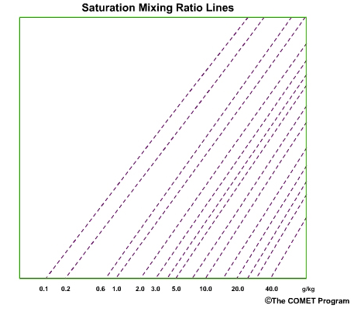
Tephigrams – the calculating curves
3. Mixing ratio lines (dewpoint lines)
Notes:
Mixing ratio lines are show the amount of water vapour in the air expressed in grams of water per kilogram of dry air. 1 cubic metre of air surprisingly weighs about 1.2 kg or, in non-metric units, a cubic yard of air weighs the same as a bag of sugar.
Very humid tropical air can contain 30g water/kg or more. Typical values in the UK would be 3g/kg to 10g/kg. You don’t need to know this number – the dewpoint temperature automatically indicates the mixing ratio on the tephigram
The lines are used to calculate the dewpoint of our parcel of air as it rises.
The mixing ratio remains constant (a constant mass of water vapour per mass of dry air) as our parcel rises (adiabatic conditions – no mass transfer or mixing) but as these lines show, even with a constant mixing ratio, the dewpoint falls slightly as the air pressure falls. If you carefully trace these lines on a complete tephigram you’ll see they rise more steeply that the temperature grid lines. This shows that the dewpoint is dropping with height even though the amount of water in the air is constant.
We need to know when to change from the DALR lines to the SALR lines – this will happen at cloudbase. The dewpoint lines above are used to calculate this point.

Slide 23
Tephigram – mixing ratio
Air temp
Dewpoint temp
Dewpoint of parcel at the surface is -5C and the mixing ratio is ~2.8g/kg
Dewpoint of parcel at 10,000’ is -10C
Notes:
Tephigram from RASP showing the data lines in colour, ref Part 1.
This show the mixing ratio line of the surface dew point. A parcel rising from the surface will have a constant mixing ratio as, under our adiabatic assumption, it can’t mix with the surrounding air.
When the parcel dewpoint equals the parcel temperature we get cloud (cloudbase)
You can see that for most situations, with the slopes of mixing ratio lines and the DALR lines all being roughly constant, the height at which the two lines meet is dependant on the base line between the surface dewpoint and the surface temperature. The rate at which the two lines come together is about 1 degree C every 400 feet. This is the famous Bradbury rule which says cloud base will be 400ft multiplied by the difference between the surface temp and dewpoint.
In the above example the surface temp is approx 11.5C and the dewpoint is approx -5C. The difference is 16.5C ( that is 11.5 - (-5)) so the predicted cloudbase is 400 x 16.5 which is 6600 feet above the surface which in this case is approx 500’ (directly referenced to the height scale) so cloudbase should be just over 7000’ which it is.

Slide 24
Tephigrams – calculating curves
These curves allow us to calculate the temperature and dew point of a parcel or thermal as it rises through the atmosphere
The temperature and dew-point of a parcel or thermal rising through the atmosphere will follow these calculating curves – not the data curves!
Notes:
To re-state an important point. As parcel of air rises its temperature and dewpoint do not follow the temp and dewpoint of the surrounding air shown on the data lines on the tephigram.

Slide 25
Tephigrams
ANY QUESTIONS SO FAR?

Slide 26
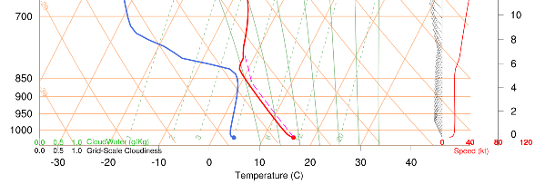
Tephigram – putting it together
Cloudtop
SALR line
Cloudbase
Mixing ratio line
DALR line
Notes:
We can now put all three components (DALR, SALR and mixing ratio lines) together.
Starting at the surface air temperature we see that the air temp line rises parallel with a DALR line up from the surface. This shows that there will be a thermal. RASP automatically shows this as a thin red dashed line.
Now moving to the dewpoint line, follow a rising diagonal mixing ratio line up from the surface dew point. Where this meets the DALR line up from the surface temperature means that the thermal/parcel has a temperature equal to its dewpoint so will form cloud (cloudbase is here!)
Now we must use the corresponding SALR line up from this point. Following that upards we see that it meets the solid red air temp line. At this point the parcel/thermal temp and the air temp are equal and the parcel/thermal stops rising (cloud tops!)
It may be the case that the parcel temp and air temp meet before reaching the parcel dew point – in this case no cloud forms and we have blue thermals.
In another situation we may have the cloud being much higher than in this example. If the cloud extends above the -10C gridline it is likely to rain (showers). If it extends above the -20C gridline we are likely to get heavy showers.

Slide 27
Thermals
Notes:
The full sized example.
The tephigram shows cloud where the red dashed line takes the up turn to follow the SALR line. Note that no cloud is indicated on the left hand grid-scale cloudiness indicator.

Slide 28
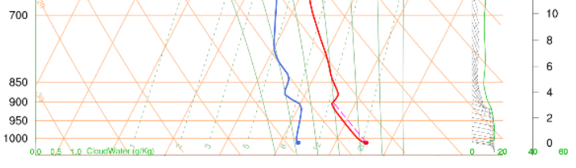
Tephigram – blue thermal
Inversion/isothermal layer
Mixing ratio line
Thermal
Notes:
As shown here, it may be the case that the parcel temp meets the air temp before reaching the parcel mixing ratio (dew point) line so the thermal stops rising before it has cooled to its dewpoint – in this case no cloud forms and we have blue thermals.

Slide 29
Tephigrams - a good thermal day
Lower air temperature profile follows dry (clear air) curves from the ground up (well mixed layer)
A stable layer / inversion at a reasonable height (top of thermal)
Cloudbase present at a reasonable height (not blue thermals)
Dry air above cloud level to minimise cumulus spread-out
Low wind speed (<15kts) within thermalling layer
No or thin upper cloud cover
Notes:
Doesn’t require much of a temperature increase to create thermal.
Stable layer stops unstable convection – showers, etc.
Need thermal activity to start early and finish late
Cloud base (saturation point) must be below the point where dry line hits air temp and inversion or stable layer

Slide 30
Tephigram – a good thermal day
Air temp
Wind info
Dewpoint temp
4.Dry air
Height
2.Inversion
3. Cumulus cloud?
1.Well-mixed layer
5. Low windspeed
Temp
Notes:
Previous tephigram from RASP.
This is a good thermal day.
No obvious cloud layers. Light winds. Freezing level at 4000’, -10C at ~8000’
4 key things;
A well-mixed layer low down. The air temp profile matches the DALR, this means that thermals will form and rise. RASP shows this as a dashed red line following the DALR line. The only time you will have thermals is when the air temp profile upwards from the surface is like this.
Just before the inversion it looks like the thermal cools to its dew-point – the dashed line shows a slight kink. This is good because it means thermals will be marked by cumulus clouds (yay!). In this example it’s not immediately clear if cloud will form – could be blue thermals. Cloud depth won’t be great as air is too stable above the inversion so unlikely to have showers.
3. An inversion (or isothermal layer, or stable layer) at a reasonable height. The air temperature line now crosses the DALR and SALR lines from left to right (so rising air will find itself surrounded by equally warm air at some point). This will stop the thermal and its cloud from developing too much (showers etc). Thermals stop at 8000’ around.
4. Dry and stable air above the inversion. Spread-out will occur when a thermal/cumulus cloud stops rising at the inversion. The dry air above helps the cloud to disperse. The stable air puts a stop to any upper-level instability (towering cumulus, etc)
Features 1, 2, and 4 create a “wine-glass” shape (ignoring stuff high up)

Slide 31
Tephigrams – why is stable air stable?
Stable layer
?!
?!
Notes:
In the stable layer any upward vertical movement by a parcel will result in it being surrounded by air which is warmer than it and vice versa.
Example shows clear air parcels moving up DALR lines but it also applies to cloudy parcels moving along SALR lines.
In clear air, all air temperature profiles are stable apart from one running parallel to the DALR lines. Also you cannot have the air temperature falling at a rate greater than the DALR

Slide 32
Tephigrams – well mixed layer
Starting air temp line
air temp cools
Mechanical turbulence forces vertical mixing
air temp warms
Notes:
The height scale is exaggerated.
Starting with a stable layer show by the vertical meandering air temp line, mechanical turbulence (aided in part by thermal turbulence) will move parcels of air vertically. We can consider this movement to be rapid and therefore adiabatic. This means that a parcel, say, rising will cool as per the DALR lines (in dry air) will find itself in warmer air having been forced there mechanically and vice versa. These parcels will disperse (they are no longer adiabatic, etc.) and will effectively transport heat/energy through the well-mixed layer until it is all in equilibrium – i.e. at the same potential temperature.
A thermal is nature’s way of evening-out differences. Air near the ground gets warm and that heat/energy can/must be distributed through the atmosphere via a thermal. Easily done in a well-mixed layer which follows DALR lines.

Slide 33
Tephigrams – surface inversion
Air temp
Trigger temp 20C
Surface inversion
Notes:
Quite common especially following a cool, clear, still night (high pressure system). Overnight the ground cools through radiation into outer space (hence frost and dew) and air immediately above in contact with the ground cools as well, up to a depth of hundreds of feet. This blocks the development of thermals as they cannot rise past the inversion.
In the example above the air temp at the surface will have to rise to 20C before thermals get anywhere (trigger temp). Forecasters can estimate the time that this will happen from solar heating tables. The area between the air temp line and the trigger DALR line is a measure of the total energy required.

Slide 34
Tephigrams – superadiabatic layer
Air temp
Superadiabatic layer
Notes:
A superadiabatic layer is one where the air temp drops faster with height than the DALR.
A rare and very unstable condition only found at ground level and can lead to dust devils or similar
Flat, featureless (low contrast) terrain, strong and even heating (sunshine) with no/few clouds, low wind. Typically seen in arid, desert or semi-desert areas (Australian outback, rural mid-west USA,..). Certainly not Scotland!

Slide 35
Tephigrams - a good wave day
Wind speed > 10-15kts at hill tops (~3-4000’) and gradually increasing with height
    Not too windy at cruising level (<50kts)
Wind direction relatively constant with height and from SW to N (at Portmoak)
Inversion or isothermal layer present at height of hill tops/ridges
Stable, relatively dry air above and below the inversion
    too dry – blue wave
    too moist – cloud filled (and possibly convective/conditionally unstable)
Notes:
May get wave if some of these factors are present.
Main difference between good wave and good thermal is windspeed. Can have both present – usually interfering with one another – result can be good or bad for soaring.
Stable –> air temp line crosses DALR and SALR curves from left to right (doesn’t matter higher up)
Isothermal layer or inversion at hill/ridge level not strictly necessary just air temp less than DALR. Guitar anaolgy!

Slide 36
Tephigrams – a good wave day
6.Stable layer
1&2. Wind Profile
5.Dry air
3.Inversion
4.Stable layer
Notes:
Looks sort of familiar – similar to a good thermal day except we have wind
Stable atmosphere – temperature line cuts across dry (DALR) and wet (SALR) lines from left to right as we move up the diagram
A favourable wind profile – winds above 15kts in lower layers, gradually increasing with height, blowing across upwind wave triggers,
Reasonably constant direction with height (or direction changes a little (<30 degrees) and gradually). At Portmoak classic wave days are W to NNW wind directions.
Inversion – a strongly stable layer at the mountain/ridge height!
Stable surface layers – limited convection to disrupt low-level flow
Dry air limits the amount of cloud created by the wave
Stable layer above the inversion again to suppress convection (especially being kicked off by the wave)
You can get wave any day the wind is blowing strong enough from pretty much any direction (e.g. E’ly wave at Portmoak) as the atmosphere is generally stable anyway.

Slide 37
Tephigrams - breaking wave
Wind
Wave
Standing wave
Breaking wave
Notes:
We are all familiar with waves breaking on a beach. These waves break because, as they move into shallow water the base of the wave experiences drag from the seabed and starts to slow up. The crest of the wave carries on, moves ahead of the wave base and so breaks.
The mountain waves we soar are stationary (sort of!) over the ground however they are travelling upwind through the air – they travel at the same speed as the wind so appear stationary. Think of them as large ripples in a stream. Normally the windspeed and wave speed are matched – otherwise we wouldn’t see them as the waves would travel upwind or downwind(!). Like the waves on a beach, if the upper windspeed drops off with height the wave crest may move forward and break violently. The reality is more complex than this but this is a basic explanation of breaking mountain waves.

Slide 38
Tephigrams
ANY QUESTIONS?

