Slide 1

Tephigrams
how to spot a good soaring day
(part 1)

Slide 2
Tephigrams
What are they?
What useful stuff do they show?
How can I use them to pick a good day?
Notes:
An intro to tephigrams. Nothing new here - a well-trodden bit of meteorology/soaring science packaged from the point-of-view of an early XC pilot and an opportunity to ask questions and see an interpretation.
This can work a two levels – an easy qualitative look followed by a bit more technical shot at using tephigrams quantitatively. I’ve also added some optional technical stuff (with a GEEK alert) for those who have trouble sleeping.
Why use tephigrams at all? Concise, at-a-glance overview of soaring potential. Simplicity and speed. They are not the complete picture so never use alone.
Why not use computer generated soaring forecasts from TopMeteo and RASP (after all they are the source of the “data” used to generate the tephigrams)? Actually you should use stuff like RASP Blipspot diagrams and various RASP maps for planning thermal flights and you don’t need to delve into tephigrams - however they do give you an insight to what makes the forecast “tick” and some of the possible issues (spreadout, cloud cover, breaking wave, etc.).
Many sources of good, readable info on using tephigrams on the internet.

Slide 3
Tephigrams…..or???
Tephigram => Tee – phi gram, “teffygram” or…
Log P – Skew T plot or…
Skew T plot or…
Sounding
Notes:
All interchangeable
Strictly speaking a tephigram is different to a log P – skew T plot but the differences are minimal as far as we are concerned
The “skew T” bit will become apparent later
Sounding is normally? the name give to an actual measurement using a balloon and instruments, etc.
GEEK alert
T stands for temperature
Phi (φ) is the usual symbol for entropy – a thermodynamic quantity which is related to energy content
Log P is log (pressure)

Slide 4
Tephigrams – where can I find them?
“Synthetic” tephigrams
RASP – link is in the Pilot’s section of the SGC website
  They are called soundings on RASP. Easy to see and use. Can generate you own set of soundings for any BGA turnpoint
SkySight
  Less user friendly even though it has an interactive tool. Again can generate a Skew-T plot for any place at any time
Real soundings
http://weather.uwyo.edu/upperair/sounding.html
meteocentre.com
Notes:
RASP and SkySight are soaring forecast programmes. They use computational models to forecast the soaring weather several days ahead.
RASP is free. Soaring forecasts (and soundings) available up to 6 days in advance but of low confidence beyond 2-3 days (as with all computational forecasts)
SkySight requires a subscription. Same as for RASP re accuracy etc.
The University of Wyoming and Meteocentre has an interactive site where you can download the latest soundings from anywhere in the world. No very useful for us but interesting anyway.

Slide 5
Tephigrams – what do they do?
Two separate functions…
Display air temperature and dew-point “data” versus height above a given location at a given time
    wind velocity with height is shown as well
    always check the location, time and date
Permit quick, basic assessment of thermal activity via calculating curves
    also useful for spotting potential wave days
Notes:
An important slide
Tephigrams have two separate functions;
Displaying atmospheric data (so what?)
Doing some basic assessment of soaring potential using that data (ahh!)
The wind data is not used in the calculations but is displayed for convenience (the thermal calculations take no account of the wind).
They were originally developed many years ago, before numerical computer models, to understand convective (thermal) activity, particularly thunderstorms.
For glider pilots, thermal activity means….are there any thermals? what height will they rise to? will the thermals form cumulus cloud or will they be blue? what height will the cumulus cloudbase be? will there be spread-out present?
A key piece of meteo info; they should be used with other info – routine forecasts (e.g. Met Office, MSLP, rain radar, satellite pics, RASP soaring maps,etc) and look at several tpgrams at turnpoints
We’ll just concentrate on point 1 to start with. (btw air temperature is some times called the environmental temp or, even worse, the environmental lapse rate)

Slide 6
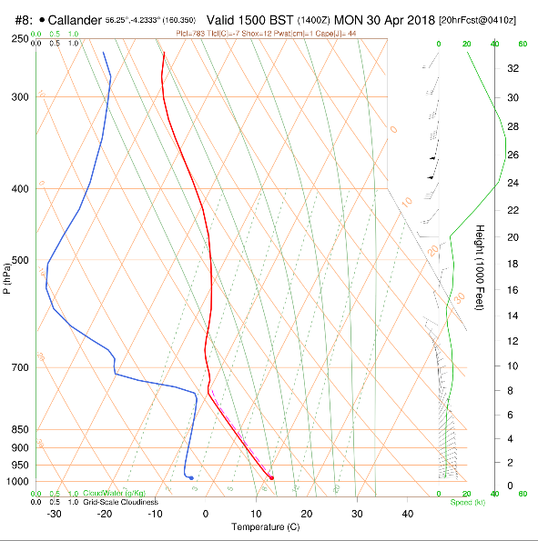
Tephigram from RASP
Air temp
Wind info
Dewpoint temp
Height
Temp
Notes:
Tephigram from RASP showing the data lines in colour.
It’s a busy/complex diagram however it’s just made up of several simple over-laid components.
The main grid is temperature on the horizontal axis and height (or pressure) on the vertical axis - height is shown on RH side of plot in 000’s of feet.
Temperature is shown along bottom (x-axis). Temperature grid-lines rise diagonally to upper right!!! – watch this as it’s easy to get caught out (see below if you want to know why the lines are sloping).
Upper half of plot is well above our usual flying levels but is useful for indications of top cover (cirrus cloud) and jet stream winds (for wave).
Dewpoint curve is always to the left or on top of air temp curve; it can’t be greater. Dew point is the temp at which water starts to condense out of the air as cloud so cloud will be present if air temp equals dewpoint temp.
Wind info is handy and essential for determining (guessing?) if there’s going to be wave.
The wind speed at any height is shown against the little green sub-scale. The wind velocity (speed and direction) is shown using the arrows which point in the direction the wind is blowing to.
Always check the date and time!
Also on the plot are three other sets of lines/curves – we’ll come to these later.
Geek alert
On the right is the pressure axis and this has an inverse logarithmic scale (as pressure drops with height in a roughly exponential manner) – this scaling means the height axis is linear (normal). Pressure lines are not displayed evenly in RASP (odd interval selection…?). Pressure is used by meteorologists; let’s just stay with the height axis on the left.
The temperature lines slope for three reasons. One is presentational in that the DALR and SALR lines (or “adiabats” or “potential temperature” lines – see the slide further on) tend to be squeezed together and not easy to use on a normal plot so skewing or slanting the temperature lines spreads the DALR lines out. Secondly this also levels out the pressure (height) lines to become more user-friendly. Finally, when the temperature lines are more perpendicular to the adiabats, any bounded area on the tephigram better represents potential (heat) energy– this has one direct use in calculating a quantity called CAPE (convective available potential energy) which is a measure of the instability and thunderstorm potential in the atmosphere which is what these diagrams were initially developed for. Hence the term “Skew-T”.

Slide 7
Tephigrams – the data comes from?
Air temperature, dew-point, and wind velocity “data” from;
direct measurements using a radiosonde on a balloon (“sounding”), or more frequently…
output from computational weather forecasting models – SkySight, RASP, etc. and we can access this in the form of a tephigram.
Notes:
Actual measurements are not very useful to us as they show the state of the atmosphere as some earlier time at just a few locations. They are useful for helping to initialize and calibrate the computer forecasting models or for generating very specific local forecasts.
The forecasts from computer models can provide predicted tephigrams for any location at any time within the scope of the forecast which is quite useful. The computer models are okay at predicting pressure, winds and temperature (less good at predicting “weather” such as rain, cloud, etc) up to a few days ahead so the predicted soundings are ok-ish. The SkySight and RASP models are themselves coupled to the large global weather models such as GFS (from USA). Always make sure you are using the most up-to-date forecasts available.

Slide 8
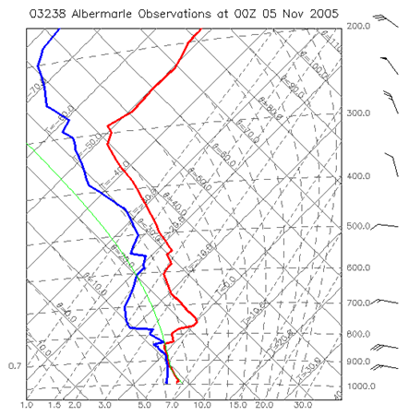
Tephigrams – real data!
Notes:
Here’s a real tephigram – more variability in the data.
Soundings to get real data are done but fairly sparsely (1-2 times a day from ~4-5 UK stations). This data is used to initialise/calibrate the computer models.
One place to see tephigrams from recent soundings is U of Wyoming or MeteoCentre

Slide 9
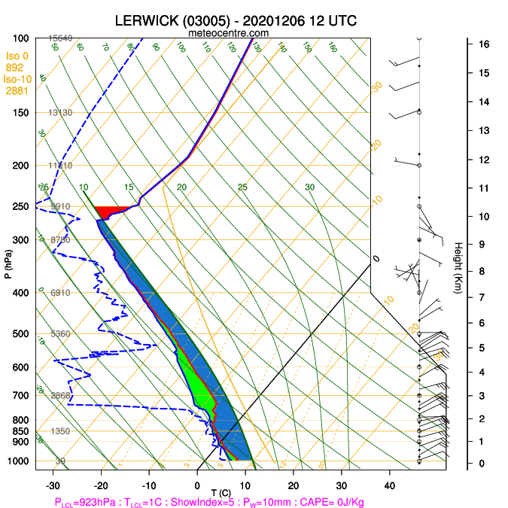
Another real tephigram

Slide 10
Tephigrams – simple observations
Looking at several forecast tephigrams for the day…
Are there cloud layers present (dew-point equal to air temperature)?
How close are the air temperature and dew-point lines? Is it likely to become cloudy?
    Lines closer than 2C?
Where is the freezing level?
    Brrr…/Showers/icing in cloud??
What is the wind velocity on the ground and at soaring height?
Notes:
Look at other met data as well – (e.g. routine forecasts, Met Office, MSLP, rain radar, satellite pics, RASP soaring maps,etc) and look at several tephigrams at turnpoints at different times
Wind on the ground for field landings (but valleys may modify wind direction)
Interesting but doesn’t answer the key questions.

Slide 11
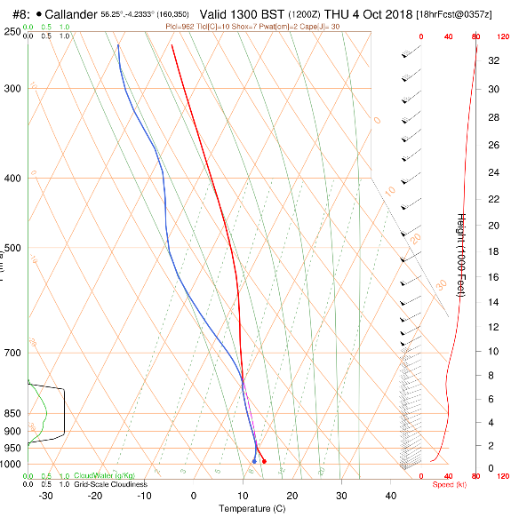
Tephigrams – low cloud layer
Cloudiness indicator
Cloud top & base
Notes:
The computer models only explicitly model widespread cloud formation such as fronts, stratus, and large cu-nim, etc. and this is called grid-scale cloudiness in RASP.
The models do not explicitly model thermal activity and cumulus cloud formation(!)
The models do factor in (via “parameterisation”) the presence and effect of small, fair-weather cumulus clouds but this won’t be shown on the tephigram so if you do not see cloud layers directly indicated don’t assume there’ll be no cloud. The full model output, i.e. the various maps, etc. will show cloud cover and type.
Clear example of wind info

Slide 12
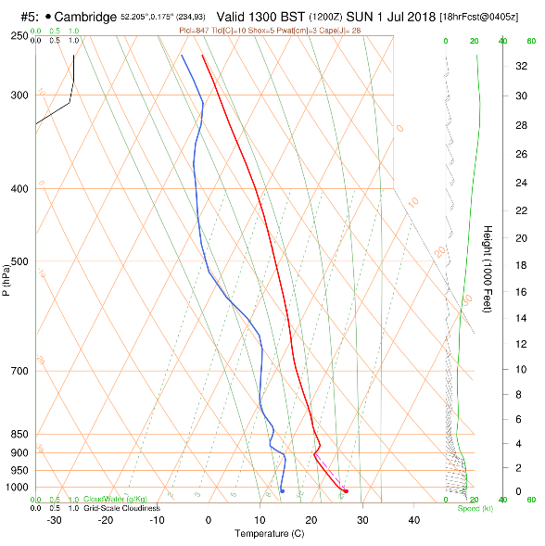
Tephigrams – freezing level?
Air temp
Freezing level at +12,000’
0 deg isotherm
Notes:
Remember the temperature lines (isotherms) rise up diagonally to the right.
Semi-useful for comfort.
Icing in cloud……
Descending from a wave flight with a very cold glider will risk icing even if entering cloud below the freezing level
Cloud water droplets may not be frozen above the freezing level and will create icing on aircraft
At high levels the water droplets will have frozen solid and have a reduced risk of airframe icing in cloud
Remaining below the freezing level should be ok either in or out of cloud

Slide 13
Tephigrams
ANY QUESTIONS SO FAR?

Slide 14
Tephigrams
At a basic level, what does a good soaring day look like on a tephigram?
Notes:
The next bit is a short-cut straight to the “answer”. It is qualitative only. This is often all you need (and all I use).
We will go into the tephigrams in a quantitative way later on for those who want a better understanding of the diagram (with a bit of the science) and to take the use of it a bit further such as understanding stability, cloud formation, spreadout.
We’ll need a quick look at a couple of the background curves.

Slide 15
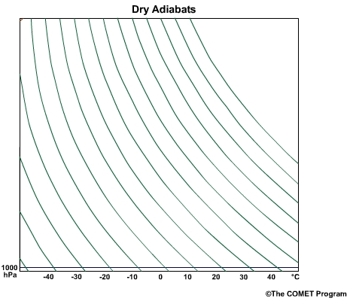
Tephigrams
Dry Adiabatic Lapse Rate Curves – these apply in clear air
Notes:
Need to identify these curves on the tephigram – these are the DALR curves. They show how clear rising air cools. Not going to use them just yet.

Slide 16
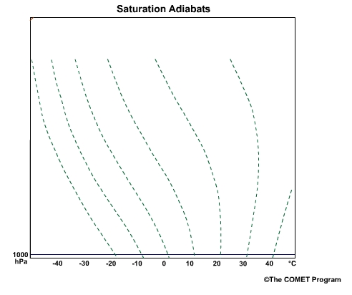
Tephigrams
Saturated Adiabatic Lapse Rate Curves – these apply in clouds
Notes:
Used in clouds – different curves are needed because of the pronounced effect that water, as it condenses, has on the way air cools as it rises.

Slide 17
Tephigram from RASP
Air temp
Wind info
Dewpoint temp
Height
Temp

Slide 18
Tephigrams – stability, what’s that?
Atmospheric stability is a very important factor in the formation of thermals and wave as they depend upon the right degree of stability (or instability)
In the atmosphere, stability means that if a parcel of air is displaced up or down from an initial height, the parcel will tend to return to that initial height.
What makes a parcel of air return to the level it came from?
  As a parcel of air rises it expands and cools. This cooling is caused by the expansion and is not due to the surrounding air
  If the temperature of the parcel drops so that it is the same or less than the surrounding air it will stop rising and start to descend as it will be more dense than the surrounding air
  And vice versa for air descending from its initial height
  For this to happen the change in the parcel temperature with height must be more than the change in the surrounding air temperature with height
Notes:
A stable system is one which;
Remains unchanging with time and/or
Resists being changed and/or
If disturbed returns to its initial state or position
A pendulum being an obvious case of a stable system. Interestingly if it is put in motion, it stays in motion for a long time as it tries to lose energy and return to its stable low-energy state. A guitar string is another example.
A parcel of air is a small discrete volume of air which is free to expand/compress according to the ambient pressure. It does not mix with the surrounding air nor receive or transfer heat to the surrounding air.
The atmosphere is generally stable. Unstable bits are thunderstorms, showers, low pressure systems, hurricanes.
A lee wave system needs the air to be stable so that it can “bounce up and down”
But thermals need a layer of nearly unstable air so they can persist. Too great a depth of instability can lead to showers/thunderstorms.

Slide 19
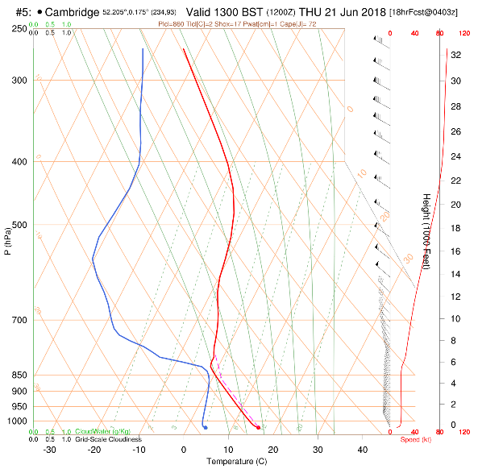
Tephigrams - stability
Stable layer
Notes:
This is a stable layer.
The air temp line is leaning to the right a bit – as you go up the line its temperature is not falling as fast as if it would if it was leaning to the left.
The air temperature line is also more vertical and right-leaning than the DALR and SALR lines in the background.
As you ascend the air temp line crosses the DALR and SALR lines from left to right. This is a stable region. Why? Find out in part 2.
At the base and the top the air temperature lines follow either the DALR and SALR respectively these are on the border of being unstable. In the low layer this allows thermals to form and rise.

Slide 20
Tephigrams - a good thermal day
Lower air temperature profile follows dry (clear air) curves from the ground up (well mixed layer)
A stable layer / inversion at a reasonable height (top of thermal)
Cloudbase present at a reasonable height (not blue thermals)
Dry air above cloud level to minimise cumulus spread-out
Low wind speed (<15kts) within thermalling layer
No or thin upper cloud cover
Notes:
Doesn’t require much of a temperature increase to create thermal.
Stable layer stops unstable convection – showers, etc.
Need thermal activity to start early and finish late
Cloud base (saturation point) must be below the point where dry line hits air temp and inversion or stable layer

Slide 21
Tephigram – a good thermal day
Air temp
Wind info
Dewpoint temp
4.Dry air
Height
2.Inversion
3. Cumulus cloud?
1.Well-mixed layer
5. Low windspeed
Temp
Notes:
Previous tephigram from RASP.
This is a good thermal day.
No obvious cloud layers. Light winds. Freezing level at 4000’, -10C at ~8000’
4 key things;
A well-mixed layer low down. The air temp profile matches the DALR, this means that thermals will form and rise. RASP shows this as a dashed red line following the DALR line. The only time you will have thermals is when the air temp profile upwards from the surface is like this.
Just before the inversion it looks like the thermal cools to its dew-point – the dashed line shows a slight kink. This is good because it means thermals will be marked by cumulus clouds (yay!). In this example it’s not immediately clear if cloud will form – could be blue thermals. Cloud depth won’t be great as air is too stable above the inversion so unlikely to have showers.
3. An inversion (or isothermal layer, or stable layer) at a reasonable height. The air temperature line now crosses the DALR and SALR lines from left to right (so rising air will find itself surrounded by equally warm air at some point). This will stop the thermal and its cloud from developing too much (showers etc). Thermals stop at 8000’ around.
4. Dry and stable air above the inversion. Spread-out will occur when a thermal/cumulus cloud stops rising at the inversion. The dry air above helps the cloud to disperse. The stable air puts a stop to any upper-level instability (towering cumulus, etc)
Features 1, 2, and 4 create a characteristic “wine-glass” shape (ignoring stuff high up)

Slide 22
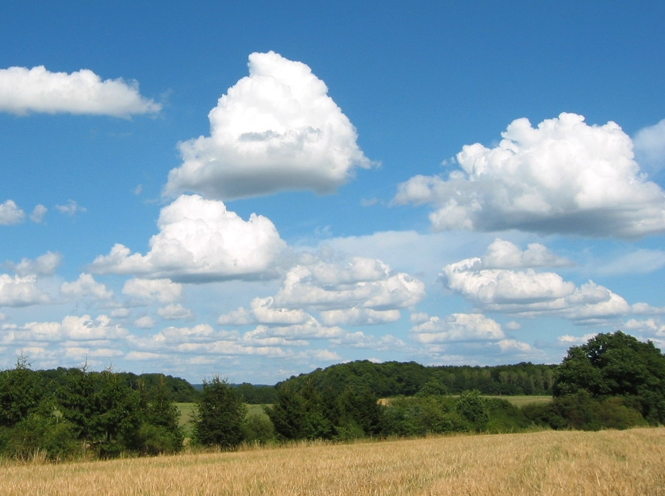
Any questions?

Slide 23
Tephigrams - a good wave day
Wind speed > 10-15kts at hill tops (~3-4000’) and gradually increasing with height
    Not too windy at cruising level (<50kts)
Wind direction relatively constant with height and from SW to N (at Portmoak)
Inversion or isothermal layer present at height of hill tops/ridges
Stable, relatively dry air above and below the inversion
    too dry – blue wave
    too moist – cloud filled (and possibly convective/conditionally unstable)
Notes:
May get wave if some of these factors are present.
Main difference between good wave and good thermal is windspeed. Can have both present – usually interfering with one another – result can be good or bad for soaring.
Stable –> air temp line crosses DALR and SALR curves from left to right (doesn’t matter higher up)
Isothermal layer or inversion at hill/ridge level not strictly necessary just air temp less than DALR.

Slide 24
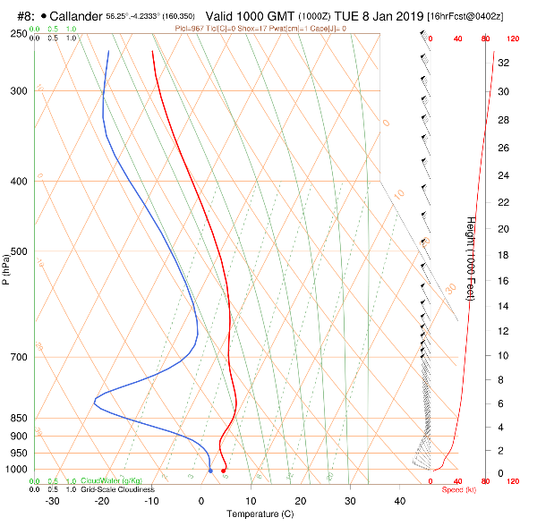
Tephigrams – a good wave day
6.Stable layer
1&2. Wind Profile
5.Dry air
3.Inversion
4.Stable layer
Notes:
Looks sort of familiar – similar to a good thermal day except we have wind
Stable atmosphere – temperature line cuts across dry (DALR) and wet (SALR) lines from left to right as we move up the diagram
A favourable wind profile – winds above 15kts in lower layers, gradually increasing with height, blowing across upwind wave triggers,
Reasonably constant direction with height (or direction changes a little (<30 degrees) and gradually). At Portmoak classic wave days are W to NNW wind directions.
Inversion – a strongly stable layer at the mountain/ridge height
Stable surface layers – limited convection to disrupt low-level flow
Dry air limits the amount of cloud created by the wave
Stable layer above the inversion again to suppress convection (especially being kicked off by the wave)
You can get wave any day the wind is blowing strong enough from pretty much any direction (e.g. E’ly wave at Portmoak) as the atmosphere is generally stable anyway.

Slide 25
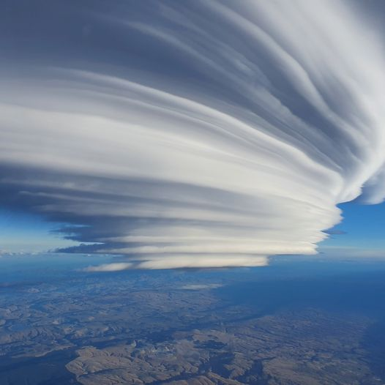
Any questions???
Notes:
The (in)famous “Taieri Pet” in S. Island New Zealand.

Slide 26
Further reading / resources
SSA note on T-Phi grams is excellent – SkySight has a link to this page
        Skew T Reading 2 JDM .docx (flsc.org)
RASP has a tutorial as well
Or just Google “gliding tephigrams” and some good stuff will pop-up such as;
    Tephigrams for Dummies - flynorfolk.org (this is quite good)
    Bicesters Gliding Blog: The Rasp skew T explained (bicester-gliding.blogspot.com)
YouTube - “Thermobytes” a series of 91 short (3-10min) videos from Australian Bureau of Meteorology covering many components of T-phi plots.
Blank Tephigram charts at Bret's Skew-T/ln p Graph (bretwhissel.net)

