Slide 1
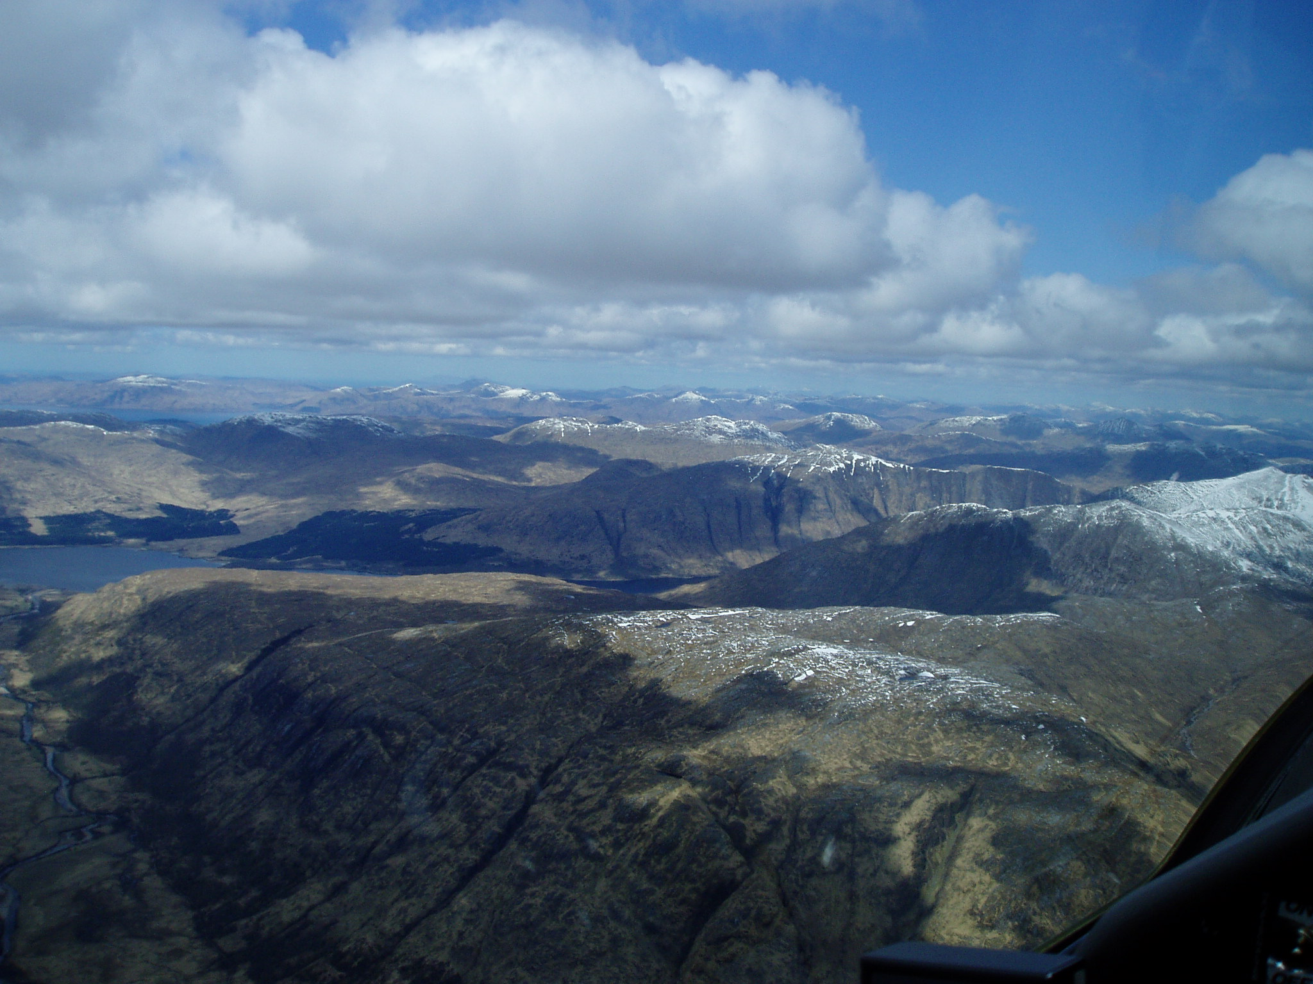
Some Task Planning Factors:
Entry route in & out of the mountains
Soaring hours available / Average x/c speed
Recent weather: wet or dry
Cloud base(s) throughout the day
Thermal strength throughout day/Streeting
When to fly into wind/downwind
Will there be: Convergences
Sea Air
Spreadout
High level cloud
Lastly: How busy is the launch point?
Exploring the Mountains-Part 3
Task Planning
Last time we covered:
- Developing good habits
- Situational awareness
- The effects of stress
- Always having a plan, (long & short term)
- Entry to the mountains (initial discussion)
Notes:
1.Exploring the mountains Part 3
Last time we covered:
- Developing good habits
- Situational awareness
- The effects of stress
- Always having a plan, (long & short term)
- Entry to the mountains (initial discussion)
Some task Planning Factors : Quickly describe then and then move on to slide 2
Entry route in & out of the mountains
Soaring hours available / Average x/c speed
Recent weather: wet or dry
Cloud base(s) throughout the day
Thermal strength throughout day/Streeting
When to fly into wind/downwind
Will there be: Convergences
Sea Air
Spreadout
High level cloud
Lastly: How busy is the launch point?
PCS-DAM-LOQ-PCS
I think this is approaching Loch Leven (east of Ballachulish)
01/05/2015 330km @ 84.1kph/84.9kph HC
6825’ highest cloud base: most of the time at 5500

Slide 2
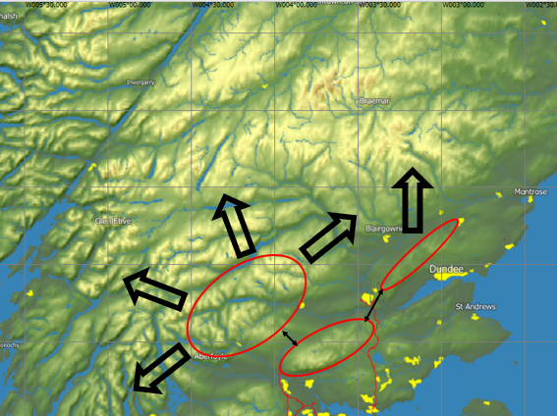
Thermal routes into the mountains
Notes:
2.Discuss Task Planning Factors:
Soaring hours available / Average x/c speed
Entry route in & out of the mountains
Recent weather: wet or dry
Cloud base(s) throughout the day
Thermal strength throughout day/Streeting
When to fly into wind/downwind
Will there be:
Convergences
Sea Air
Spreadout
High level cloud

Slide 3
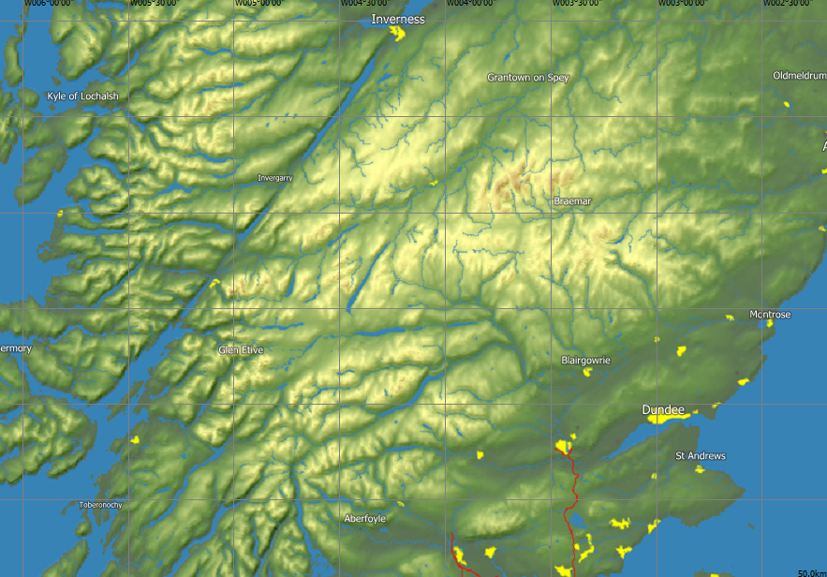
Plateau/Low relief areas
6
5
4
3
2
1
Notes:
3. PLATEAU / LOW RELIEF AREAS
Quickly go through slides 3-10 with just the salient features

Slide 4
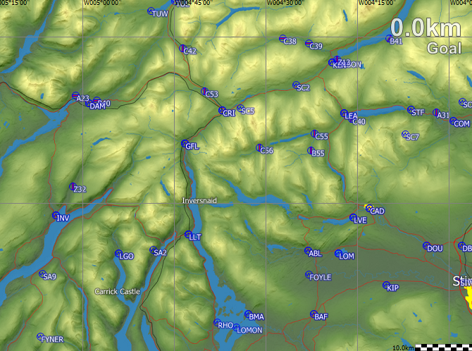
Area 1
Notes:
4. AREA 1
Covered by Kate last week

Slide 5
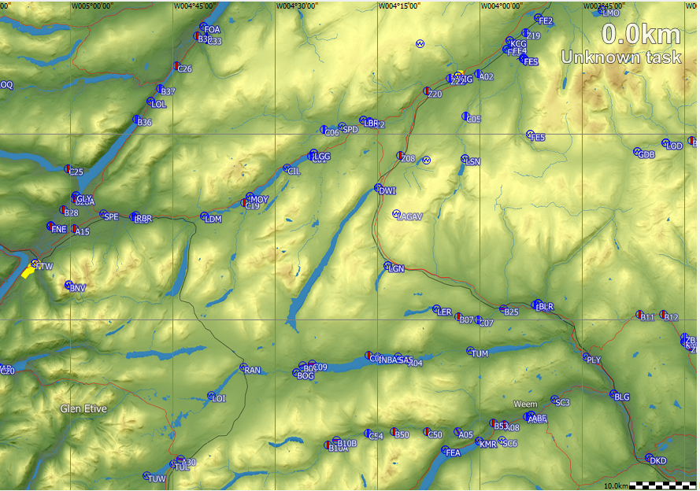
Area 2
Notes:
5. Area 2
Brief discussion of Area 2 (A9) as it at the top of the easiest entry route into the mountains

Slide 6
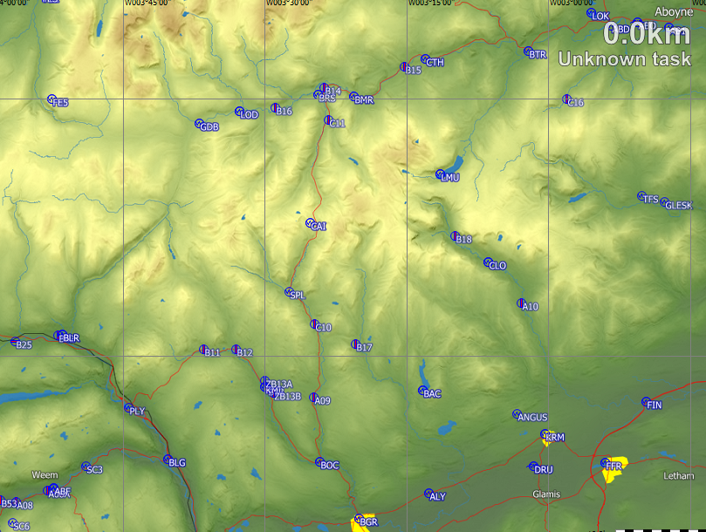
Area 3
Notes:
6. Area 3
South of the River Dee/Glen Clover

Slide 7
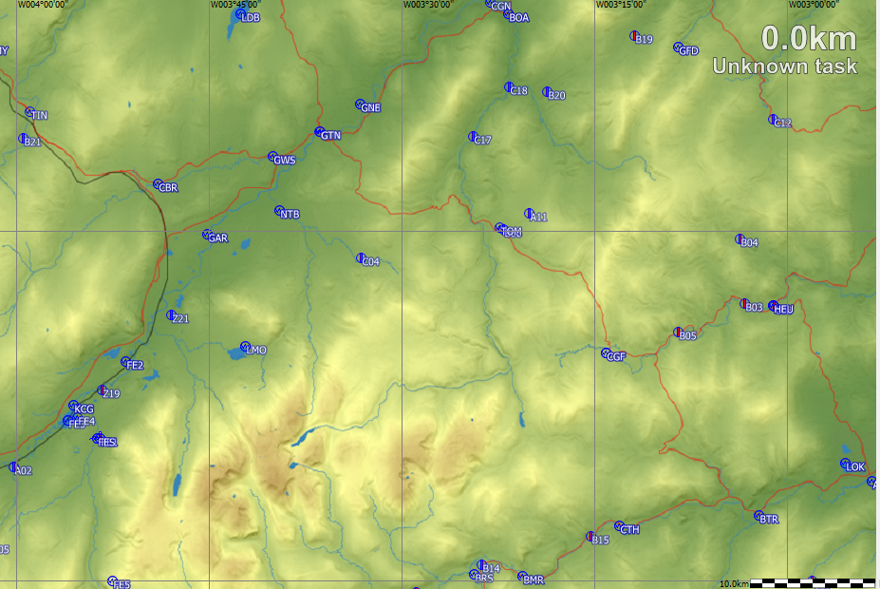
Area 4
Notes:
7. Area 4
Cairngorms/Feshie

Slide 8
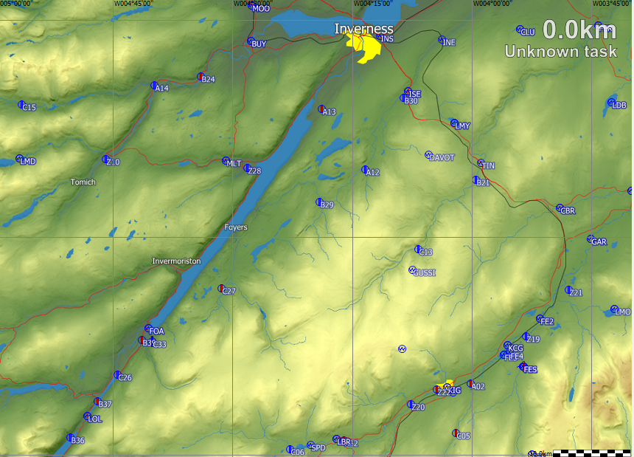
Area 5
Notes:
8. Area 5
NW of Feshie to Loch Ness

Slide 9
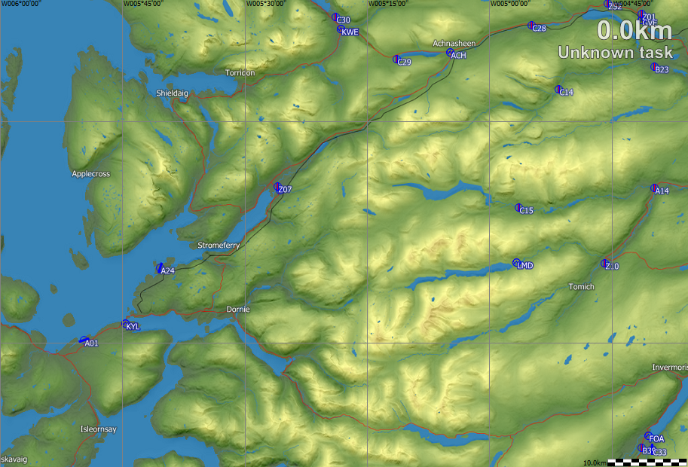
Area 6
Notes:
9. Area 6
ENE of Skye (Torridon etc)

Slide 10
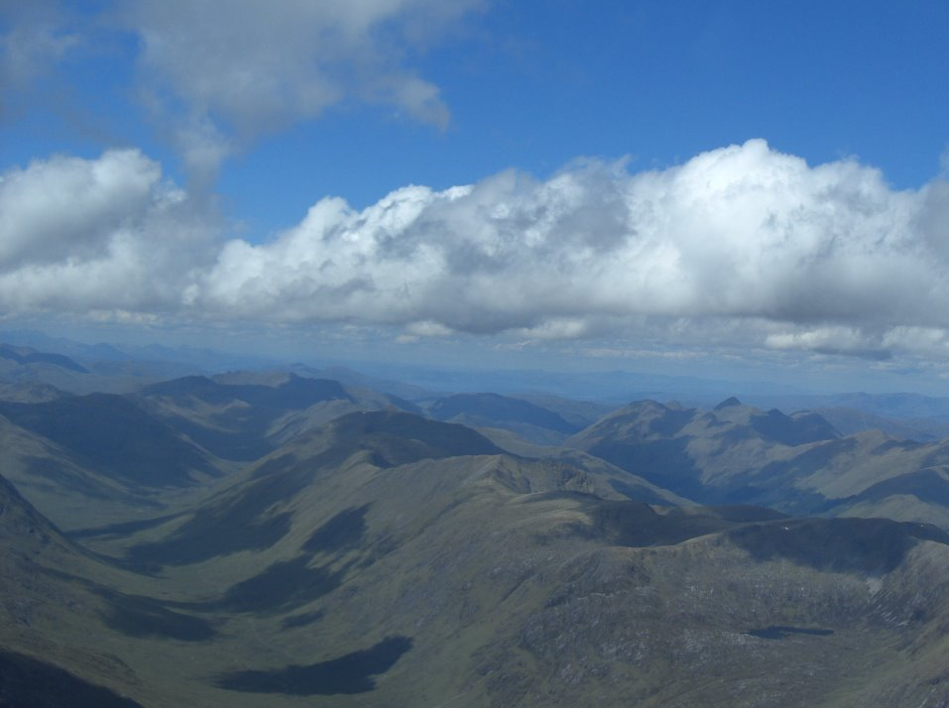
07/06/19: Roy Wilson (Aboyne) routing between Loch Quoich(LOQ) & Garve (GVE)
Notes:
10. 07 06 19 Roy Wilson
Approximately 6000’ going to LOQ (Loch Quoich) and then going up to GVE (Garve)…….for the experts

Slide 11
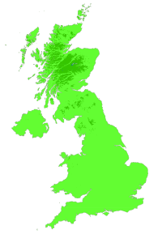
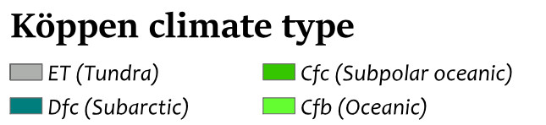
Polar
Oceanic
Polar
Continental
Polar Front (Jetstream)
Temperate
Oceanic
Temperate
Continental
Notes:
11 The Four Airmasses
For Thermal soaring
Types and qualities of the airmasses
A bit like the oil in lava lamps or melting jellies
Continental airmasses usually best for thermals

Slide 12
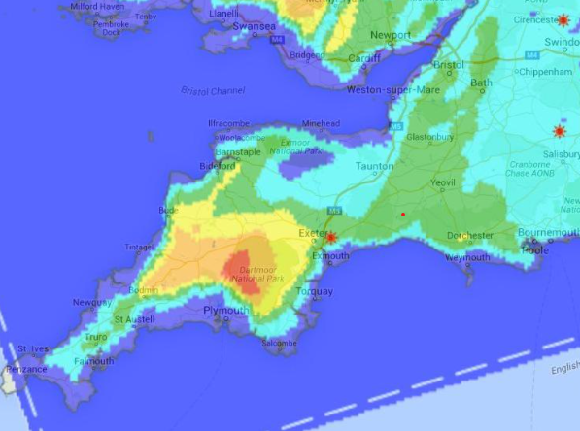
Rasp: Star Rating
(1 – 5)
Notes:
12. RASP Free weather forecasts
STAR rating

Slide 13
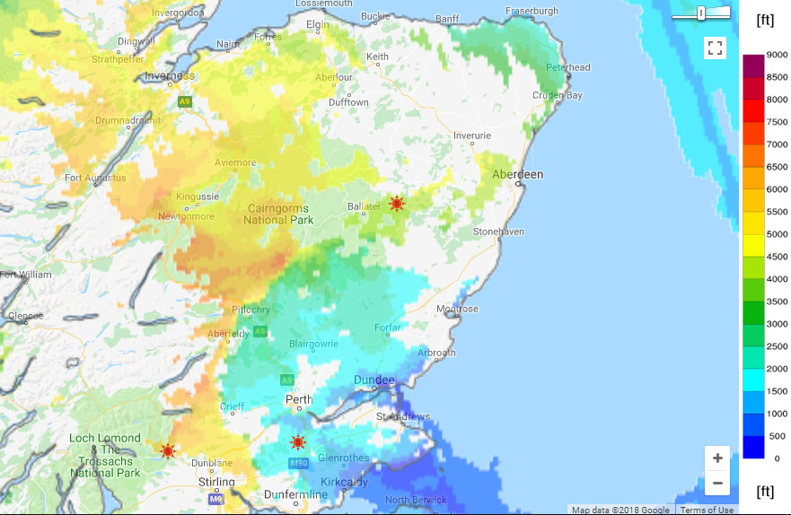
05/07/18 Cu Cloudbase15:00L - RASP
Notes:
Slides13 (– 23) Rasp Cu Cloud base at 1500
SC & JDW to discuss as appropriate

Slide 14
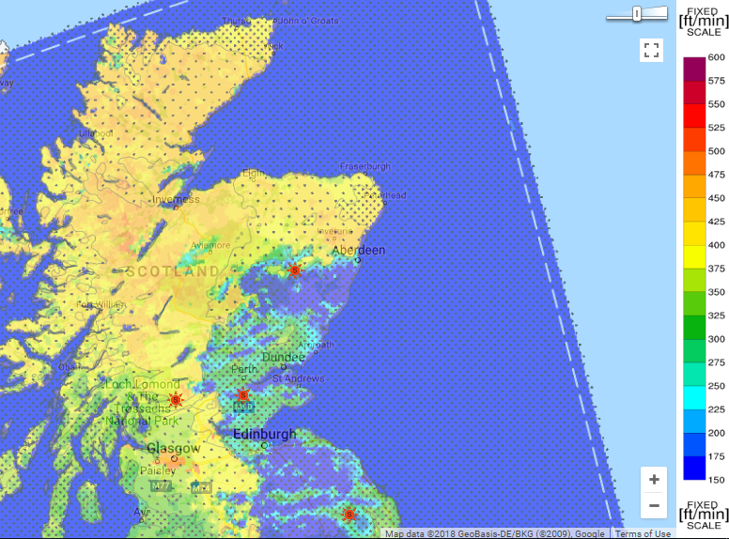
Thermal: Buoyancy/Shear Ratio: 15:00 - RASP
Notes:
14. Thermal Buoyancy /Shear Ratio
SC : 415.8km PCS-LBD-COM-FE1-COM @77.6/ 79.2kph(HC)
JDW : 374.6km of a 435.4kmTriangle GLE-ACH-MOS-GLE@80.2/70.4kph(HC)

Slide 15
Land Air
Convergences
Wind Velocity
<5-6kts: Good chance
<6-8kts: Some chance
>10kts : No chance
Sea Air
Notes:
15. Convergences

Slide 16
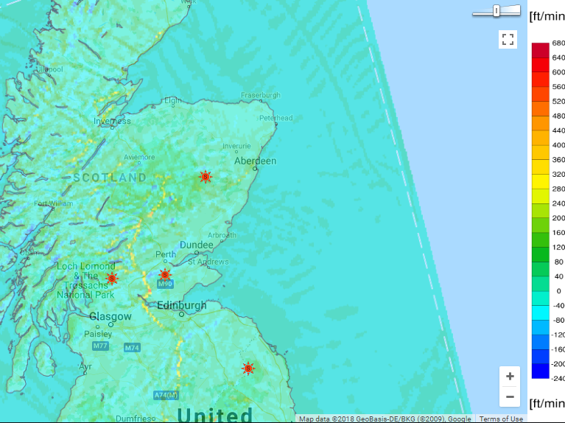
05/07/18 Convergence 15:00L – RASP
(BL Max Up/Down)
Notes:
16. BL Max Up/Down Convergence
The boundary layer is defined as that part of the atmosphere that directly feels the effect of the earth's surface. Its depth can range from just a few metres to several kilometres depending on the local meteorology.

Slide 17
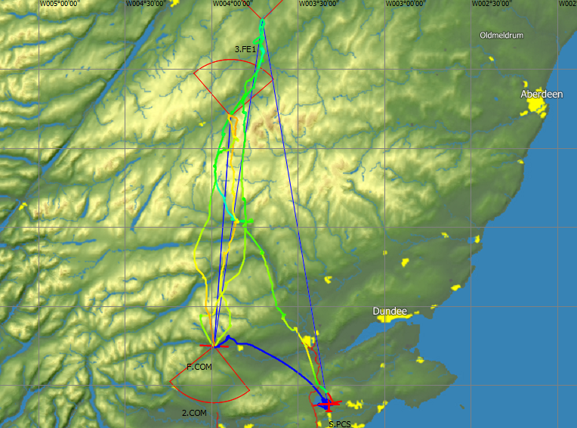
SC : 415.8km
PCS-LBD-COM-FE1-COM
@77.6/ 79.2kph(HC)
Notes:
17. SC :
415.8km PCS-LBD-COM-FE1-COM @77.6/ 79.2kph(HC)
Describe legs

Slide 18
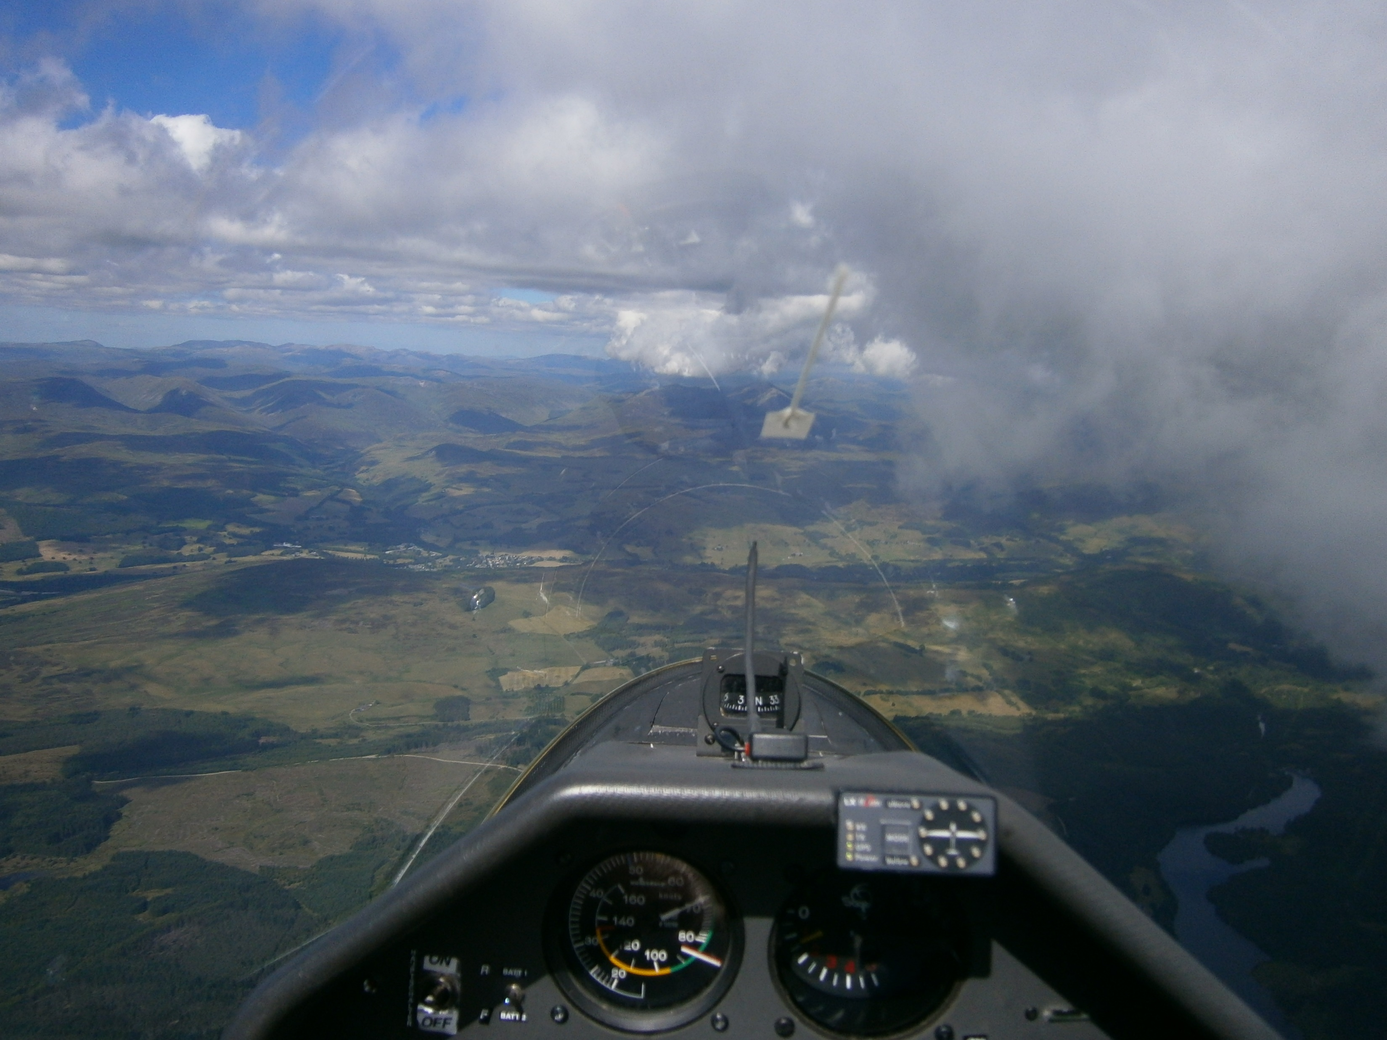
Notes:
18. Third leg approaching Blair Atholl; Loch Tummel below
Sea breeze air coming in from right. Land air from left
Step cloud ahead

Slide 19
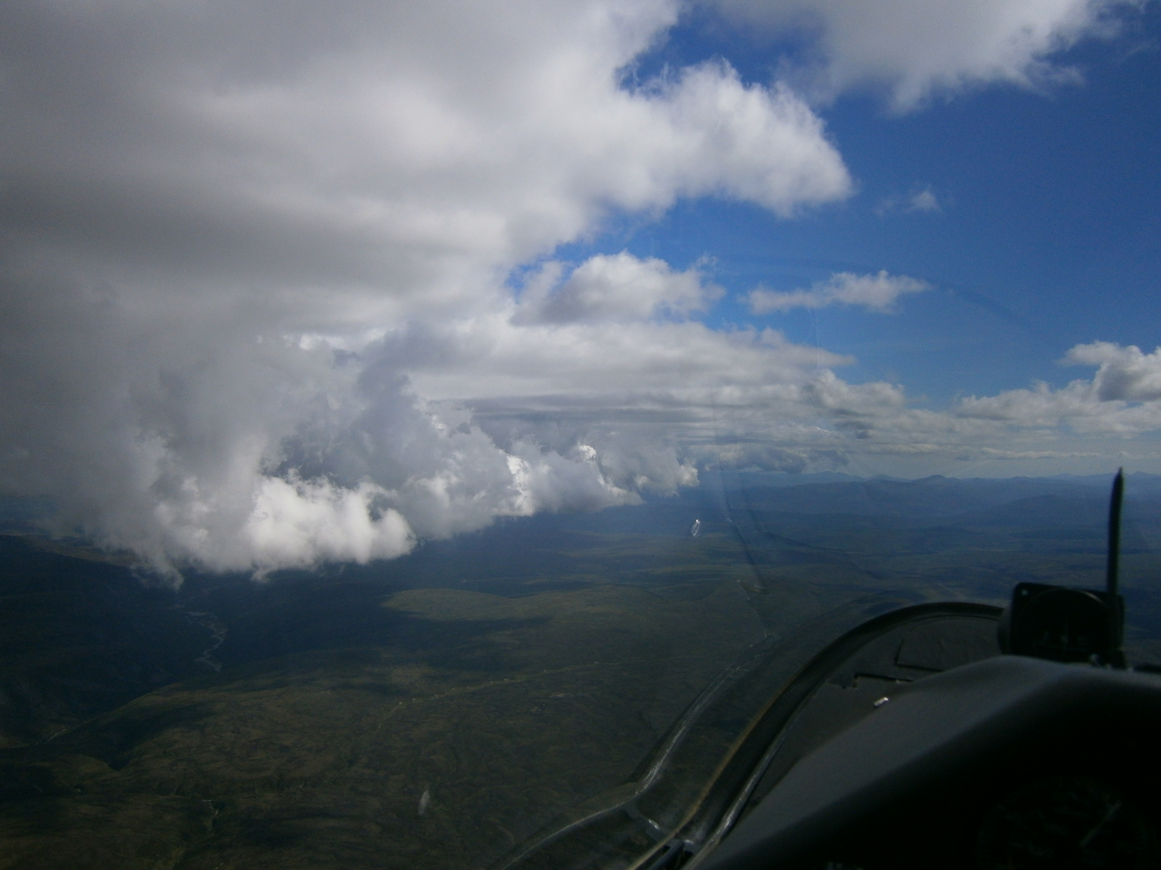
Notes:
19. Final leg over plateau to the NW of Linn of Dee
Going other way on last leg; epic. SW of Feshie

Slide 20
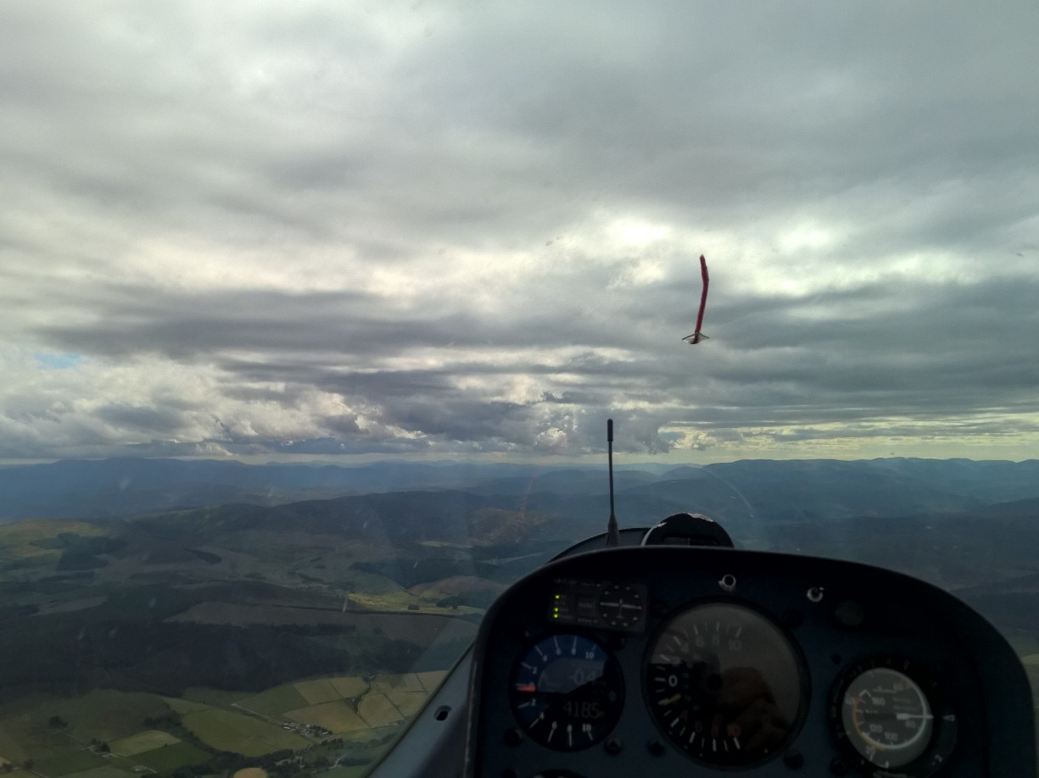
Notes:
20. JDW having turned Mossat and heading SW

Slide 21
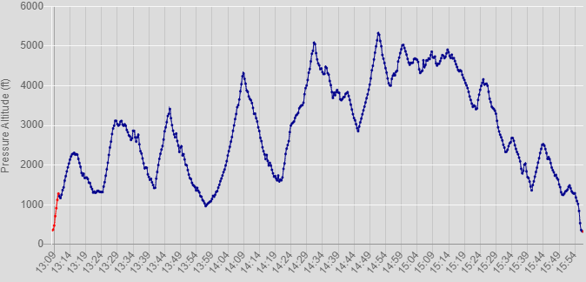
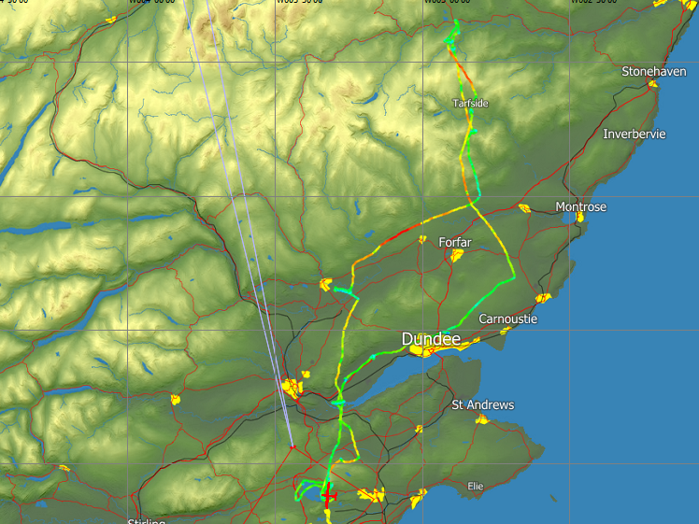
JDW
203.2km O/R
PCS-AB0-PCS
23/08/18
G/S trace
Notes:
21. JDW: 203.2km O/R PCS-AB0 –PCS 23/08/18

Slide 22
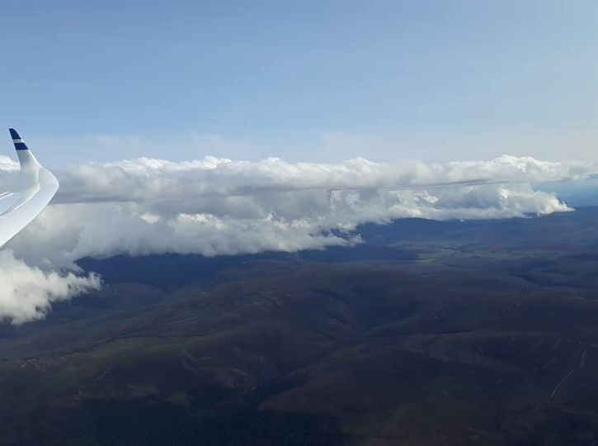
Aboyne’s Jakub Hlavacek : Perkoz : 23/08/18
Notes:
22. Aboyne’s Jakub Hlavacek : Perkoz : 23/08/18

Slide 23
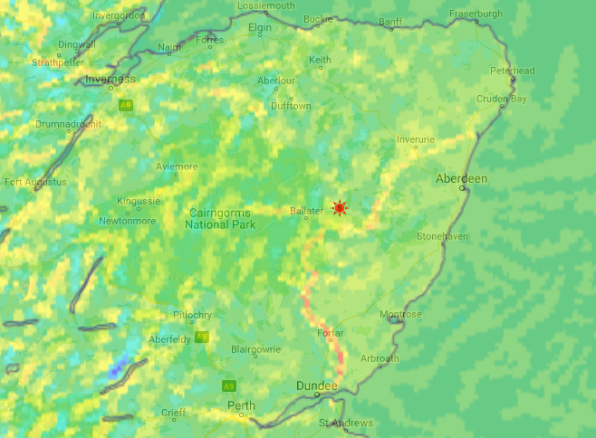
23/08/18 Convergence 16:00L – RASP
(BL Max Up/Down)
Notes:
23. Convergence on east coast 23 08 18
RASP BL Max Up/Down Motion at 1600L showing the predicted position of the sea breeze front.
One of the things that is interesting is the strength of the predominant west wind.
As can be seen the convergence extended into the Aberdeen CTR and JDW turned around at Aboyne and headed home

Slide 24
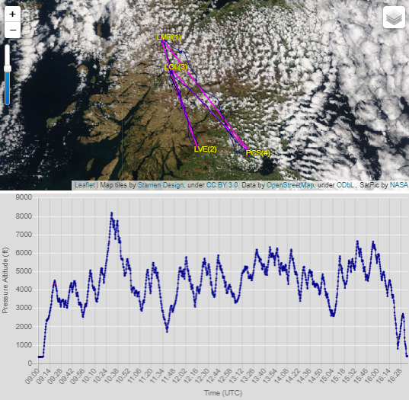
BGA Ladder
“Flight Details”
Section
14/05/2016: 519.9km @ 74.2/75.7kph(HC)
PCS-LMD-LVE-LOL-PCS
Notes:
24. 14/05/2016 519.9km @ 74.2/75.7kph PCS-LMD-LVE-LOL-PCS
Wave to start off with; climbed to 8000’ Could not put it on the Hot Wings Ladder

Slide 25
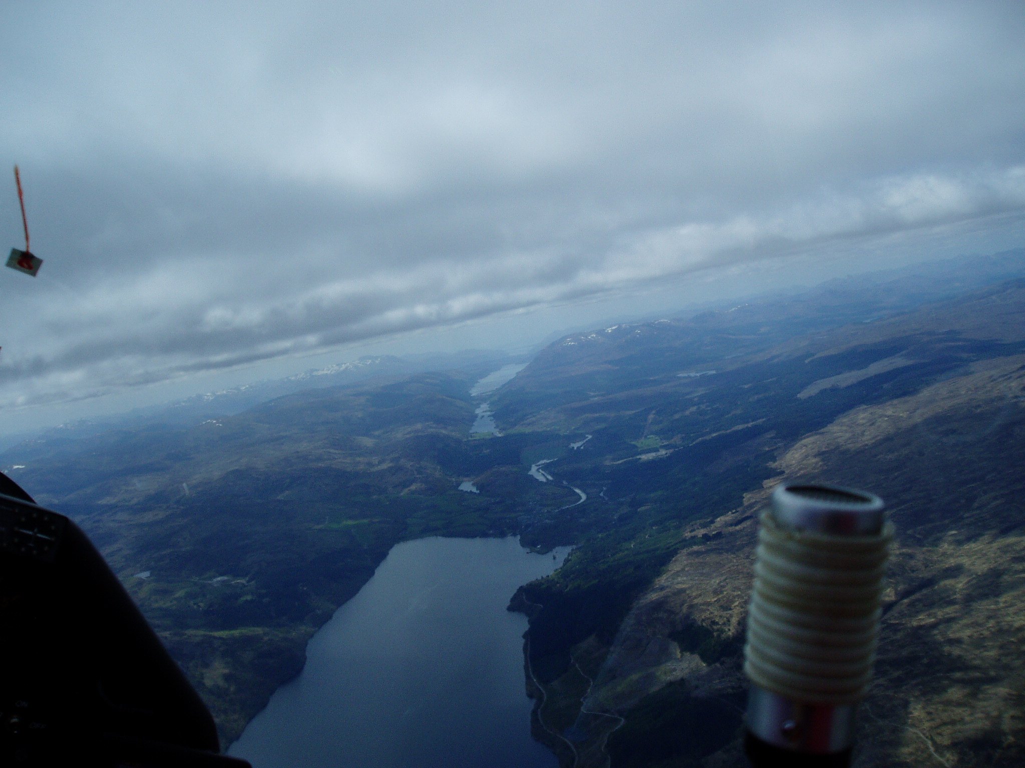
Looking SW at Fort Augustus ably assisted by a Dalek
Notes:
25. Looking SW at Fort Augustus ably assisted by a Dalek

Slide 26
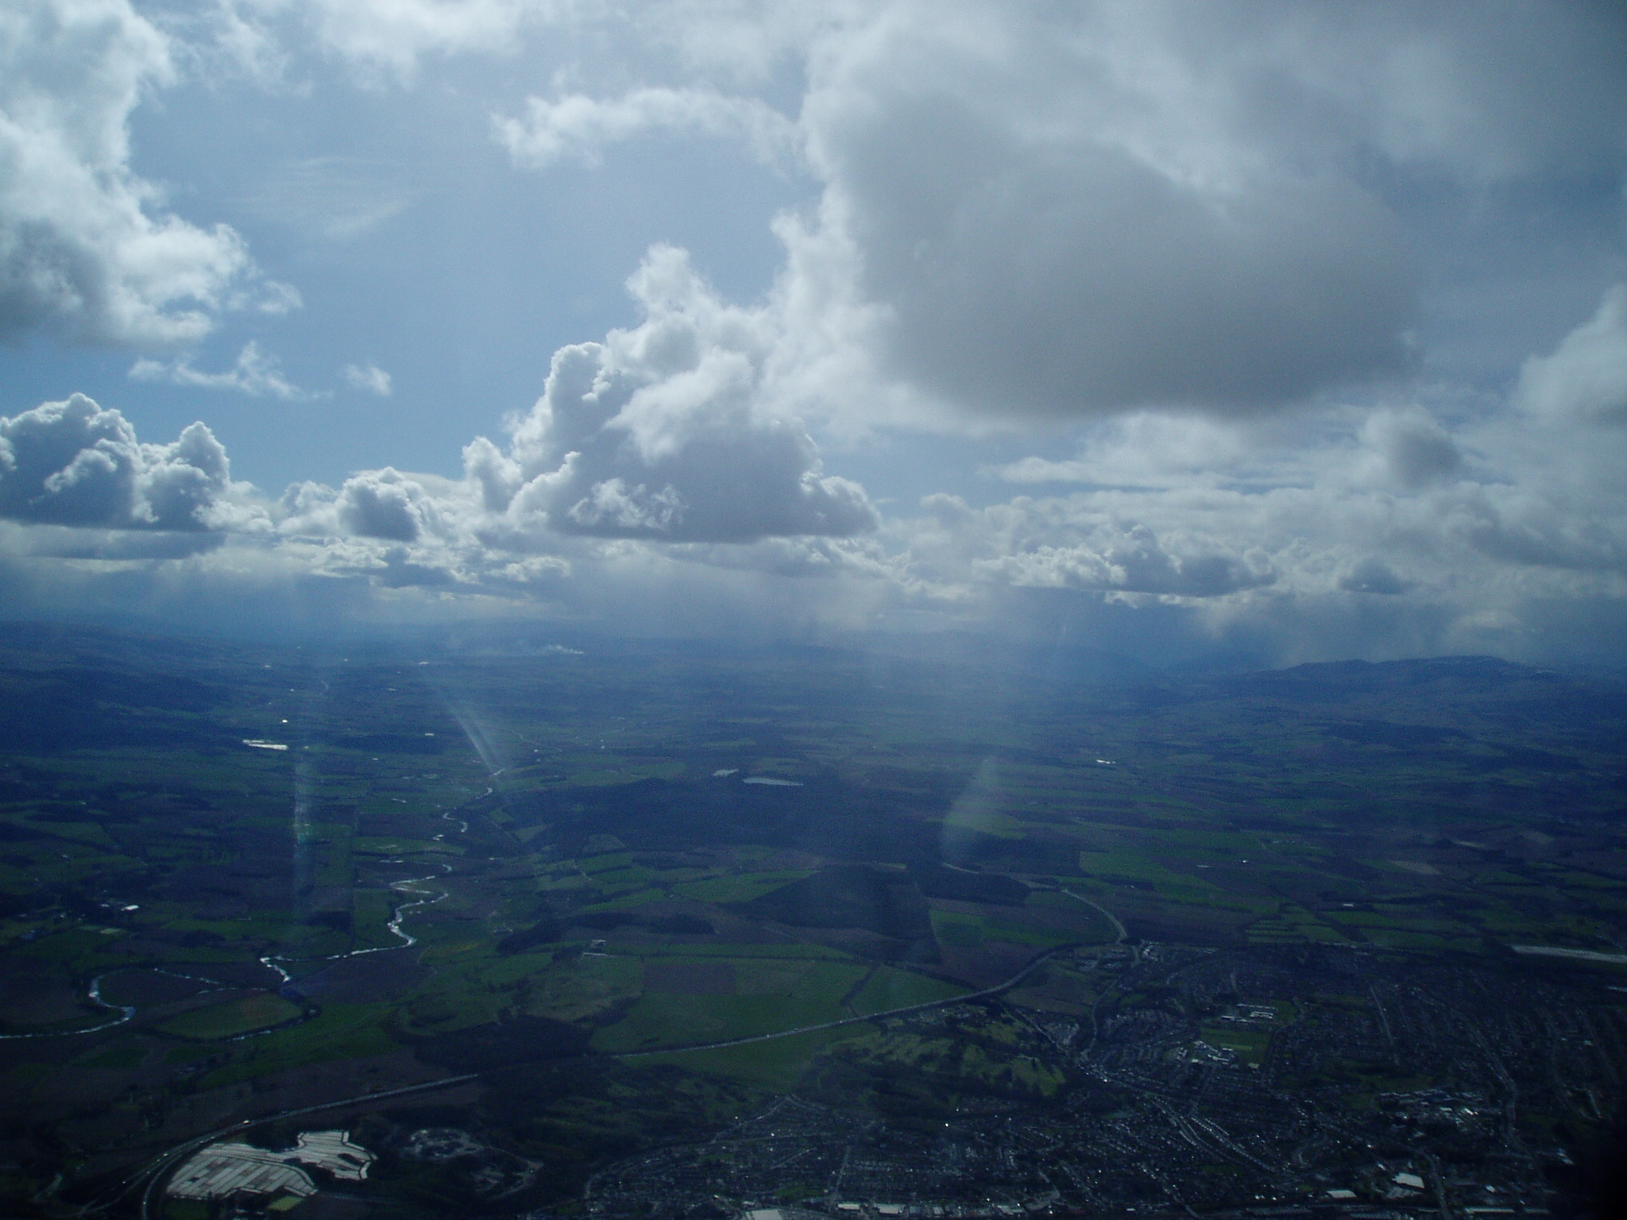
The end
Notes:
26. Perth looking SW
Showers on the horizon which I had just come through.

