Slide 1
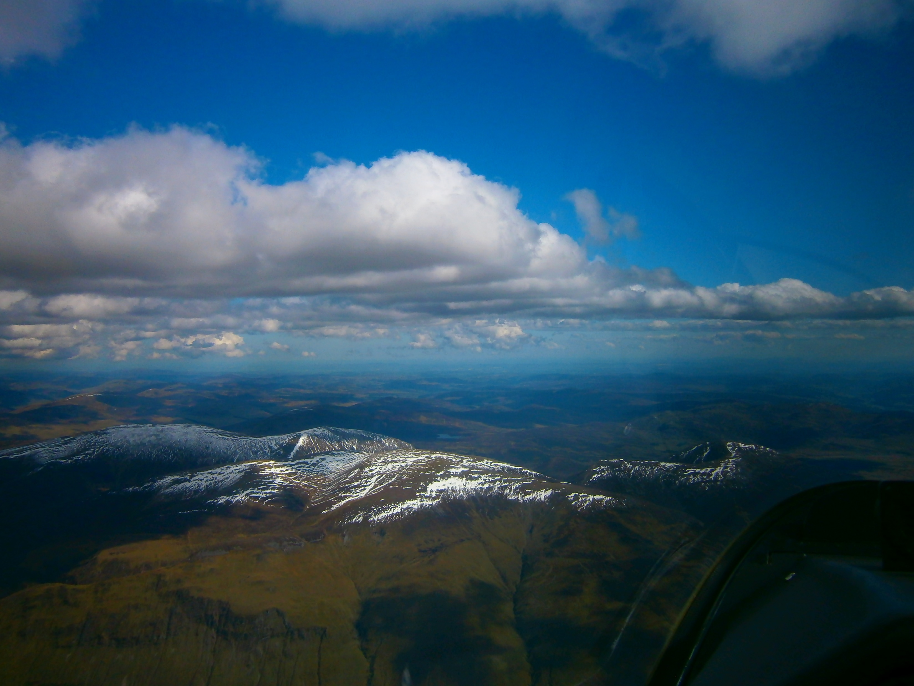
Last session we discussed -
: Why do it
: The required tools
: An introduction to the right mindset
:An example mountain soaring flight
: Setting (personal) boundaries
: The field landings database
Exploring the Mountains-Part 2
The most Important rule
ALWAYS be within safe gliding distance of a field
Notes:
1. EXPLORING THE MOUNTAINS PART 2
11 05 2019

Slide 2
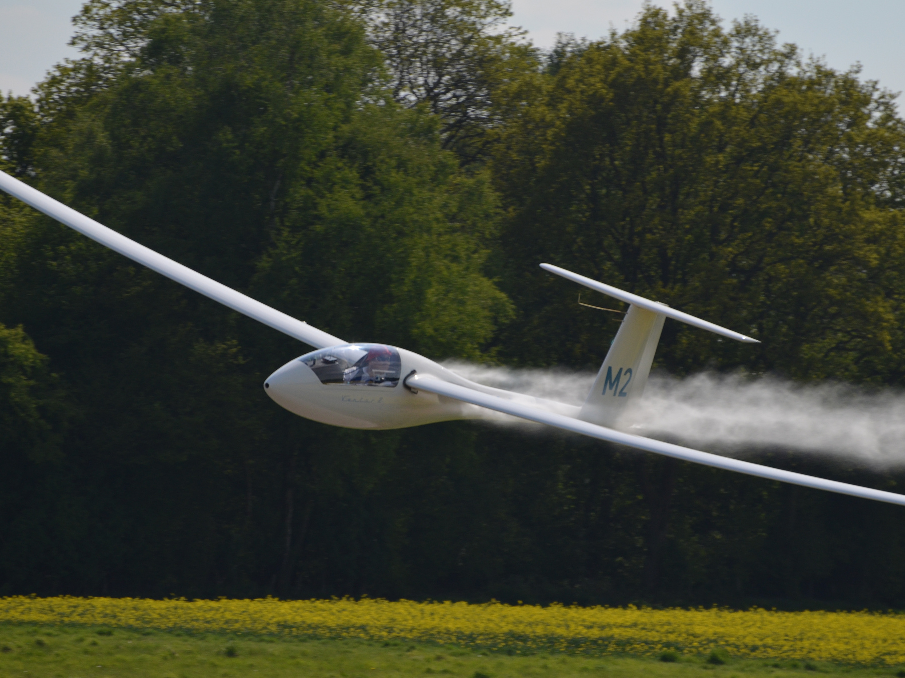
Becoming a Good Pilot
- Developing good habits
- Situational awareness
- Always having a plan,
(long & short term)
Notes:
2. BECOMING A GOOD PILOT
Developing good habits: Managing yourself: Getting the right information: : Improving/maintaining manual flying skills: Correct order of priority?
Situational awareness:
-”the perception of environmental elements and events with respect to time or space, the comprehension of their meaning, and the projection of their future status” – WHATS ACTUALLY GOING ON - WHAT WE THINK IS GOING ON- WHAT WE THINK IS GOING TO HAPPEN
All three depend on our perceptions.
Planning
When does long term planning start? When does short term planning start? The three in trays: What can I do now?- What can I do next? – Discard the rest.

Slide 3

Creating the Right Mindset
(Long Term Planning)
Preparation: Gaining knowledge and preparing for a soaring flight
Early Morning/JFDI Groups and chatting
Looking at the weather ( and notams)
Notes:
3. CREATING THE MINDSET.
We discussed this briefly last week
Creating the right mindset:
Be part of a peer group
Examples: Early morning/JFDI group and email chatter
In this example it is still an overview and long term plan. The final planning decisions are left until the night before/morning.

Slide 4
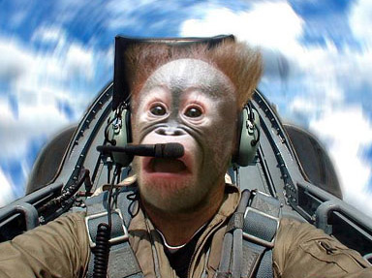
Is this a result of lack of planning?
Improving Confidence:
Addressing ones fears?
Solution: Practise what you are bad at until you are good at it.
Notes:
4. IS THIS A RESULT OF LACK OF PLANNING?
Its one of the factor leading to:
Overloading
The effects of stress of situational awareness:
Ways of reducing stress: Planning: Reducing workload: Getting emotionally prepared (the right mindset)
Improving Confidence
Setting realistic goals: Preparation, planning and taking the “baby steps”
Addressing ones fears
My main fears:
Becoming overloaded (due to advancing years): Example: starting the turbo;
Short term plan: The three in trays: What can I do now?- What can I do next? – Discard the rest
That’s why having an escape option is so important.
Being able to reach a field. That determine the conditions that I will fly in and the task I set.
3. Some people may fear disapproval if using a a club glider and landing out on a cross country.
What’s your fears?

Slide 5
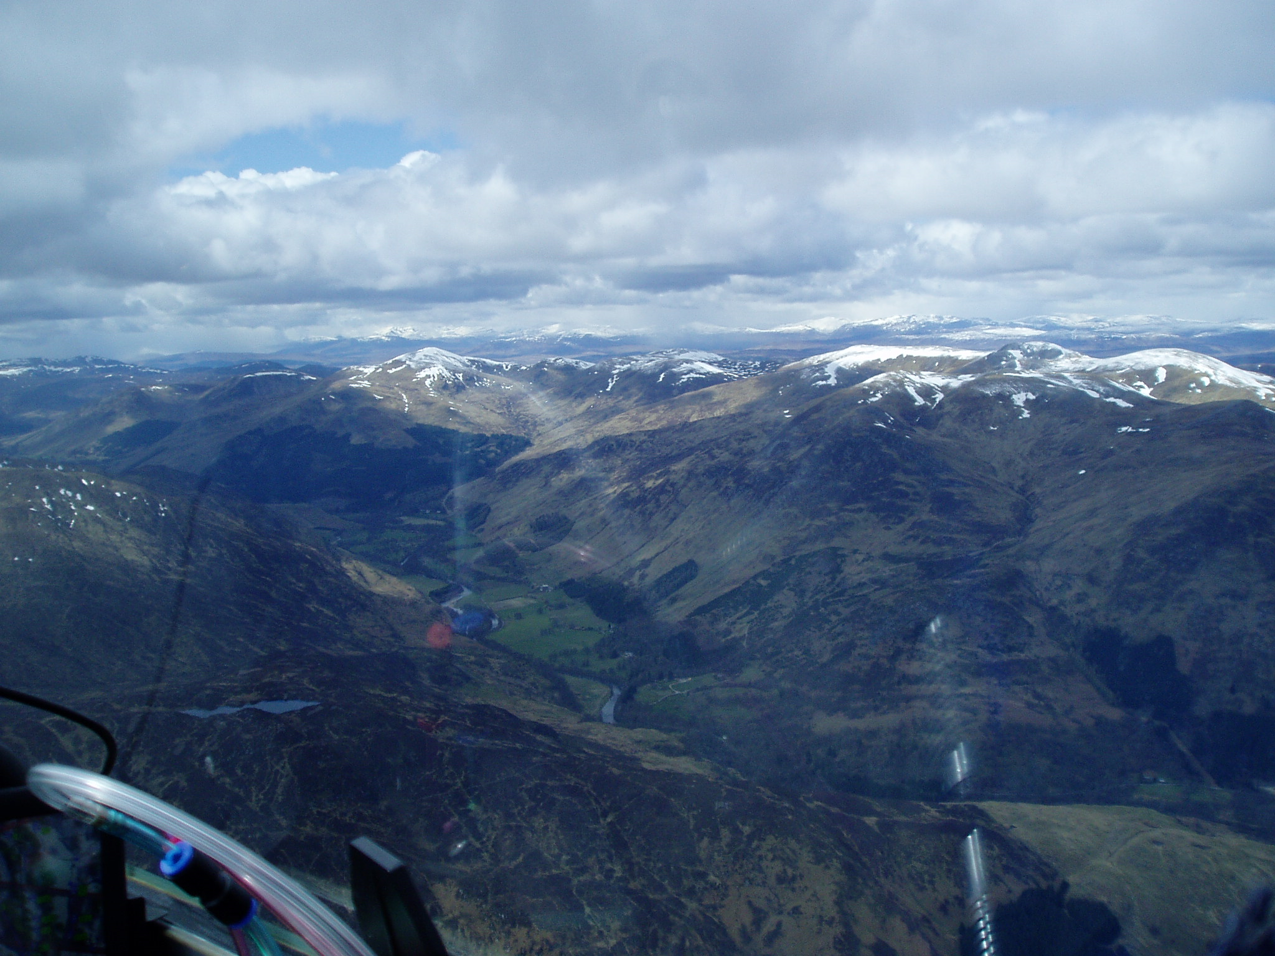
Preparing for field landings
Notes:
5. PREPARING FOR FIELD LANDINGS
27 04 16 Glen Lyon
BRING KATE IN HERE

Slide 6
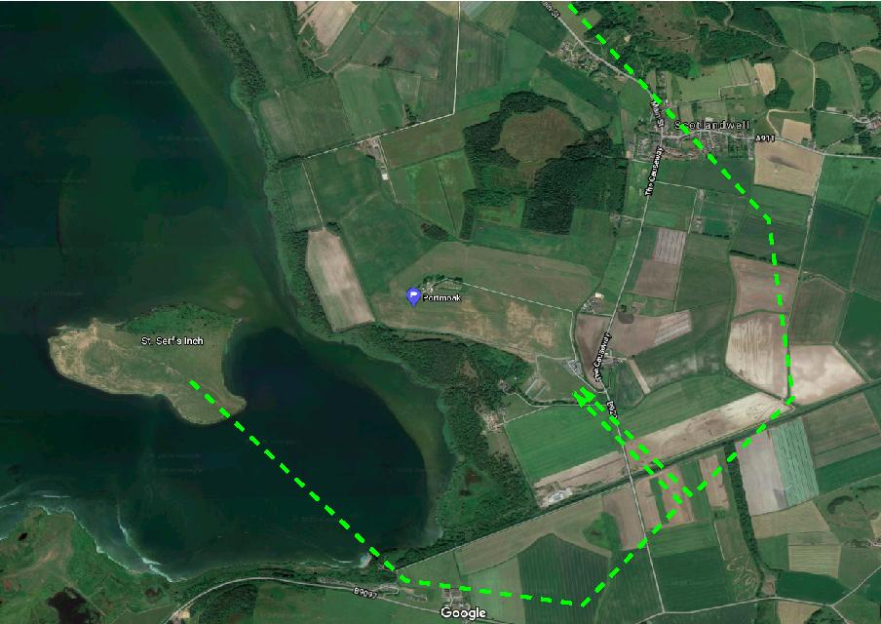
Practicing field landings
South Field
(Taking into account the winch line)
Notes:
6. SOUTH FIELD
Compare the south field to the fields surrounding the airfield.
The club could ask a farmers permission to land in their field,
e.g. Turfit, George Turnball………..Great access, you may well have to derig the glider anyway.
Assess the wind conditions for each wind direction & consider “escape” options
Ensure that others are aware of your intentions

Slide 7
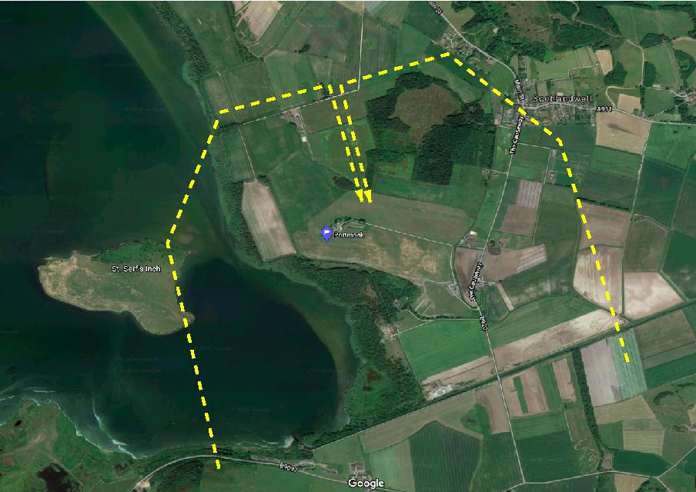
North Field (1)
Notes:
8. NORTH FIELD (1)

Slide 8
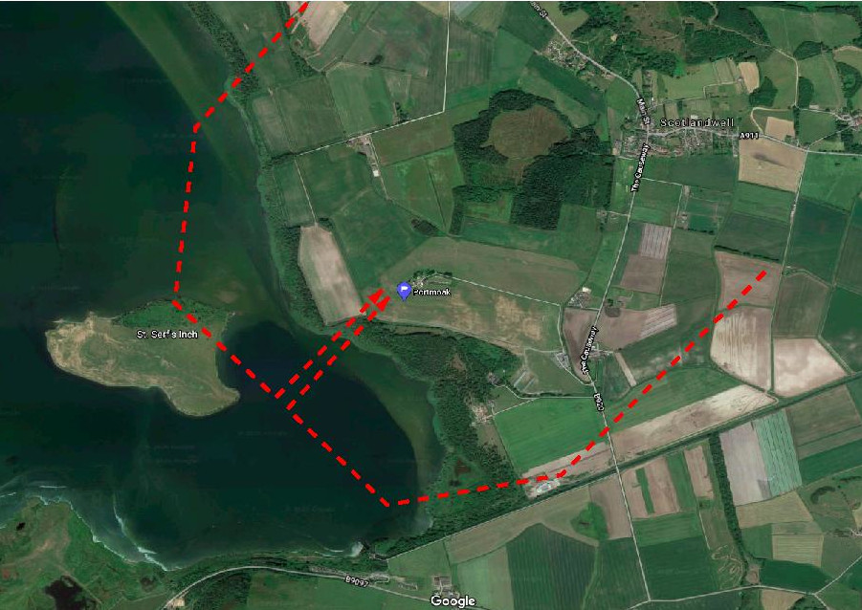
Back Strip
Notes:
7. BACK STRIP

Slide 9
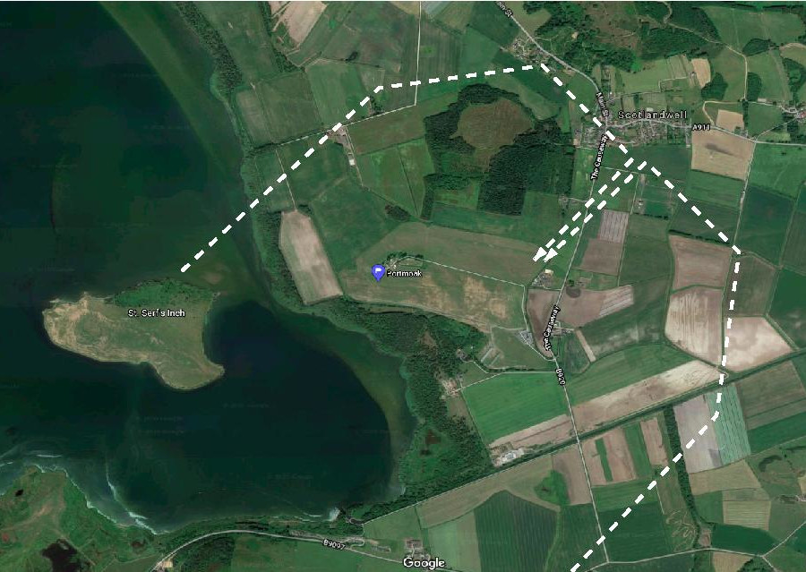
North Field (2)
Notes:
9. NORTH FIELD (2)

Slide 10
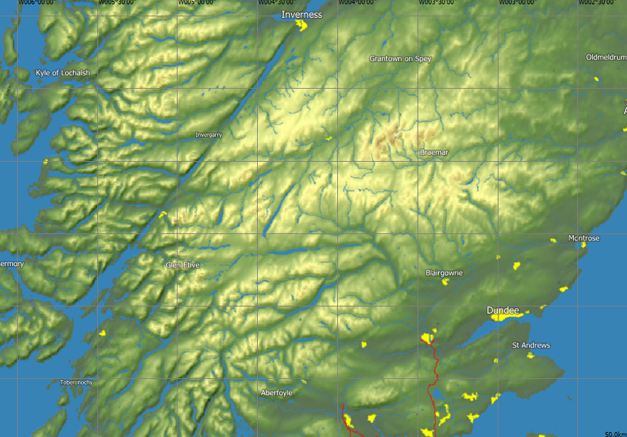
Our Playground
FES
ABO
PMK
Notes:
10. OUR PLAYGROUND
Easterton is off the top of the picture
Review of the various advantages/disadvantages of each site as a thermalling site
Discuss plateau areas

Slide 11
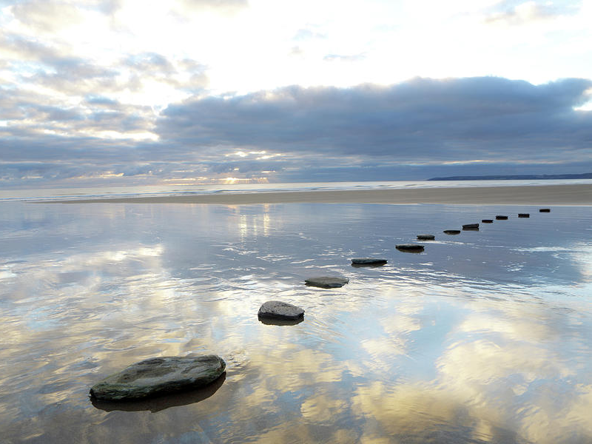
Soaring height bands (AGL) for x/country
(assuming 1000’ for the field landing)
Using fields & thermals as “Stepping Stones”
“Decision factors” %
Height AGL Distance (1:40 G/A) Soaring /landing” 5000’/4000’ useable 26.7nm/49.4km 90%/10%
4000’/3000’ useable 20nm/37.0km 67%/33%
3000’/2000’ useable 13.3nm/24.7km 50%/50%
2000’/1000’ useable 6.7nm/12.3km 33%/67%
1000’AGL Circuit planning 10%/90%
Field
Thermals
ad infinitum
Thermal
Field
Thermal
Notes:
11. USING FIELDS & THREMALS AS “STEPPING STONES”
What are the factors affecting decision making?
The biggest is stress level.
The closer to the ground does the stress level go up?
Concentration
Concentrate on what’s important ( but don’t lose situational awareness- “overfocusing”)
One cannot concentrate fully 100% of all the time – comes back to managing workload.
“Crux” moments in the flight.
BRING IN JOHN

Slide 12
Early exploration:
Entry points
field availability
Notes:
12. EARLY EXPLORATION ENTRY POINTS
Starting out:
Early thermal cross country is done in the flatlands and gaining experience down south
Entry into the mountains.
When starting out on mountain flying why not just follow the lift rather than setting a task?
Instead of picking waypoints as your goal, set landing areas and go and have a look a the
Azimuth: Being able to see into the next valley?

Slide 13
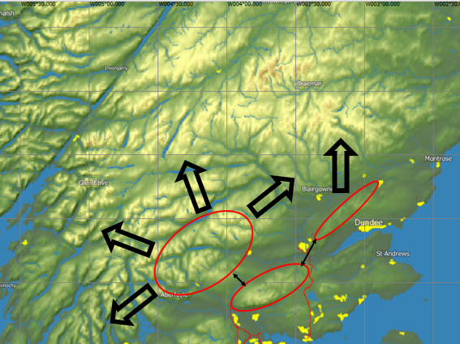
Thermal routes into the mountains
Notes:
13. THERMAL ROUTES INTO THE MOUNTAINS
Portmoak’s most likely entry routes into the mountains
Use of “bridges”
Use of the Ochills as a training tool for both ridge & thermal.
Does Condor help in this?

Slide 14
Plateau/Low relief areas
6
5
4
3
2
1
Notes:
14. PLATEAU / LOW RELIEF AREAS
Plateau areas/low relief mountain areas.
The ability to glide out or work around
Discuss and move to next slide

Slide 15
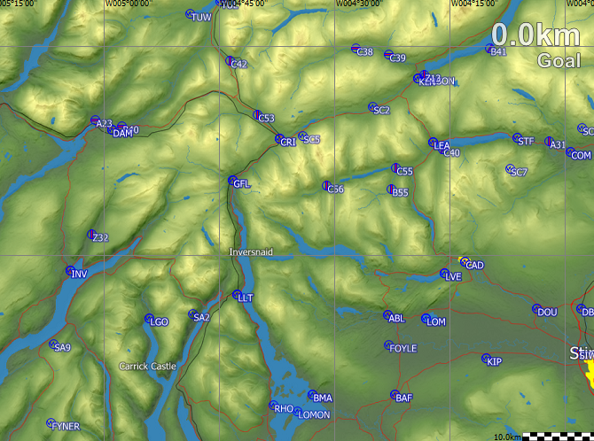
Area 1
Notes:
15. AREA 1
BRING IN KATE

Slide 16
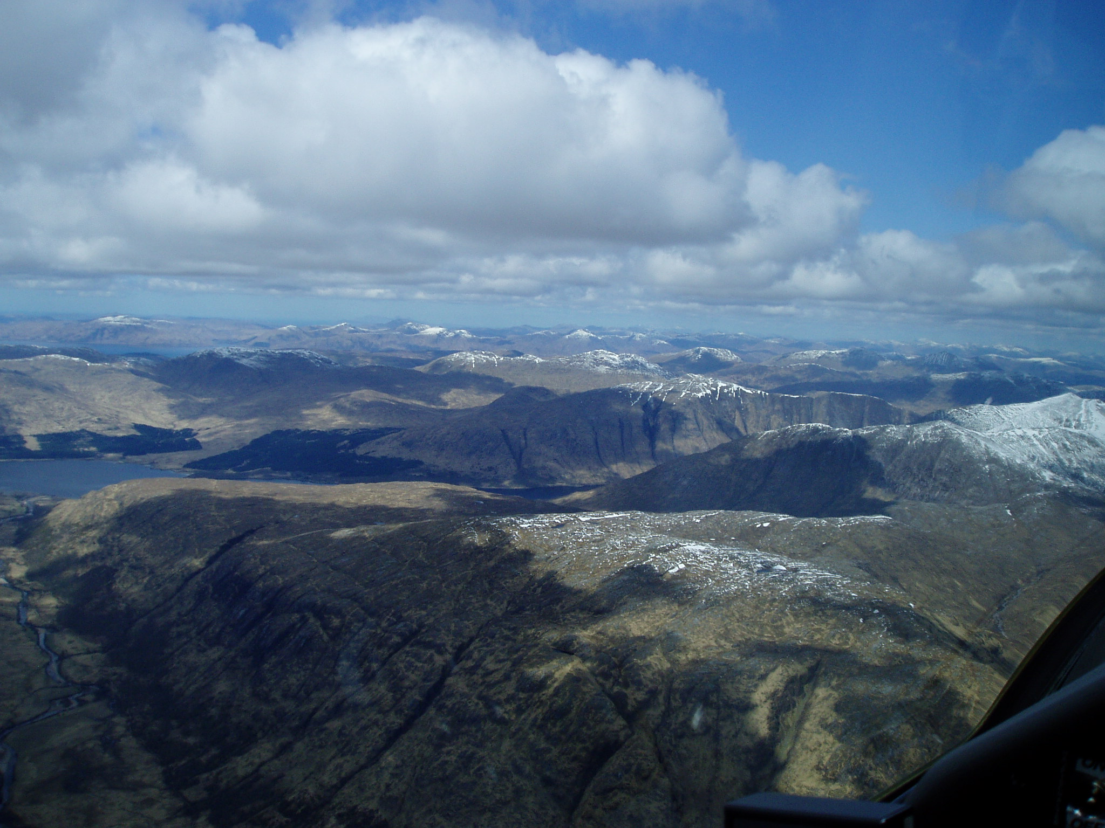
What’s in the next valley?
Knowledge & Confidence
End of Part I
Notes:
17. WHATS IN THE LEFT VALLEY?
Confidence: PCS-DAM-LOQ-PCS
I think this is approaching Dalmally
01/05/2015 330km @ 84.1kph/84.9kph HC
6825’ highest cloud base: most of the time at 5500’

Slide 18
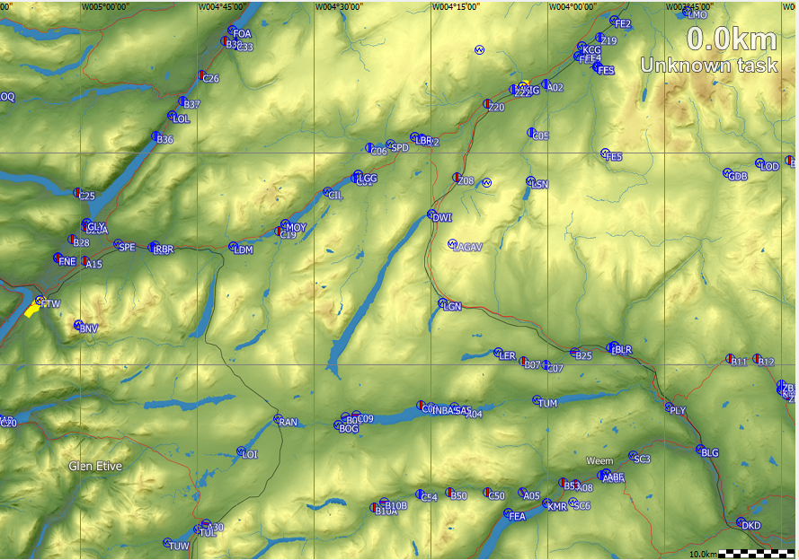
Area 2
Notes:
Discussion of Area 2 as it is the easiest entry route into the mountains

