Slide 1
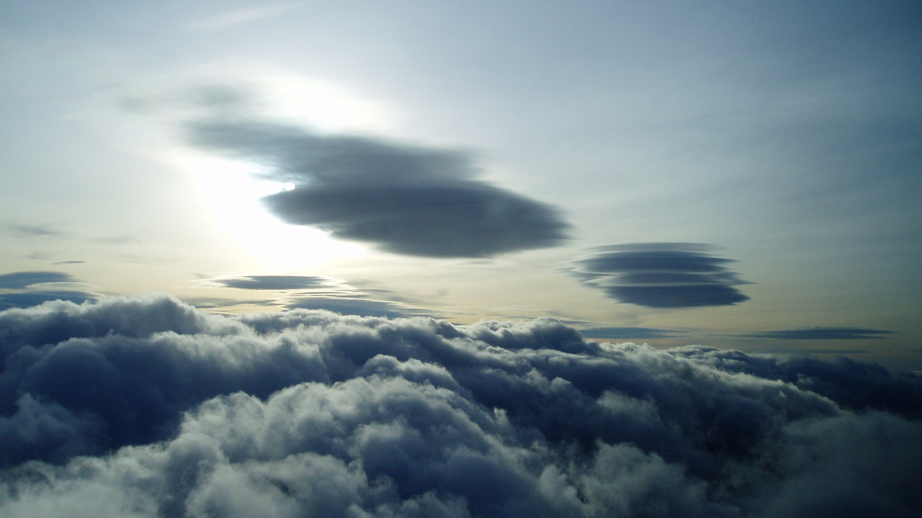
Wave flying in Scotland – Fast & Far
Part 4:
Review of Part 3: Crossing Airway N560
IAS/TAS Relationship
Task Planning
:Flying a 500km Wave Task
13 02 12
Notes:
Introduction
500k: we will be looking some basic rules, an example 500. broken it down into legs showing some pertinent pictures and videos
300k O/R record attempt.
Did not get it on that occasion

Slide 2
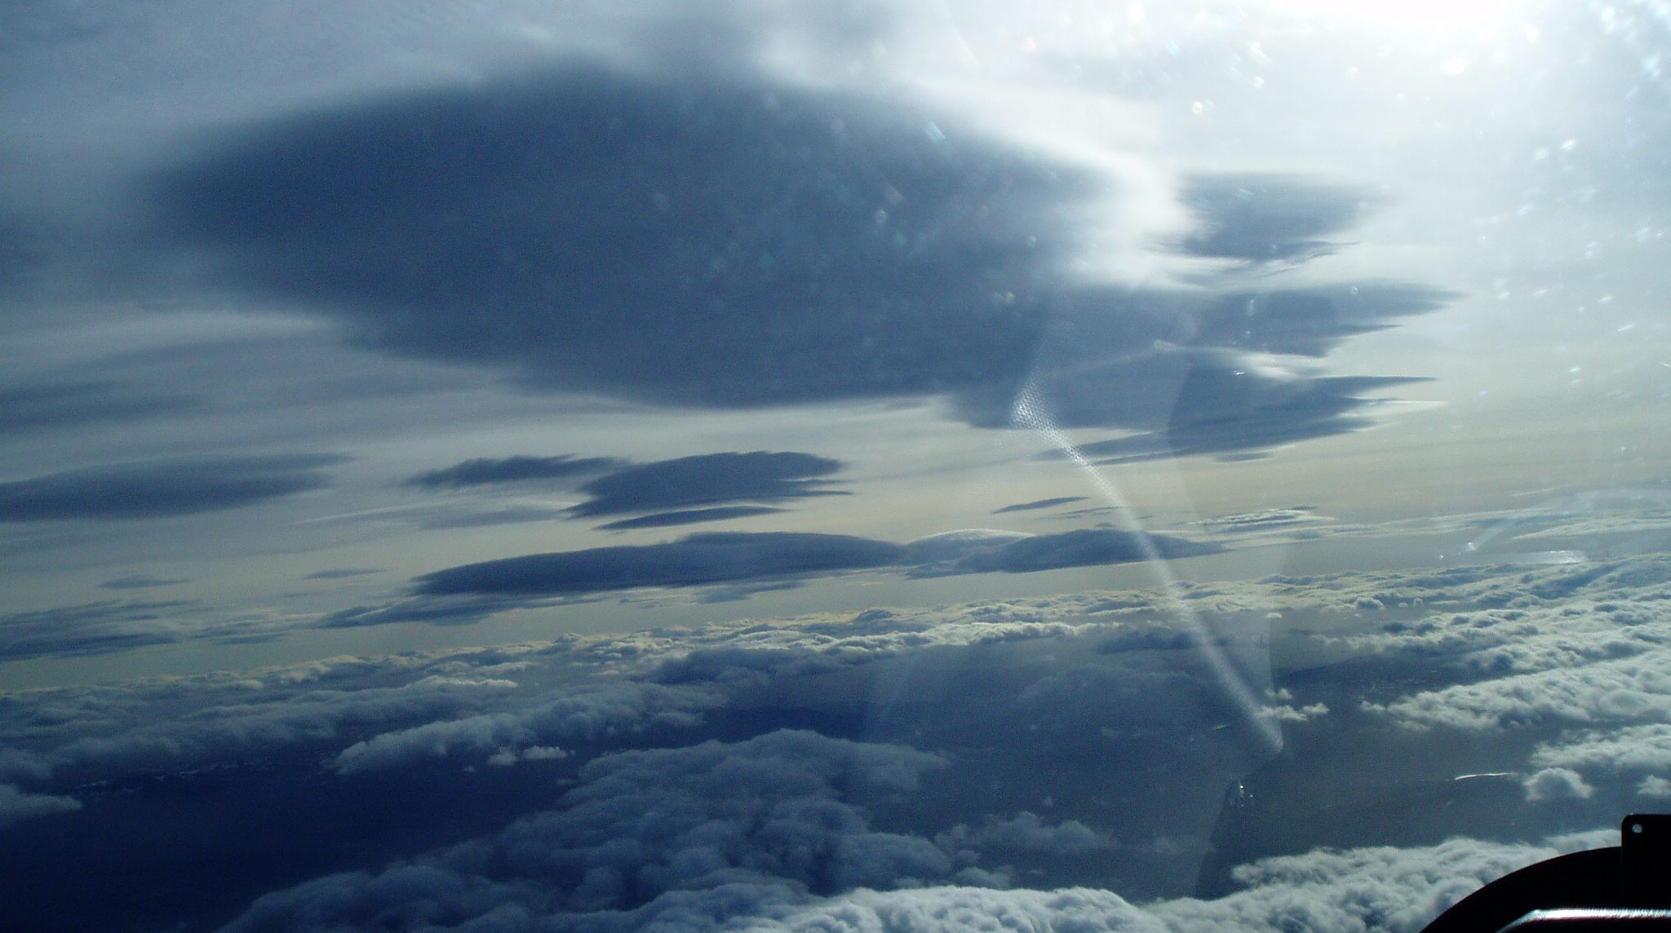
International
Standard
Atmosphere
15°C
Environmental
Lapse Rate
1.98°C
Per
1000’
Sea level Pressure
1013.25hpa
Wind Direction
Flying high makes sense where:-
1 W/V not increasing with height
2 Lift is constant with height
3 Need reach next line of lift,
read the sky ahead
or avoid/fly over cloud
4 You can start high and stay high
Flight Level ISA temp. IAS/TAS
Sea level +15°C 90kts/90kts
FL50 +5°C 90kts/96kts (6.66%)
FL100 -5°C 90kts/105kts (16.7%)
FL150 -15°C 90kts/113kts (25.5%)
FL200 -20°C 90kts/124kts (37.8%)
Discus 1bT best L/D with water :
1:43 @ 68kts/ 126kph
05 04 17
IAS/TAS
Relationship
Notes:
Nick Norman IAS/TAS relationship question
This photo max alt gained was 13400’ to get round HEU. Lift was only 6kts average Task speed 135.1kph
Did not need it on the way back as the lower wave was so well marked
Balance of time it takes to get to altitude verses speed differential.
Normally wv increases with altitude:

Slide 3
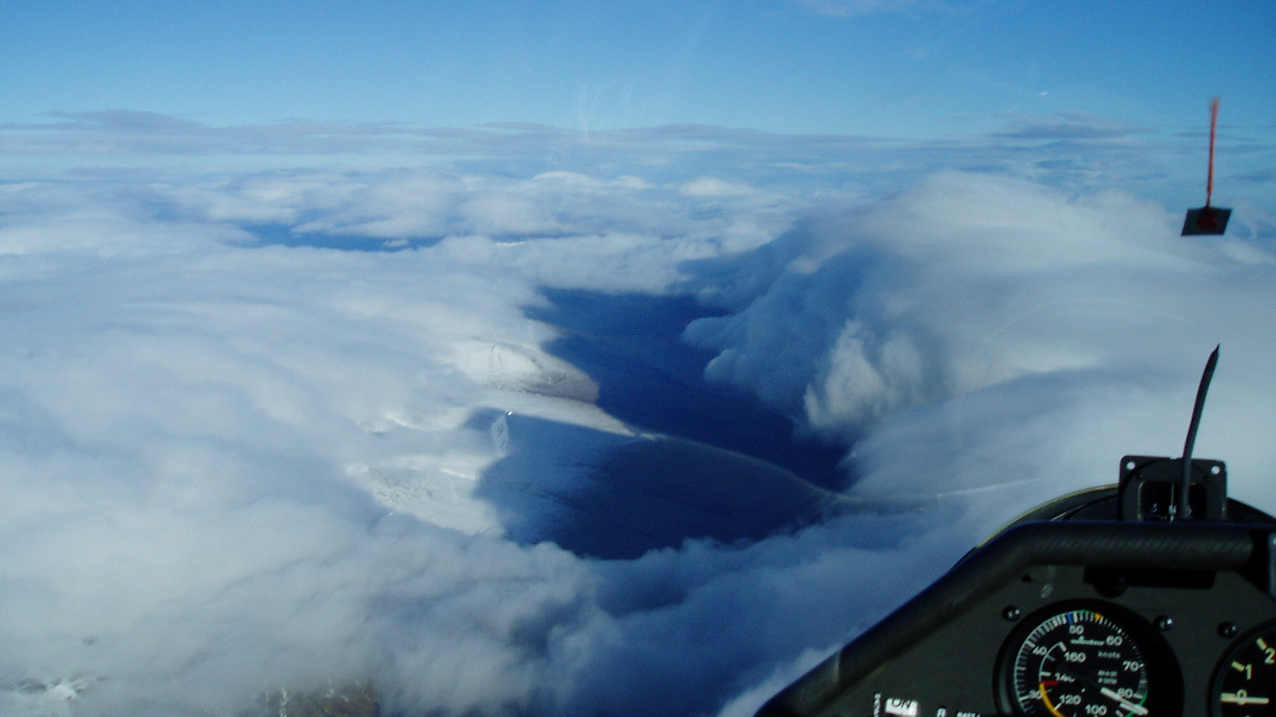
Basic Rules
:The most Important rule: Don’t stop –Keep going!!
:Aim to be at a sufficient height to jump when you need to.
:With that in mind slow down in strong lift, fly fast in moderate lift & fly “McCready” in sink.
-Into wind Faster/ Down wind slower.-
:ALWAYS have an escape route.
Wind Direction
Notes:
Basic rules
Basic rules of flying fast
85kts /zero sink
Actually too high.
Describe how you would fly it

Slide 4
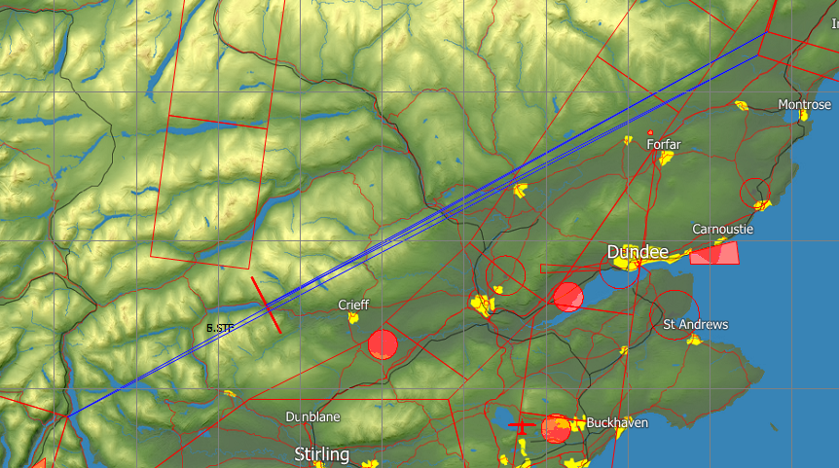
08 01 19: STF-EDZ-LLT-FET-STF
Planning the Task: “Useable wave pattern”
Notes:
Usable wave pattern
The two hot spots; L.Tay and Edzell area
The conjunction of the “Loch Tay Arc” and the potential difference in wave orientation around Loch Lomond

Slide 5
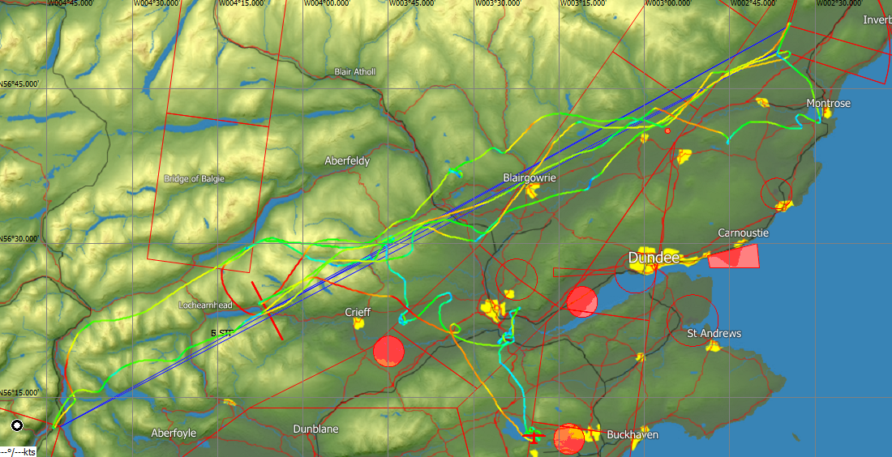
08 01 19: STF-EDZ-LLT-FET-STF
506.5Km@137.6kph/140.4kph HC
Won the Frank Foster Trophy
& Manio Cup 2019
Notes:
5.
Speed trace

Slide 6
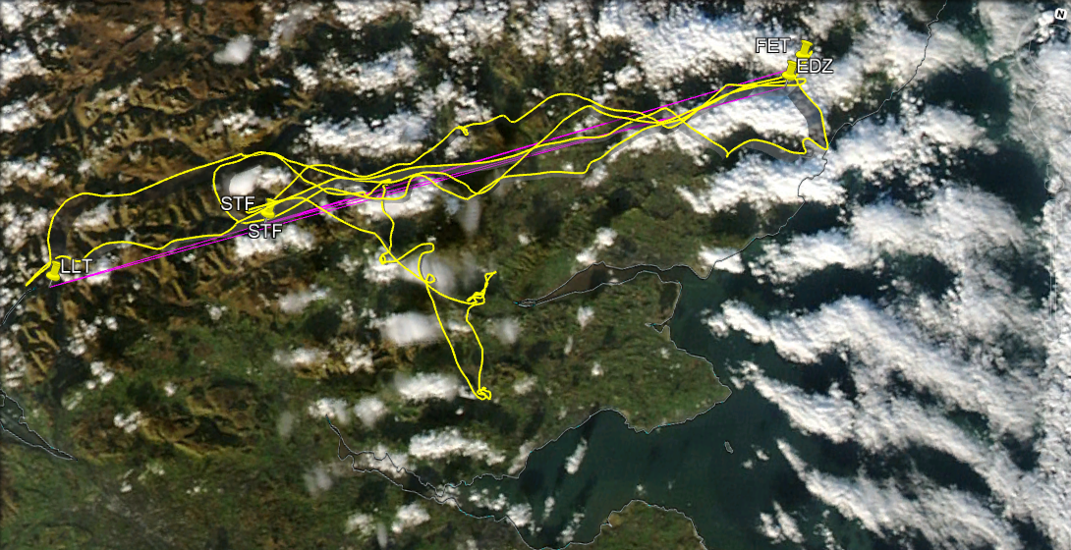
Notes:
Hotspots
The hotspots Loch Tay & Edzell
Tie it in with the previous slide

Slide 7
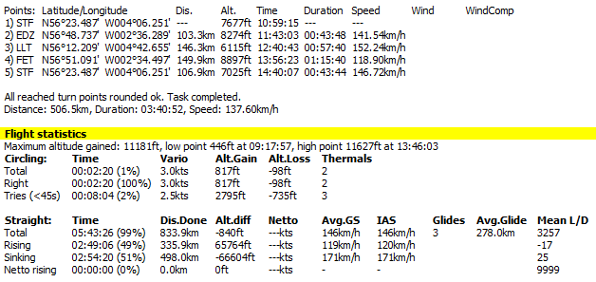


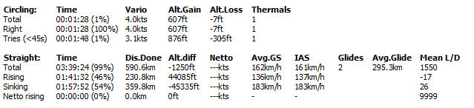

Leg Speeds
Effect of not turning
120kph = 2km per min
Every 30 sec turn cost 1kph per hour
off Task speed
Potential Task speed = 139.53kph
Actual Task speed was 137.6kph
Circling times
1.4% total
3min 16sec total
Total
Rising
Sinking
Glide Angles
& Speed
Notes:
Task statistics
These figure are to be treated with caution : too simplistic
Does not take into accounting doing beats

Slide 8
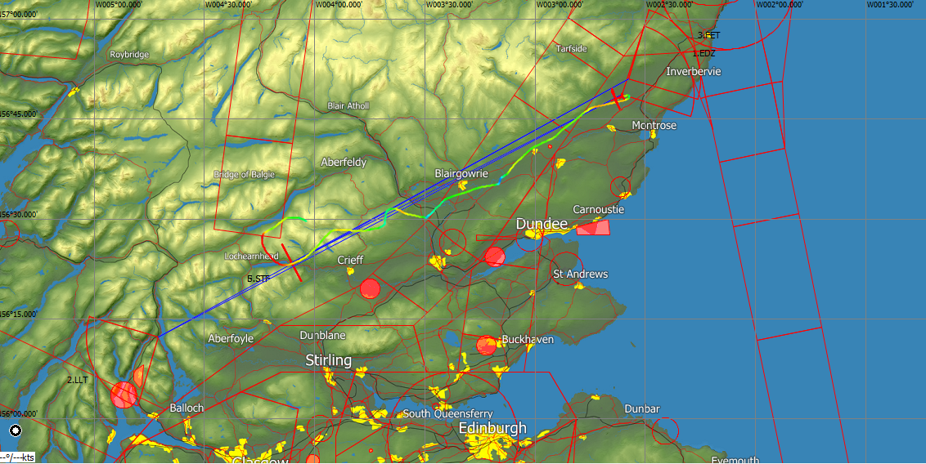
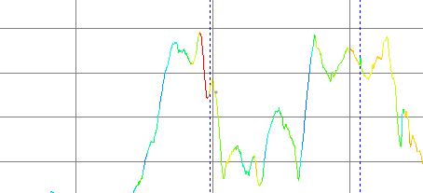
Leg 1:STF-EDZ:103.4km@141.54kph
5
6
7
4
2
3
TP1
8274’
1
High point Low Point
1 2
8838’
Start
7677’
7218’
8563’
Max Alt
7834’’
Max Climb Rate 8kts
11.2kts
8kts
9,000’
St. Fillans10:59L Start Line
Edzell11:43L
Turn point
8,000’
1
2
3
4
5
6
7
7,000’
10:20L
11:00L
11:40L
6,000’
5,000’
Tay Gap
Notes:
Leg 1 STF-EDZ
Climb after start along wave bar; dive to Methven; climb SE of Blairgowrie dive to Edzell bar making sure that I’m below FL85 and then a run into Edzell TP
Well worth studying at your leisure

Slide 9
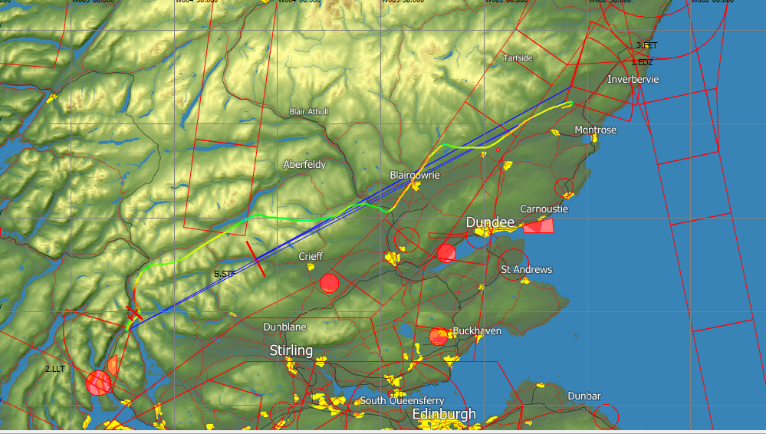
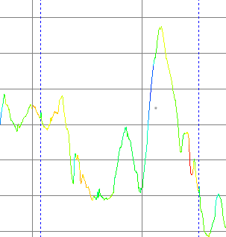
Leg 2: EDZ-LLT:146.3km @152.24kph
3
2
1
8
7
6
5
4
TP1
8274’
11.0kts
8829’
8796’
8796’
10744’
31.8kts
“Zoom”
9.0kts
11.0kts
TP2
6115’
11,000’
Edzell
11:43L
Loch Lomond Tarbet
12:40L
10,000’
1
3
4
5
6
9,000’
2
8,000’
7,000’
6,000’
7
8
5,000’
11:40L
Tay Gap
12:20L
5,000’
Notes:
Leg 2 EDZ- LLT
Dash along Edzell bar; dive to join the Blairgowrie bar, a Zoom climb a quick dash and then a bit of a trickle across the Tay Gap to join a bar N of the Methven bar; dive to join the Loch Tay bar. Looking blue to the SW. Therefore a dash to a cloud SW of Crianlarech and a dash downwind to LLT passing a bar on the way south.
We will now look at some photos of this leg

Slide 10
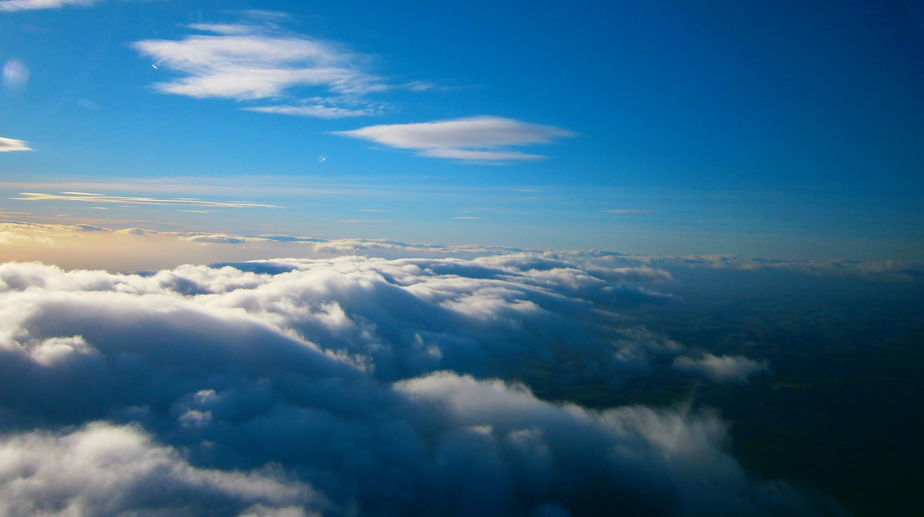
Notes:
Wave bar at Edzell
Wave bar coming out of Edzell. Strong bits are the puffy bits ahead of the main bar

Slide 11
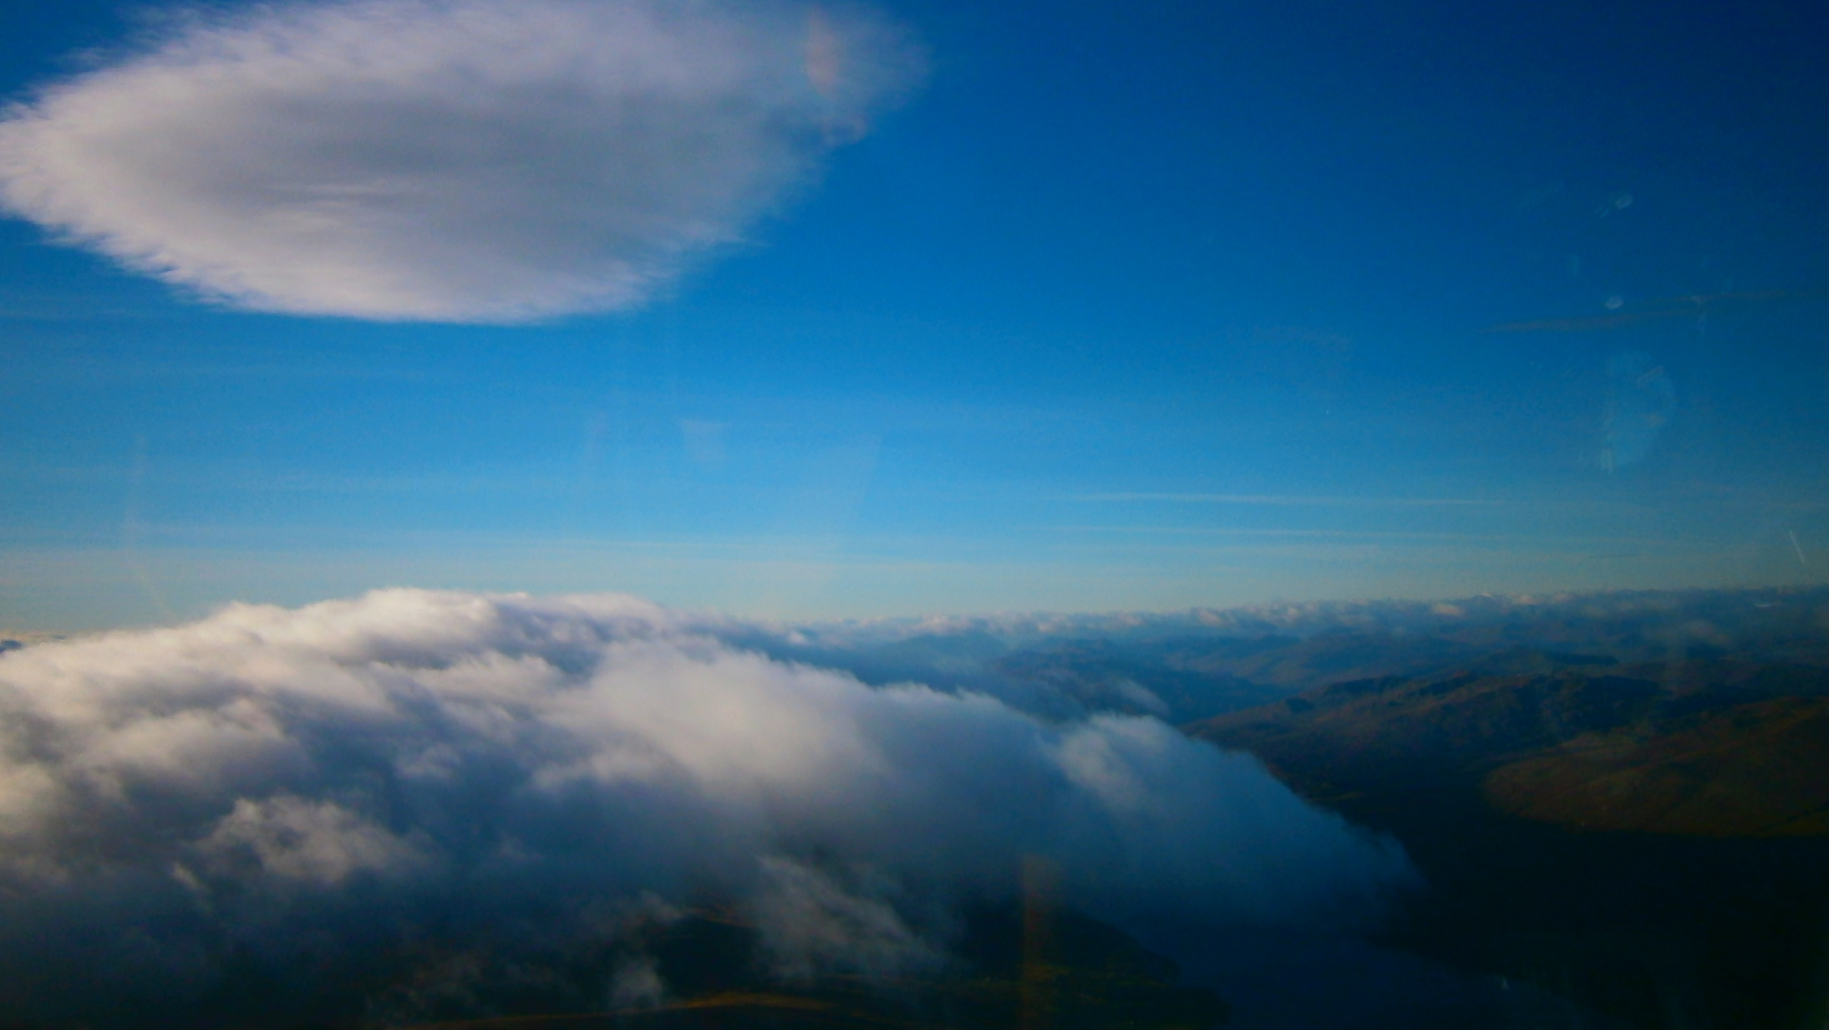
Notes:
Loch Tay hot spot
Looking for the good bit

Slide 12
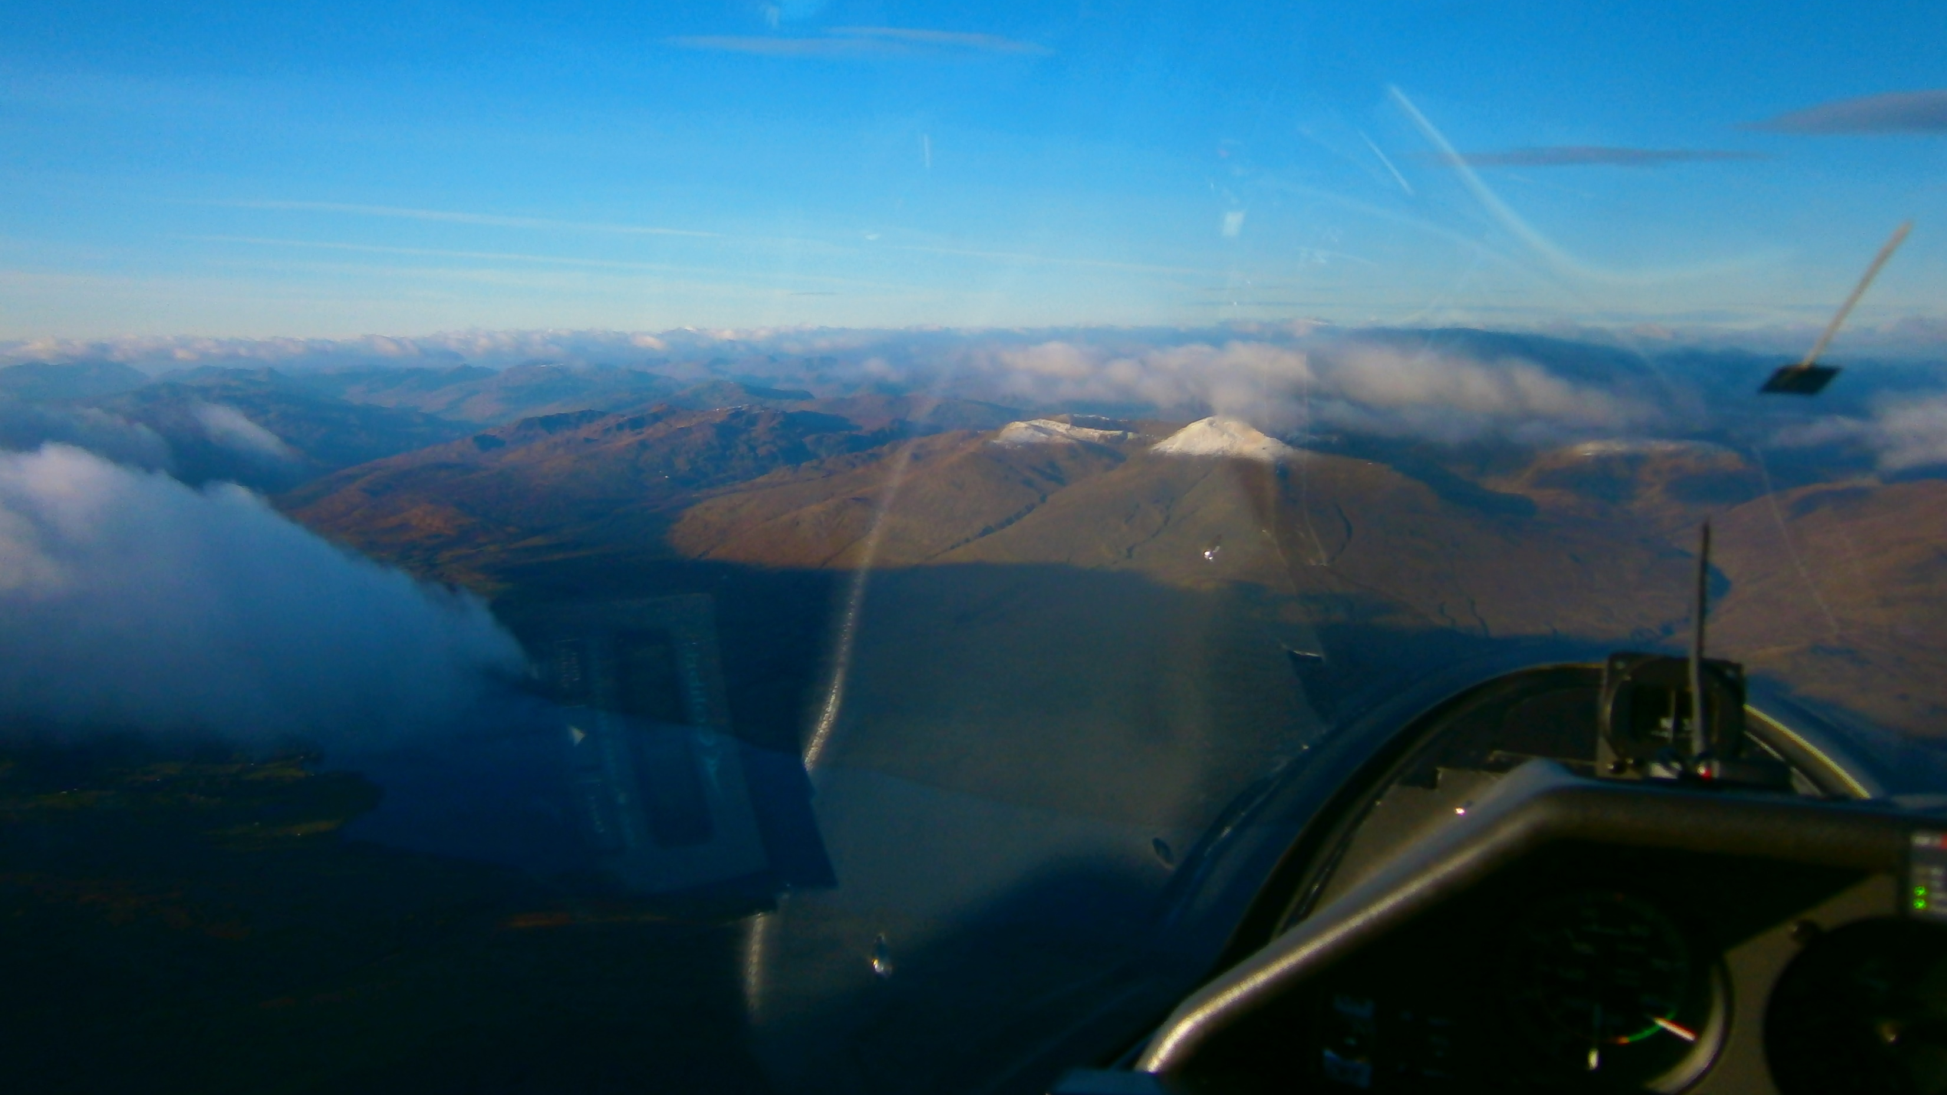
105kts
Notes:
Loch Tay hotspot 2
Cruise climbing along Loch Tay bar waiting for the really good lift.
Looking at the cloud shadow on Ben laws make it a privilege to be flying.

Slide 13
Notes:
Sat Phot 13
Description about flying fast along a wave bar

Slide 14
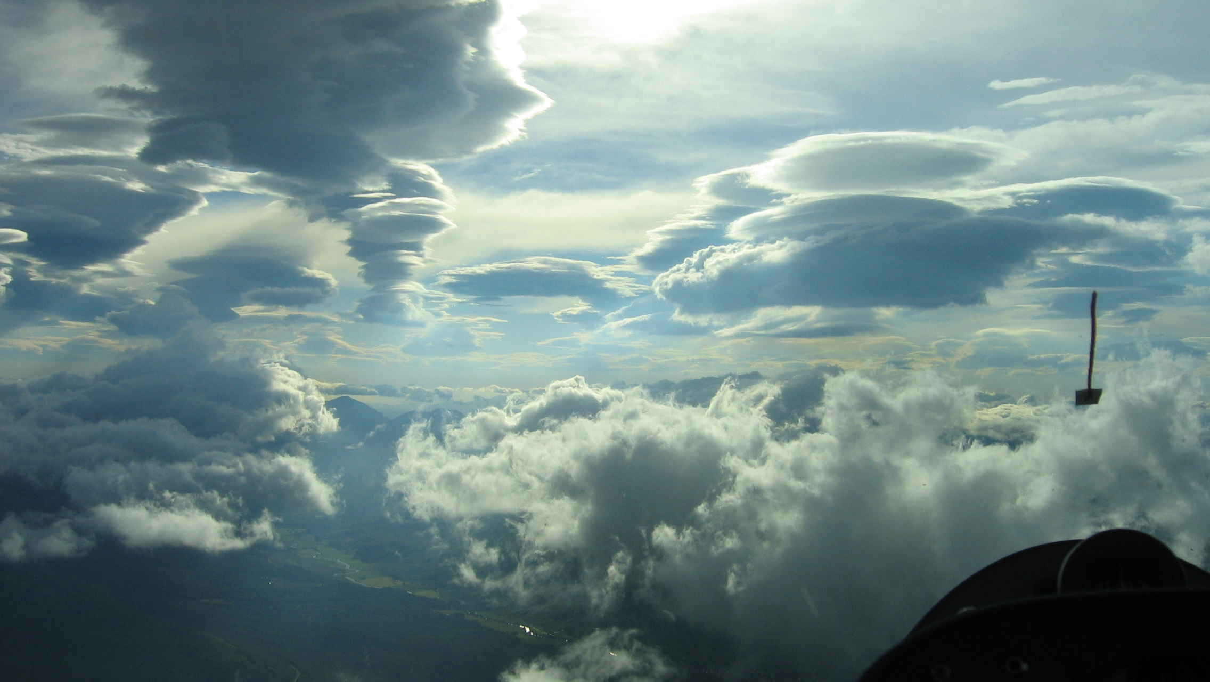
My favourite picture: John Williams at Loch Tay
We will now look at a video of how to fly along a wave bar
John’s flight of the 20th February 2017
Notes:
JDW flying along a wave bar
North of the Scottish TMA under airway P600 sector A which has a base of FL55.
The small puffy clouds on the left are good indicators of strong lift
Flying along at 110 knots and the speed slowly increases as the lift increase.
John clears the Airway south of Comrie ; waits until he gets around 10kts and the brings the speed back to get max climb rate

Slide 15
Notes:
Sat Phot 15
Description of getting away from LLT

Slide 16
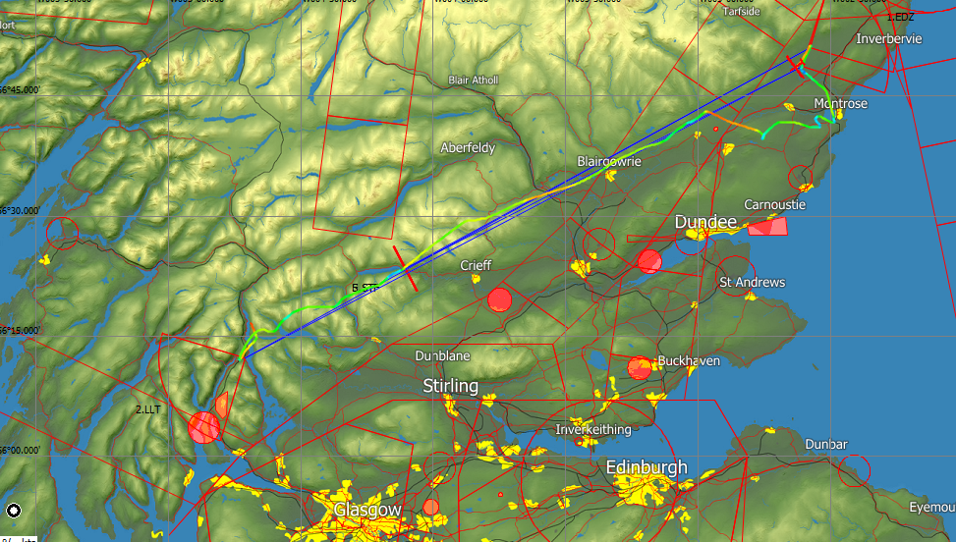
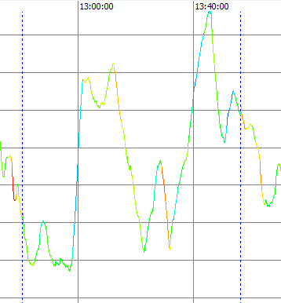
7
Leg 3:LLT-FET149.9km
@118.9kph
6
7
TP3
8897’
5
1
2
3
4
7516’
8
9507’
10
TP2
6115’
9862’
10,256’
15.2kts
11.7kts
9
6043’
11,627’
18.0kts
1
11.9kts
11,000’
LLT 12:40
Fetterciarn
13.56
10,000’
9,000’
1
2
3
4
5
6
7
8
9
8,000’
7,000’
6,000’
5,000’
10
4,000’
13:00L
Tay Gap
13:40L
Notes:
Leg 3 LLT-FET Part 1
Description of dive out of LLT to the wave cloud that I had passed on the way down
Marginal situation as I bumped along trying to get to the Loch Earn wavebar
Constantly assessing my escape routes in case it went wrong

Slide 17
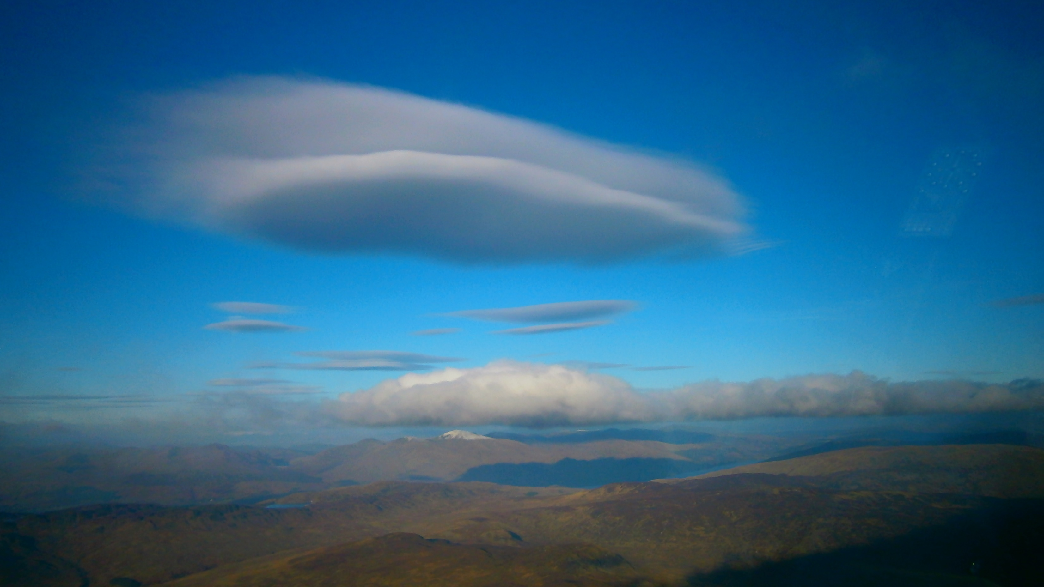
Notes:
Loch Tay bar
Approaching St. Fillans; looking upwind at the Loch Tay bar. I know its going to be good at St. Fillans

Slide 18
7
Leg 3:LLT-FET149.9km
@118.9kph
6
7
TP3
8897’
5
1
2
3
4
7516’
8
9507’
10
TP2
6115’
9862’
10,256’
15.2kts
11.7kts
9
6043’
11,627’
The Fettercairn jump cost about 21min. Leg speed should have
been approx 165-170kph & resultant Task Speed around 152kph.
18.0kts
1
11.9kts
11,000’
LLT 12:40
Fetterciarn
13.56
10,000’
9,000’
1
2
3
4
5
6
7
8
9
8,000’
7,000’
6,000’
5,000’
10
4,000’
13:00L
Tay Gap
13:40L
Notes:
Leg 3 LLT-FET Part 2
A very good cruise climb at St,. Fillans and then a dash along the wave followed by a dive to the wave bar to the east of Blairgowrie.
Climbed and at this point looking ahead it was obvious that I could not get over the wavebar without infringing airspace and so HAD to take a detour south. Climbed at Montrose to get over the cloud, dive and take another climb-detour to avoid cloud and get into FET with a decent escape route.

Slide 19
Notes:
Sat Phot 19
Discuss the issues going into FET.

Slide 20
My favourite picture again:
Lets now look at a video of how to jump to a wave bar
20th February 2017
Notes:
JDW crossing a wave bar.
Further up the Loch Earn valley south of N560 airway in clear airspace
Going for the gap between the cloud tops
A bit bumpy as the is transiting the wave gap
Only slowing down when really into the lift and then zoom long the wave bar
It’s a fantastic feeling.
Discus with lower performance would have to be higher height loss margins ‘cos it transits a lower speed.
This is where performance really counts The discus is limited because of the of drag curve to120 -125 kts max
Icing issues?

Slide 21
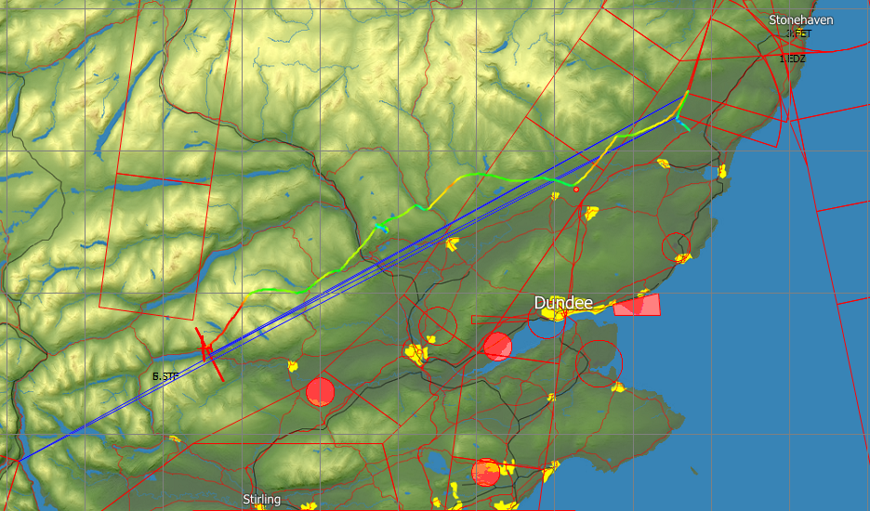
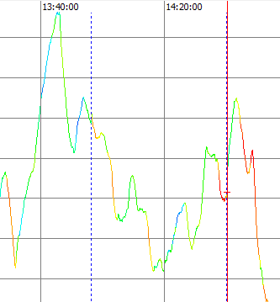
Leg4:FET-STF:106.9km
@146.72kph
TP3
8897’
2
1
3
7.5kts
5
6
8796’
4
16.5kts
TP4
7025’
8796’
13.3kts
8090’
\
FET 13.56
11,000’
\\\\\\\\\\\\\\\\\\\\\\
St. Fillans 14:40
10,000’
9,000’
1
2
3
4
5
6
8,000’
7,000’
6,000’
13:40L
5,000’
4,000’
14:20L
Tay Gap
Notes:
Leg 4 FET-
Good exit out of FET onto the inbound wave bar. Dive to join a wave bar N e of Blairgowrie. All getting a bit marginal. Easy escape rote to S. Have to take a poor-ish climb NE of Dunkeld to get across the Tay gap. Then a join onto the Amulree bar and a join onto the St Fillans bar. Final dash and Bobs your uncle

Slide 22
Notes:
The bit that slowed me down.

Slide 23
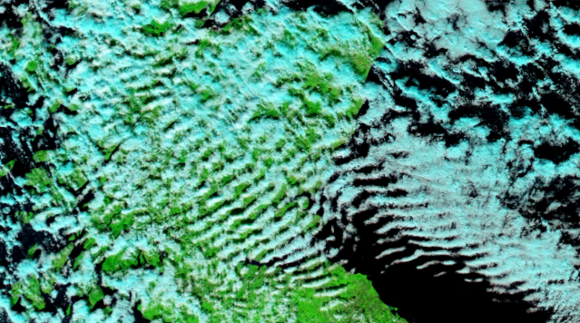
Part 1: Overview
-Our playground
-Setting boundaries
Part 2: Aircraft performance
-Interpreting Met.
Part 3: Airspace
-Task setting
Part 4: Flying the Task
HGC
& Fulmar
DGC
CGC
Summary:
SGU
DGGC
Notes:
Conclusion 1
Mention the clubs
Overview of the talks
Mention the revived landout database in setting boundaries

Slide 24
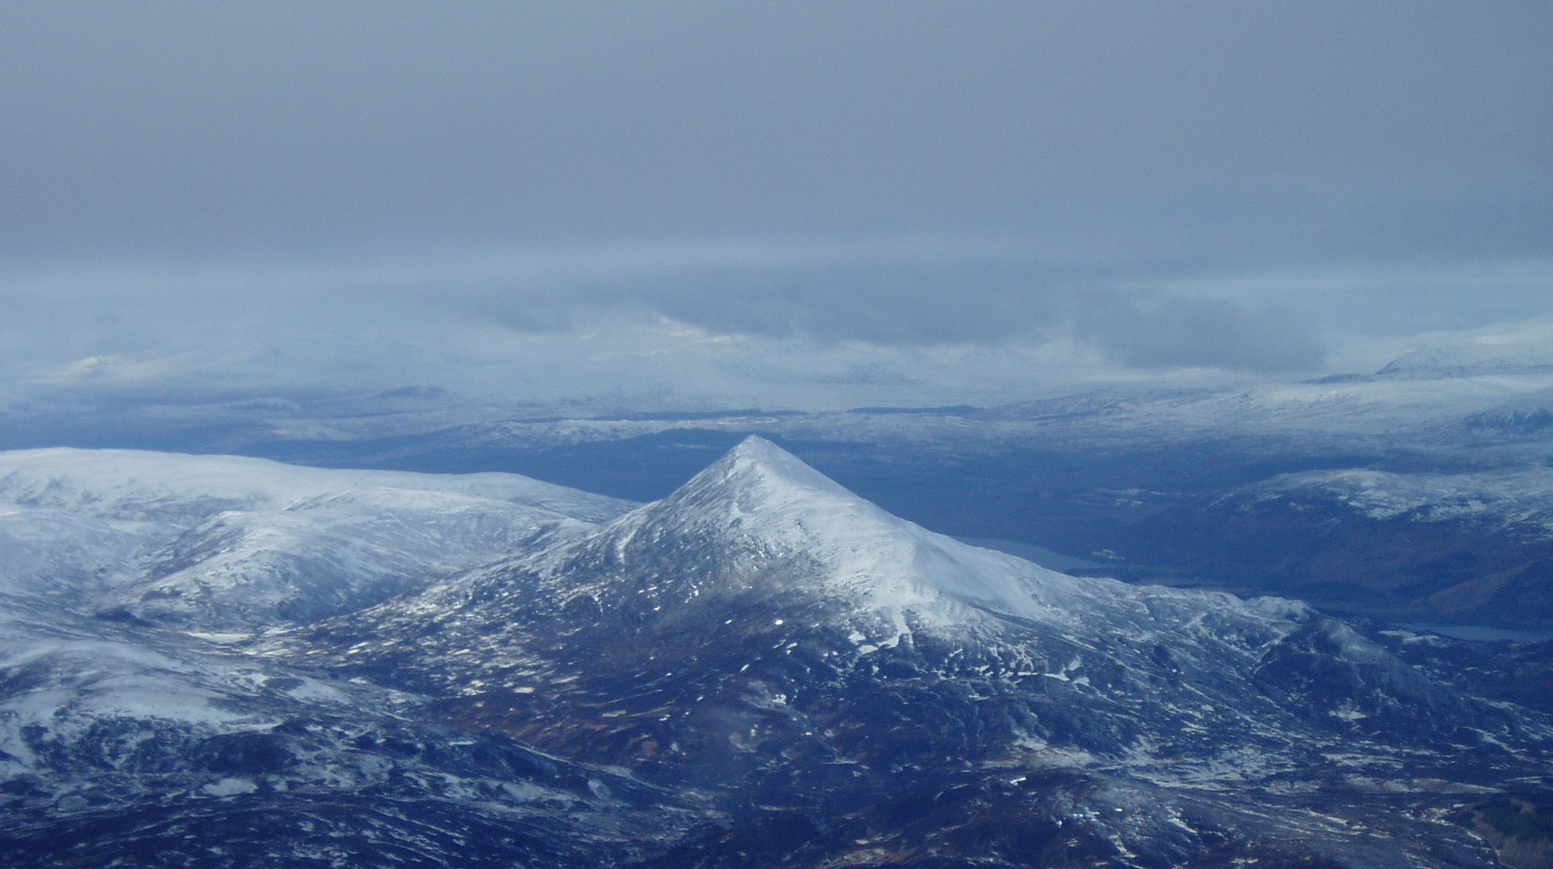
End of
“Flying wave in Scotland
Fast & Far -”
Any questions?
Notes:
Conclusion 2

