Slide 1
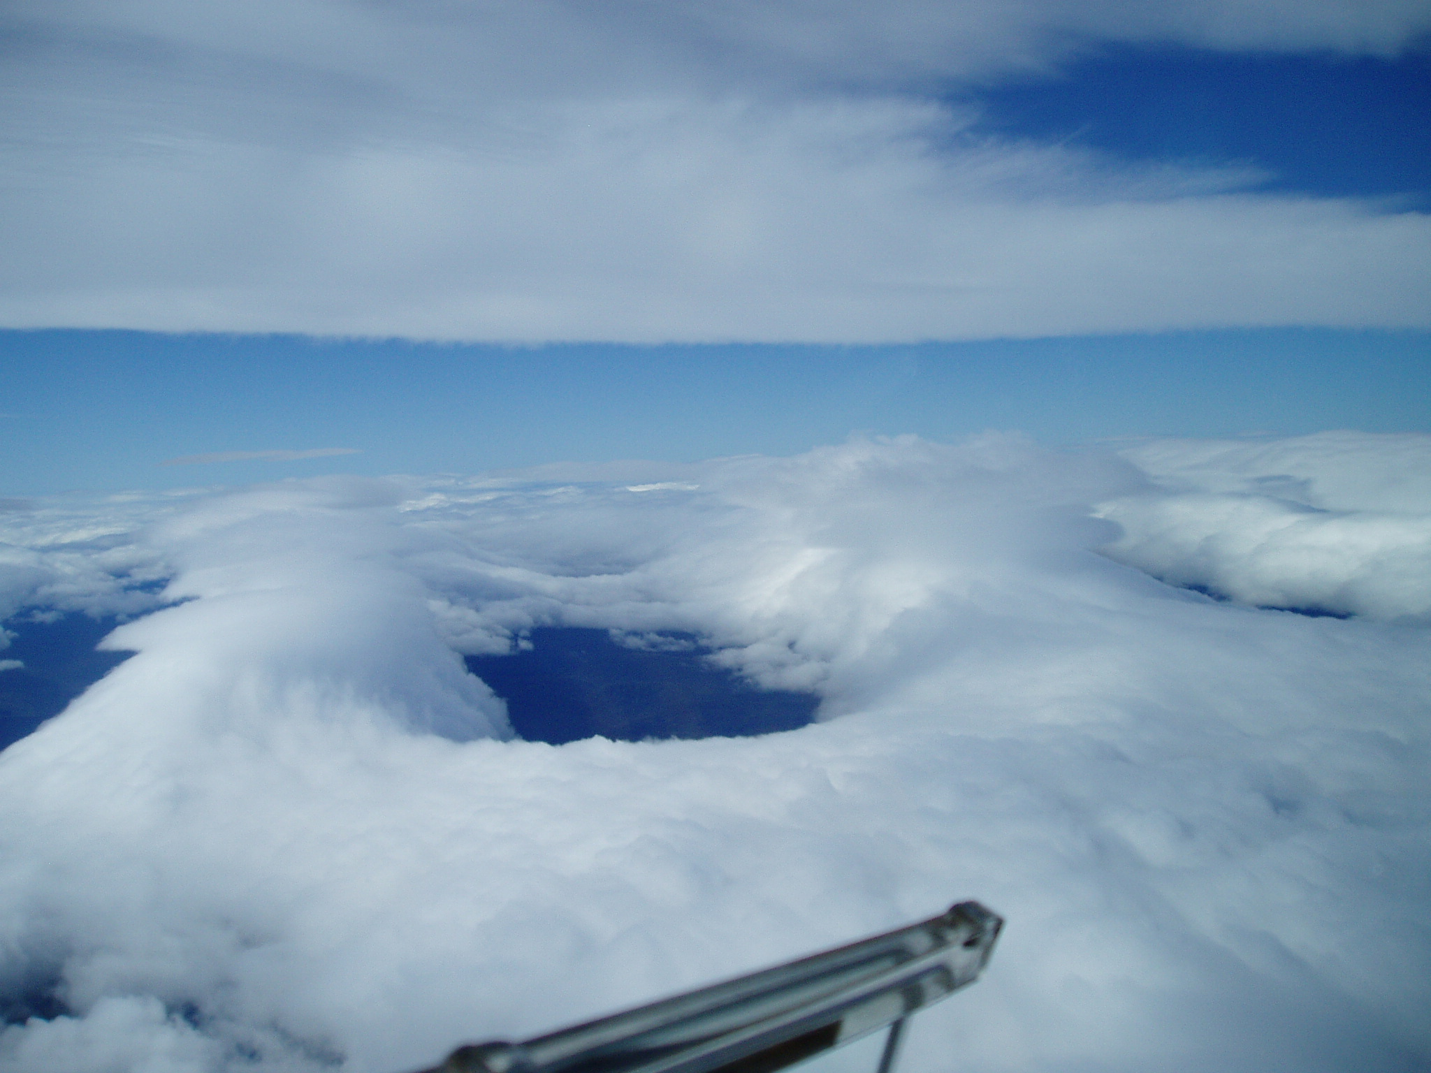
Wind Direction
Recap: Performance & Met.
Jumping upwind : “Bridges”
Flying Wave in Scotland
- Fast & Far-
Part 3
Airspace & Task Setting
Notes:
Slide 1
Recap: Performance & use of met
Use of bridges

Slide 2
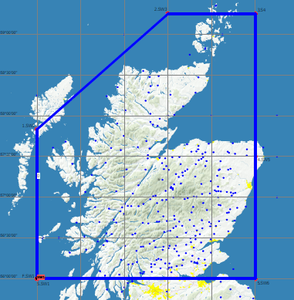
Airspace: FL100 Notam
FL 100 NSGA Exemptions
(Notified Non SSR Glider Area)
“TEZ”
Must, however, remain clear of Controlled Airspace
SW Wind
Example
Notes:
Slide2.
Allows you to fly non radio above FL100 whilst remaining clear of controlled airspace.
Must be requested by 1500 the day before.

Slide 3
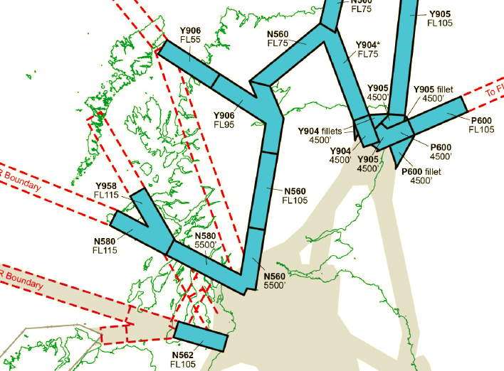
N560
Scottish Class E+
Airspace
Southern sector of N560 is activated
by notam
Notes:
Slide 3
Class E+ replaces Class F airspace

Slide 4
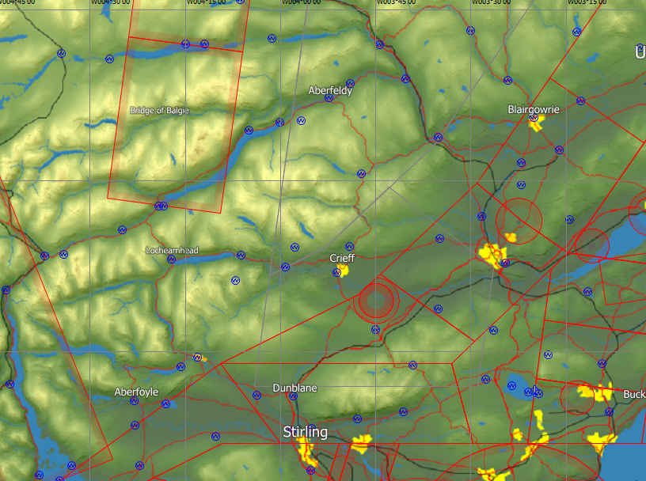
Crossing N560
Non transponder & Transponder equipped
Class E+ Airspace
N560
(FL125)
VFR traffic does not require clearance to enter class E airspace but must comply with ATC instructions.
FL
55
C/A-P-A-C-R
Notes:
Slide 4.
Airway drops as it goes further north
Non transponder aircraft must be in radio contact
VFR traffic does not require clearance to enter class E airspace but must comply with ATC instructions.
Transponder Aircraft:
Do not need to be in radio contact

Slide 5
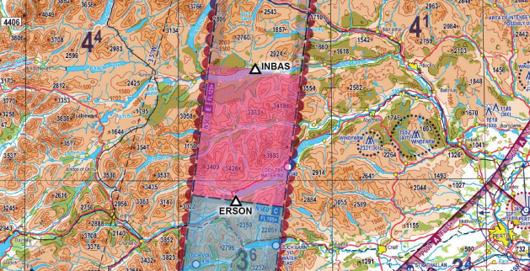
:Glider SC
:10miles SE of INBAS
:Currently FL140
:V M C
:Intend to cross N560 East to West not above FL150 not before time 12.50
Callsign/Aircraft
Position
Altitude
Conditions
Estimates/Requests
C:A:P:A:C:E:R
Crossing N560
Radio Call Example
Transponder Equipped?
This section
Activated by Notam only
Notes:
Crossing N560
Given as a flight level
Use a ATC waypoint
Reciprocal of Go/To
300/120. Better to use South East
Direction of travel , Max FL & time

Slide 6
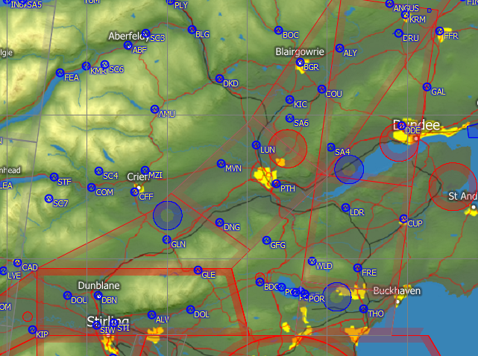
P600 Weekend
Delegation Area
Notes:
Slide 5
Note : increased size of Strathallan parachute zone

Slide 7
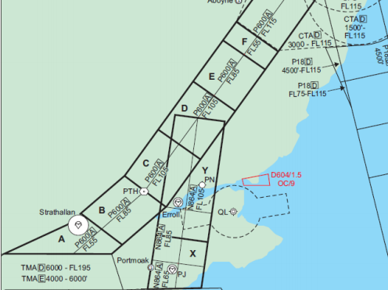
Airways around Portmoak:
P600 & N864
Notes:
Slide 6
N864
Describe Sectors
Letter of agreement for pre arranged crossing of airway non transponder
Transponder equipped can (if we don’t abuse it) get an ad hoc crossing clearance

Slide 8
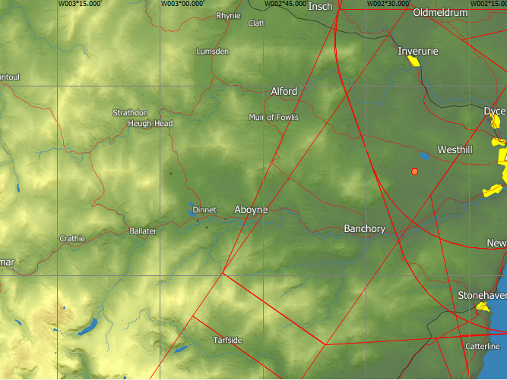
Aboyne Airspace
3000’ -FL115
Class D
3000 -FL115
FL55 -FL195 Class A
Notes:
Slide 7
Feshibridge only problem is the close proximity of N560

Slide 9
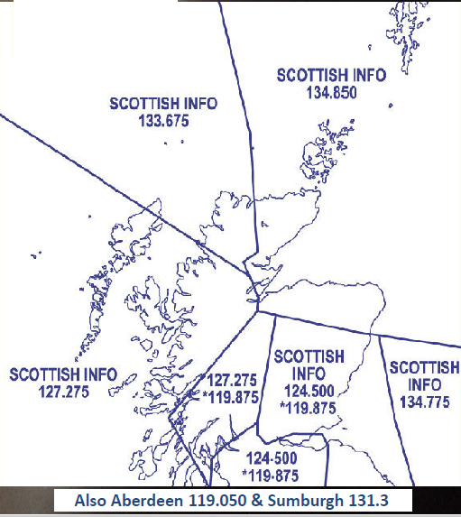
Scottish Info
Radio Frequencies
Notes:
Slide 8
Centre 127.275 is the frequency for crossing N560

Slide 10

Task Setting:
300k’s
500k’s
750k’s & beyond
Notes:
Slide 9.
The two ways of going xcountry
Climb high and glide or low and fast

Slide 11
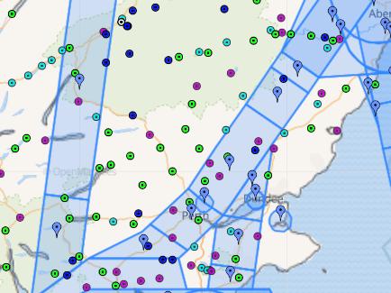
Bill Fuller: Gold C distance
Pegase: 309.5km@67.6kph
08 08 2016
PCS-FET-BDO-FIN-PCS
Notes:
Slide 10
Task planned to remain clear of controlled airspace

Slide 12
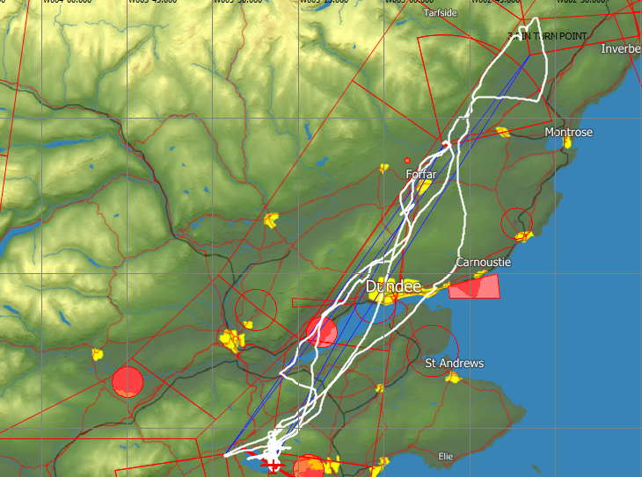
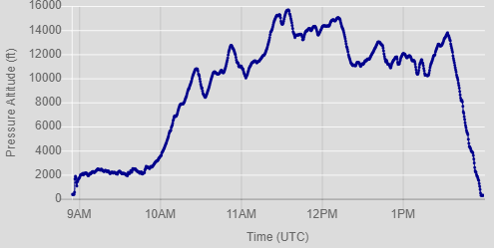
PCS-FET-BDO-FIN-PCS
PCS-FET-BDO-FIN-PCS
Notes:
Slide 11
08 08 16
309.5km@67.6kph
Always clear of controlled airspace

Slide 13
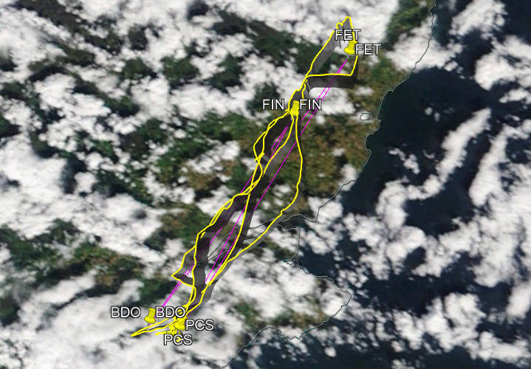
Notes:
Slide 12
Quite a showery day drying out in the lee of the Grampians

Slide 14
Bill Fuller: Diamond Goal
Pegase: 301.3km@70.7kph
07 06 17
PCS-FOD-ABL-PCS
N560 FL55 Activated by
NOTAM only
Notes:
Slide 13
Can be moved westwards to take in account conditions

Slide 15
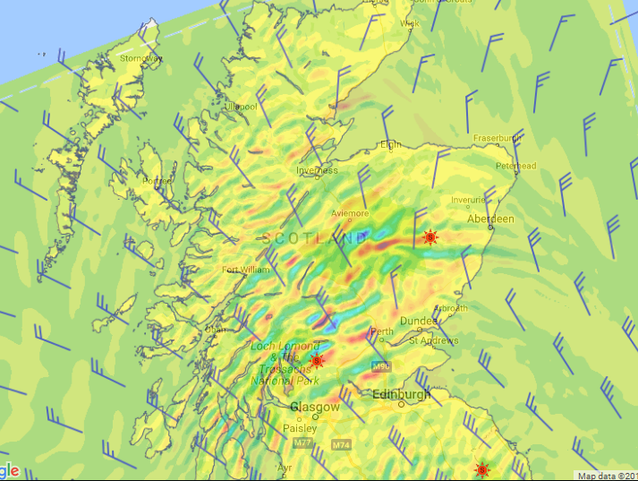
0900L 700hpa
Notes:
Slide 14
0900L 700hpa 07 06 17
Anti cyclonic & cyclonic flow

Slide 16
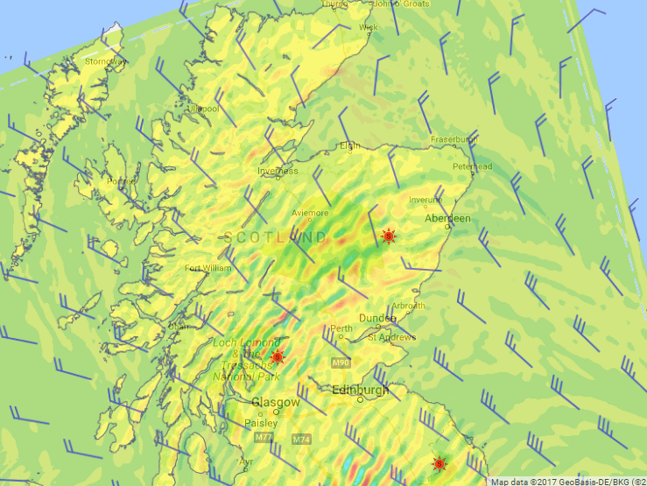
1200L 700hpa
Notes:
Slide 15
Weaker and disappeared by 1500

Slide 17
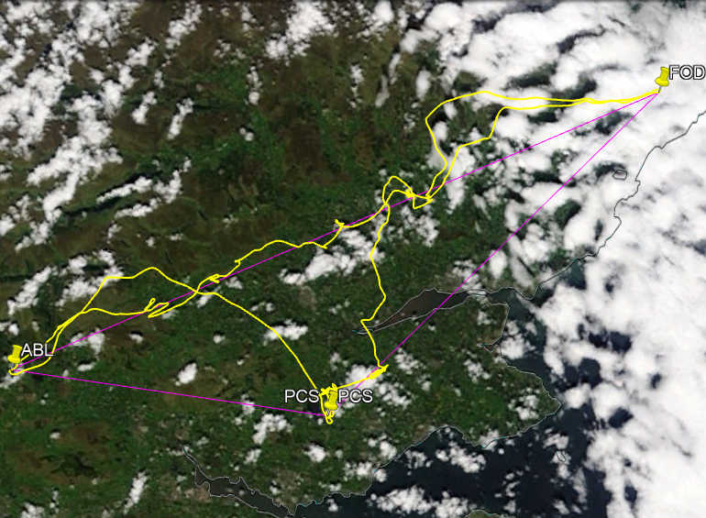

Slide 18
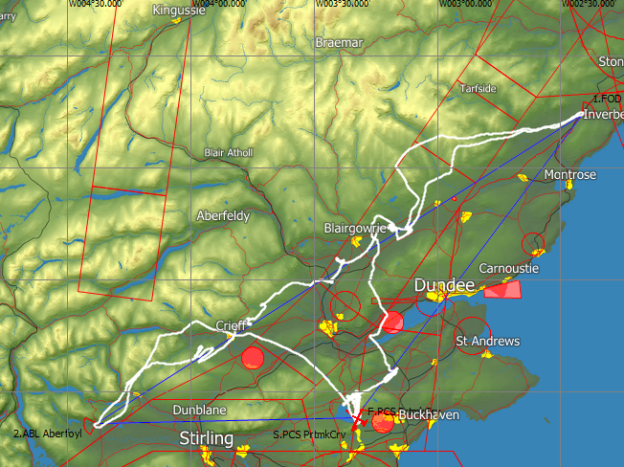
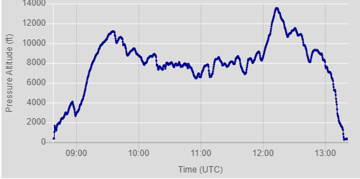
Notes:
Slide 17
7 06 17
PCS-FOD-ABL-PCS (Aberfoyle-FOYLE)
301.3km@70.7kph
Always within gliding distance of Portmoak

Slide 19
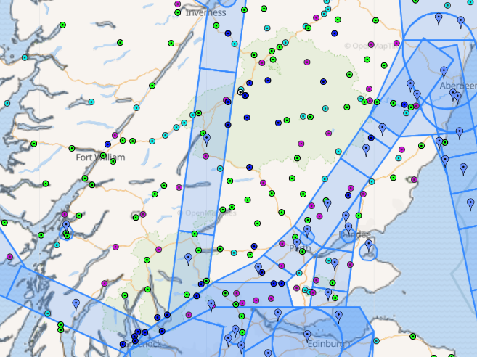
A “Beginners” 500k
PCS-EDZ-LLT-MOS-PCS
Notes:
Slide 18
Have to go into the mountains for anything above 500k
Airspace at N560

Slide 20
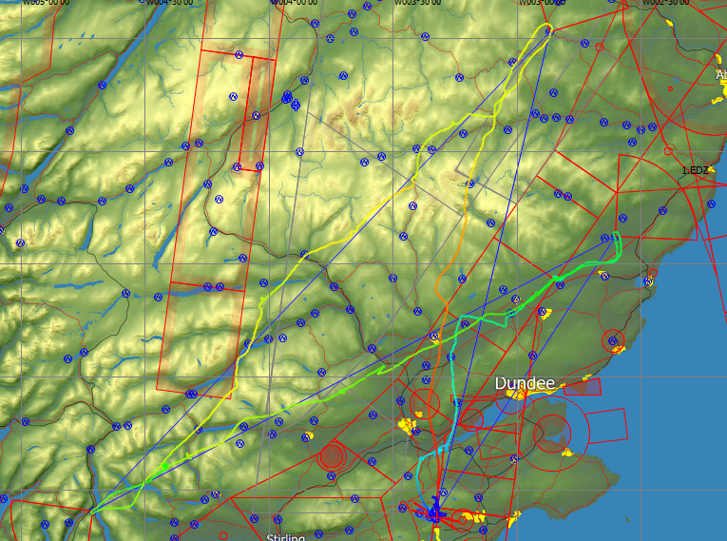
Libelle : 30 08 07
Speed trace
514.3km@95.11kph
Notes:
Slide 19
Shows the speed of each leg

Slide 21
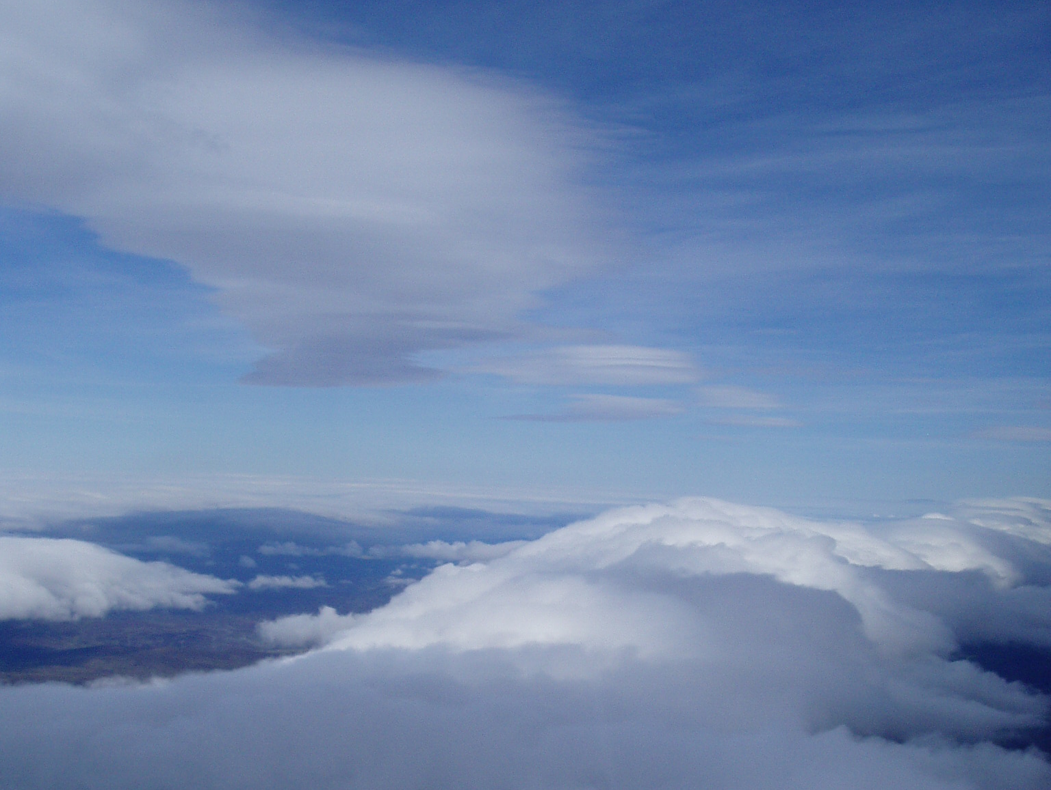
The “Braemar”
Wave System
Notes:
Slide 20
Diamond distance 30 08 07

Slide 22
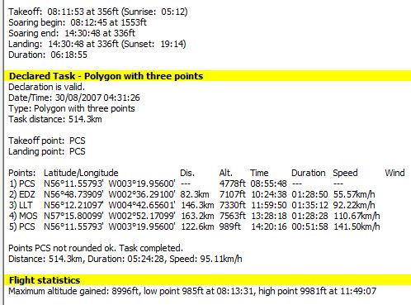
Handicaps:
Libelle 89
Discus 98
Antares 114
Discus61.19
101.55
121.86
155.81
Discus 104.73kph
Antares 121.83kph
Notes:
Slide 21
Speed leg comparisons

Slide 23
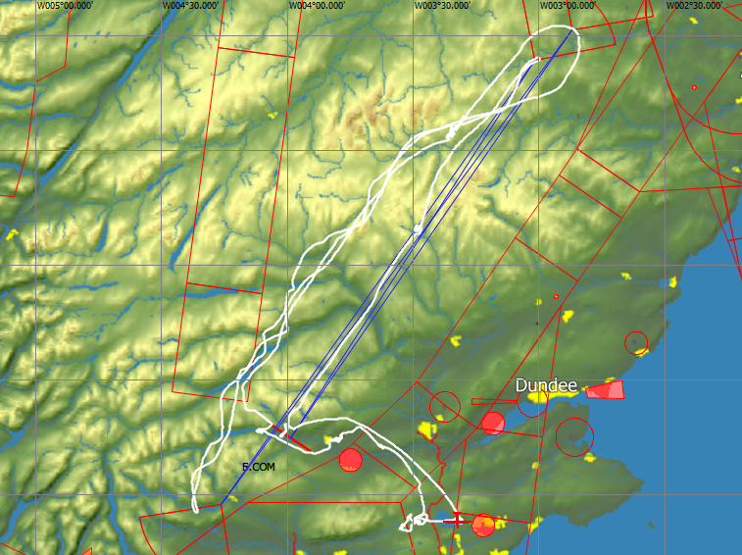
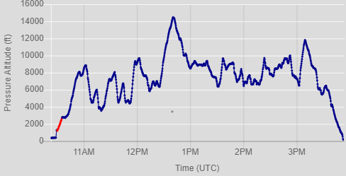
A Fast 500k: 09 03 17: Discus 1bT
504.8km @135.7kph
COM-MOS-LVE-HEU-COM
Notes:
Slide 22
By removing the into wind leg it increases Task Speed.
Triangles require the WV to be below 35-40kts to make them practical in the Discus.

Slide 24
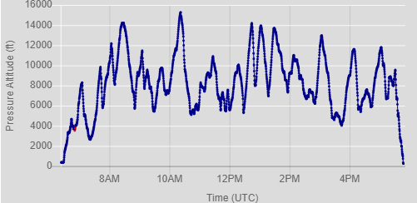
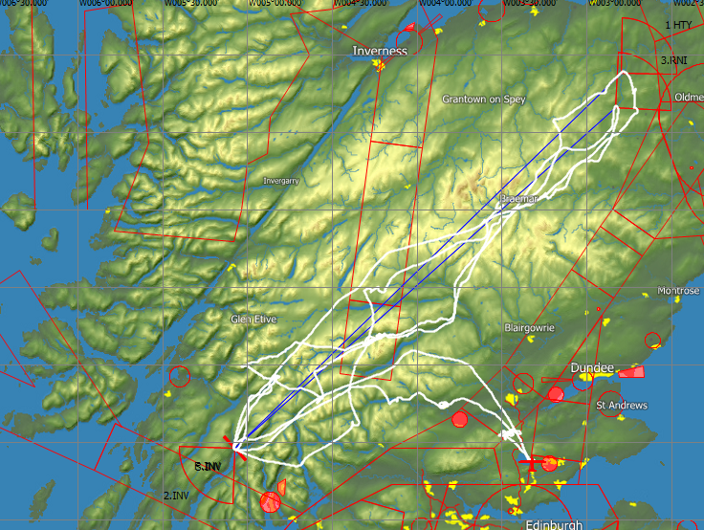
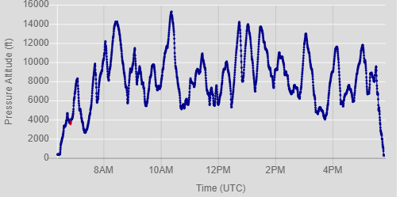
02 10 18: Discus 1bT : 754.6km@90.3kph
INV-HTY-INV-RNI-INV
Notes:
Slide 23.
A stepping stone day. As a result slow.
Fitting the task in.
Total flight time 11.19 and landed one minute after sunset

Slide 25
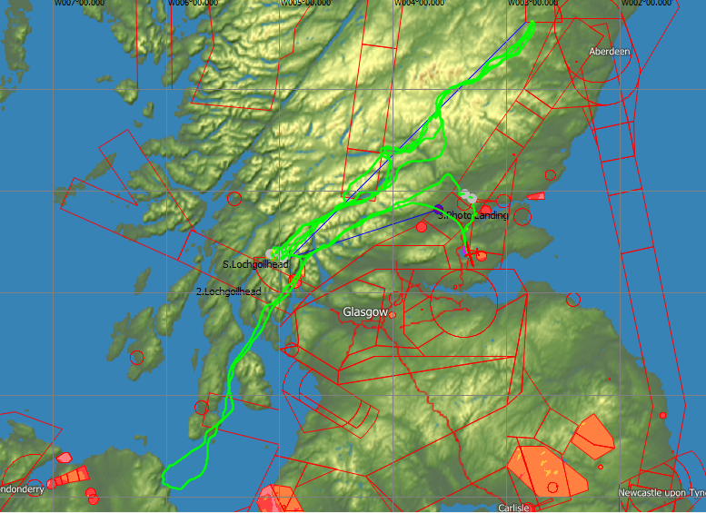
John Williams: Antares 20E
1225.2km OLC@128kph
(722.5km@127.9kph BGA)
Notes:
Slide 24
John , the explorer
As he has a better glider and is more skilled than me his task speed is higher.
In strong winds the Discus begins to suffer.

Slide 26
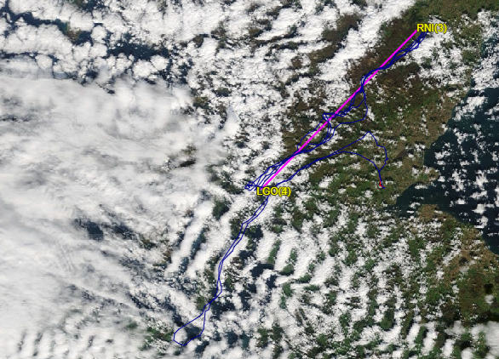
What the day looked like
Notes:
Slide 25
Very wide blue gaps up to the NE

Slide 27
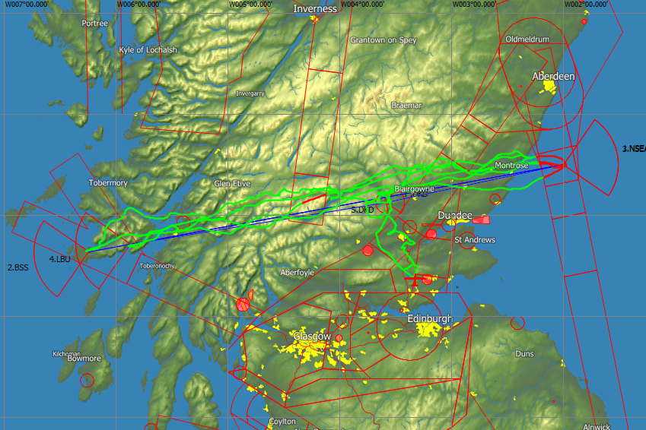
John Williams: 10 09 07
1015.9kM@139.9kph
DKD-NSE1-BSS-NSE1-LBU-DKD
Notes:
Slide 26
DKD DUNKELD-NSE1 NORTH SEA 1-BSS BUNESSAN PIER-NSE1 NORTH SEA 1-LBU LOCHBUIE-DKD DUNKELD

Slide 28
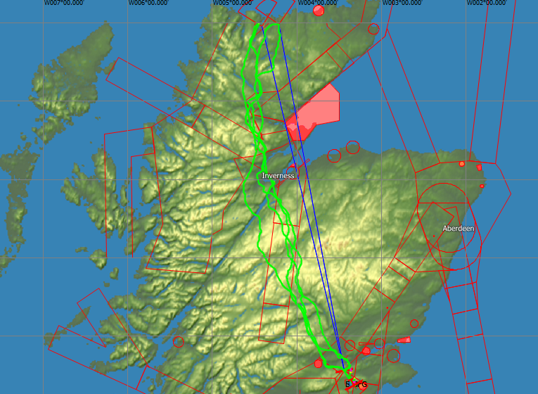
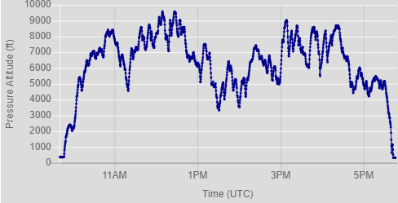
John Williams: 05 07 13
1003.0km@135.12kph
GFG-TOG-GFG-ACN-GFG
Notes:
Slide 27
The whole flight was conducted below 10000’
GFG GLENFARG RESERVOIR E-TOG TONGUE-GFG GLENFARG RESERVOIR E-ACN ACHNABOURIN-GFG GLENFARG RESERVOIR E

Slide 29
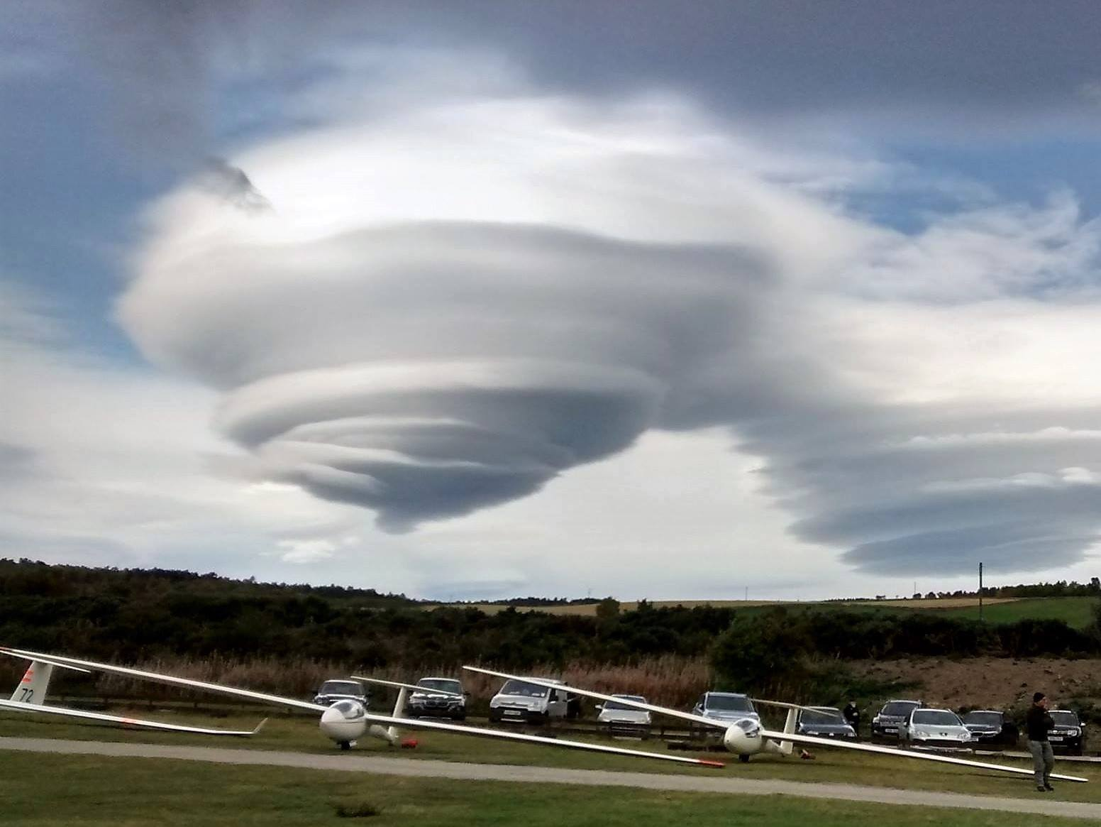
End of Part 3: Any Questions?
Notes:
Aboyne

