Slide 1
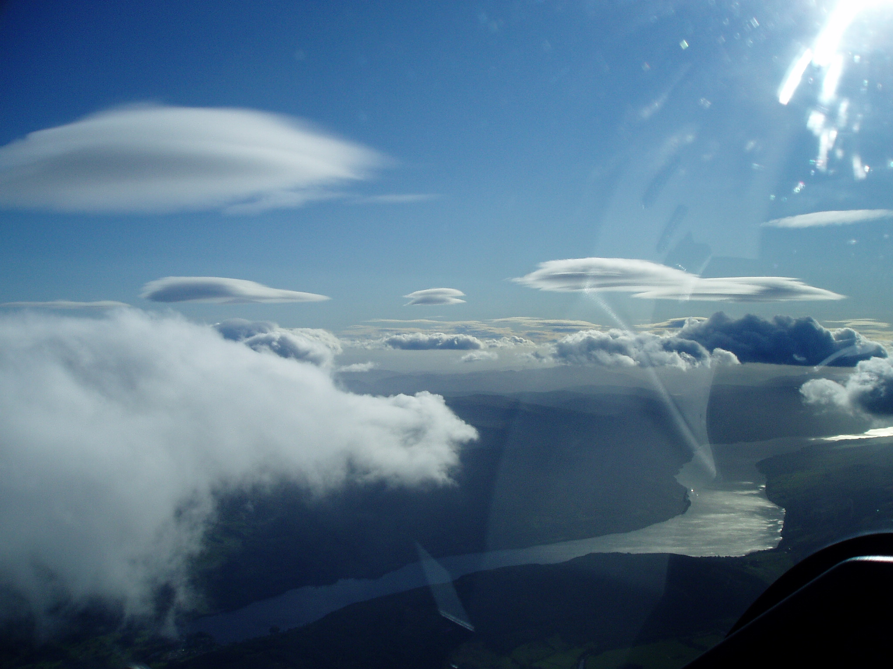
Flying Wave in Scotland
Fast & Far- Part 2
: Recap of Part 1
: Aircraft Performance
: Interpreting Met.
07 10 2011
Notes:
Slide 1
Recap of last week; an overview of out playground in different wind directions
Setting boundaries
Terrain & landout options/Phil Dolan has updated the Aboyne database of the Portmoak area. Will appear on the SGU website soon. Perhaps somebody could do it for Aboyne.
Setting boundaries
Risk management
Handling cloud and descending.
Questions:
Q: Operating height band: 8000’-10,000’
Q: Winch or aerotow: aerotow. Can get it off the ridge but aerotows are quicker to get going.
Text Book wave at Loch Tay looking SW
Actually quite rare conditions.
07 10 2011 592km

Slide 2
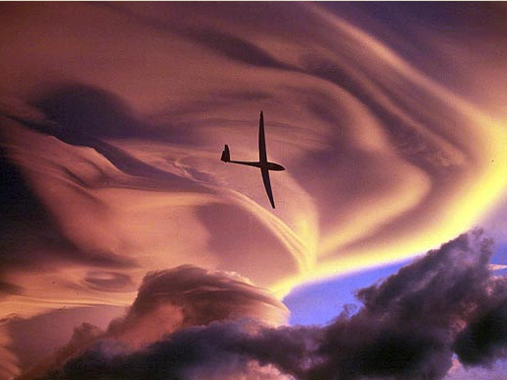
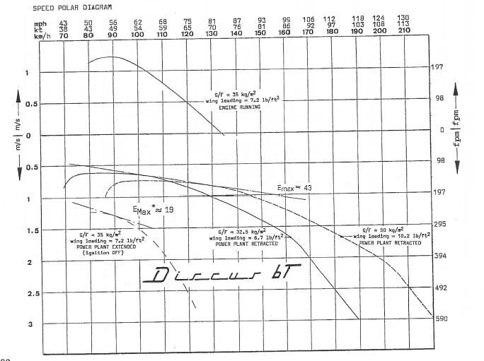
Aircraft Perfomance
84kts & 95kts (157kph & 176kph)
Glide Angle:
84kts = 1 : 28.8
95kts = 1 : 32.6
With a 60kt x/wind at 90°:
84kts = G/S of 71kts (131kph). Drift 38°
95kts = G/S of 81kts (150kph) Drift 35°
Antares 110kts = 1:37.75 G/A
GS of 95kts (176kph)
At 95kts has G/A of 1:43
Notes:
Slide 2
Best G/A 1:43 at 56kts
With water ups to 68kts
Best G/A based on a 3kt rate of descent

Slide 3
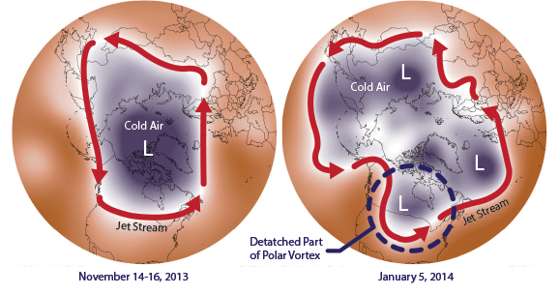
:The Polar Vortex extends vertically in the stratosphere from 8-11km to 50-60km
:The Polar Jetstream is in the troposphere and basically follows the Polar Vortex
The Polar Vortex
Notes:
Slide 3
Polar Vortex is high up in atmosphere/ the stratosphere: 8-11km extending to 50-60km
The Jetstream is usually follows it in the troposphere . If the jetstream weak usually end up with cold easterlies in the winter

Slide 4
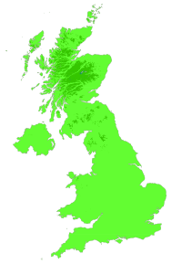
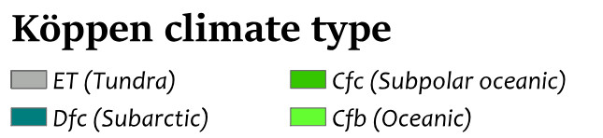
Polar
Oceanic
Polar
Continental
Polar Front (Jetstream)
Temperate
Oceanic
Temperate
Continental
Notes:
Slide 4
Effects of airmass.
The polar front position largely determines the type of weather we have, can go up and down with the seasons slide across the country and be up and down across the country.
Types and qualities of the airmasses
A bit like the oil in lava lamps or melting jellies
Currently easterlies with cold polar air coming of the east

Slide 5
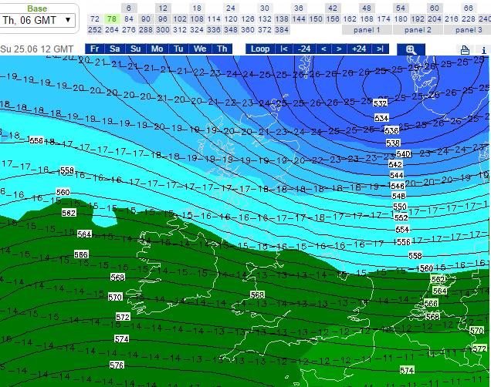
Expert Weather Online: Temp@500hpa/18,800’
ISA temp @ 500hpa = -22°C
If temperature is warmer then airmass good for wave
Notes:
Slide 5
Most probably a front straddling across the UK

Slide 6
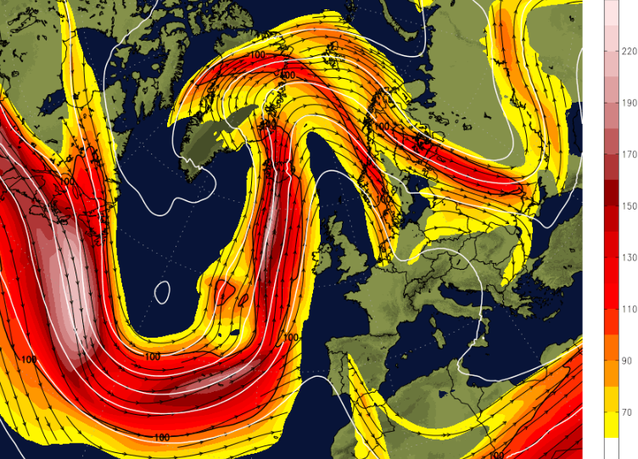
Thurs 21 02 19 : Netweather
0900L
Why is the Jetstream important?
Notes:
Slide 6
Jetstream at 1200 21/02/19
Wave at Aboyne
Discuss the Omega Curve

Slide 7
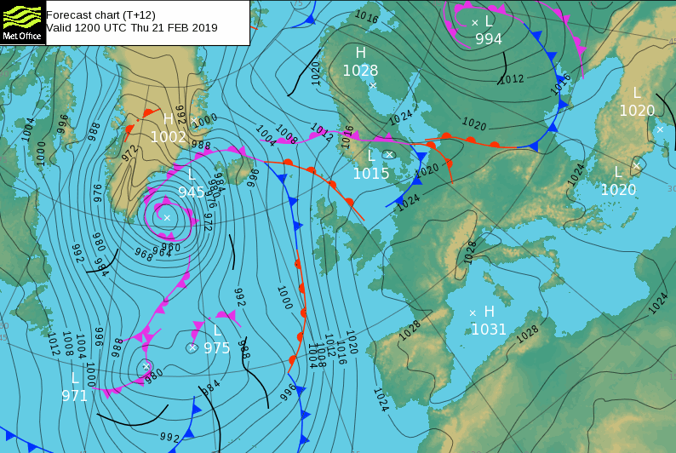
21 02 19: Roy Wilson: Ash31Mi
ABD-DRB-TAD-MLT-ABO
503.5km@88.9kph
Notes:
Slide 7
Met Office surface pressure synoptic in colour on the 21st
Can choose to have it black
On this day the temp at Aboyne was 18C.

Slide 8
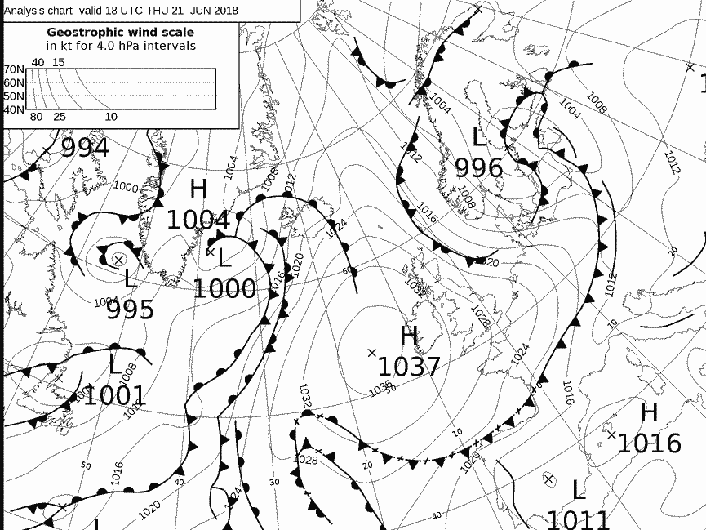
21 06 2018
1900L Synoptic
Notes:
Slide 8
Met brief gives it up to 5 days in advance
Draw out the Jetstream
Where is the air coming from.
In the morning a decaying front was moving SE off the Scottish east coast

Slide 9
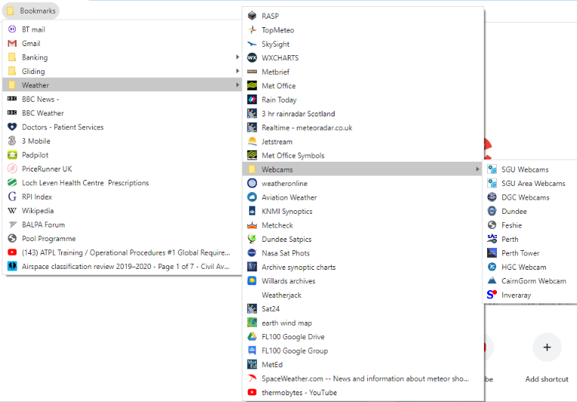
The
well balanced
glider pilot’s
Bookmarks

Slide 10
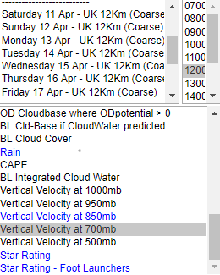
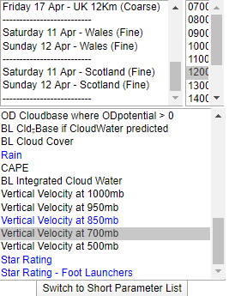
RASP(compact) Wave Forecast 11 04 2020 : 12km, 4km & 2km Grids
(4800’)
(10,100’)
Notes:
Slide 10
12 Km : 7days
4Km : 3 days
2Km : 2 days: will not get the actual day until around 0800

Slide 11
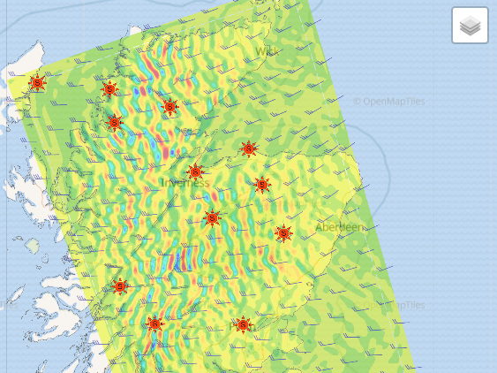
0900: 700hpa (3km)
Sat 11th April 20
with soundings
Notes:
Slide 11
Last semi decent wave day: 0900: 700hpa Sat 11th April
Get tephigrams from pages top right

Slide 12
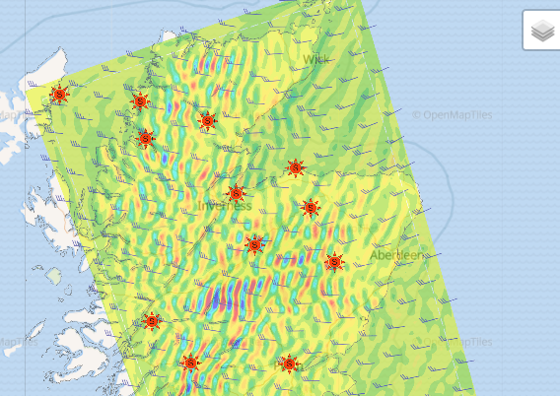
1200: 700hpa
Sat 11th April 20
with soundings

Slide 13
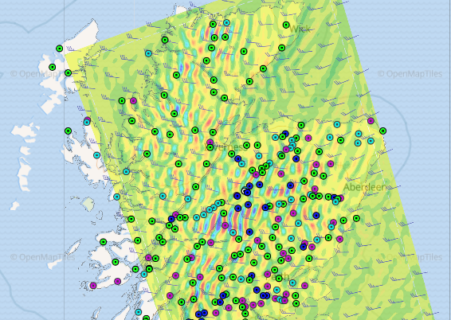
RASP
BGA Waypoints
Notes:
Slide 13
Rasp now does not have the option to draw a task

Slide 14
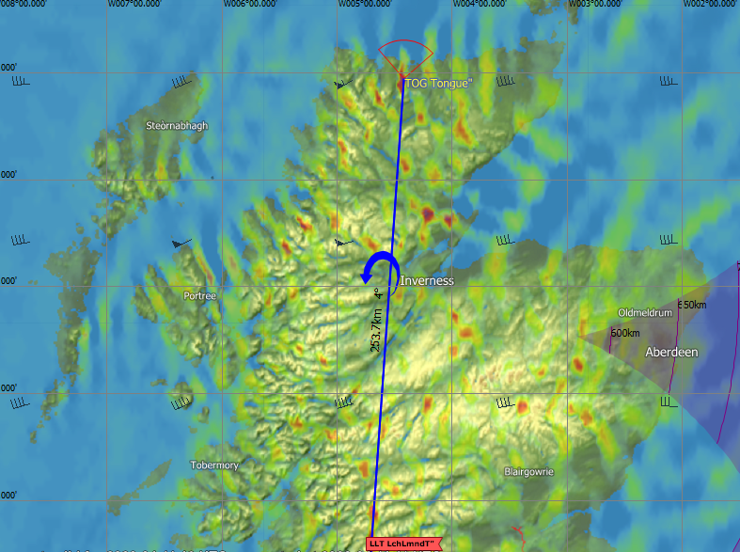
Skysight
Vertical velocity 2km/7kft
30nm
Notes:
Slide 14
Approximately 1200L

Slide 15
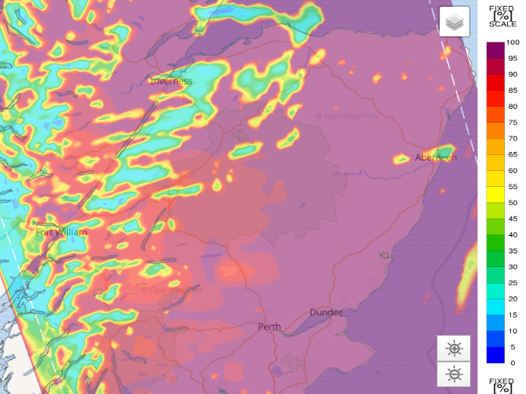
RASP: 1200L
Normalized Sfc Sun
(Solar Radiation)
Notes:
Slide 15
Cloud Streeting & possible wave bars

Slide 16
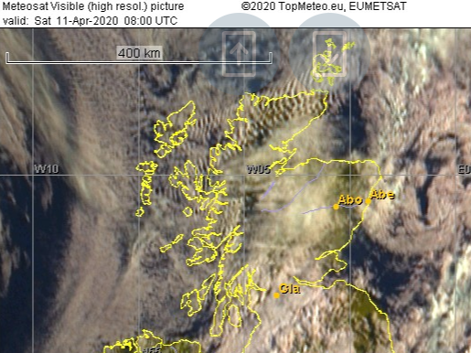
(0900L)
Topmeteo
Sat Photo 09:00L

Slide 17
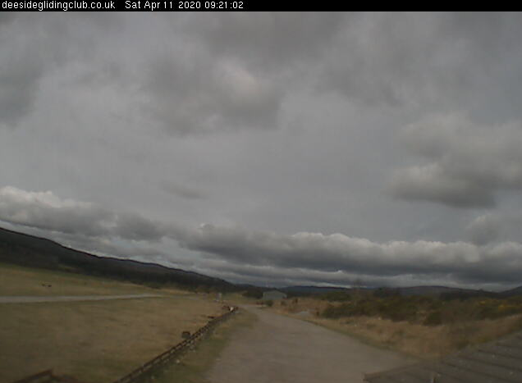
Deeside GC
Webcam 09:21L
Notes:
Slide 17
0900: Wind 262/33kts at 2600’ dropping to 10kts at 7500’ increasing 50kts 25,000’

Slide 18
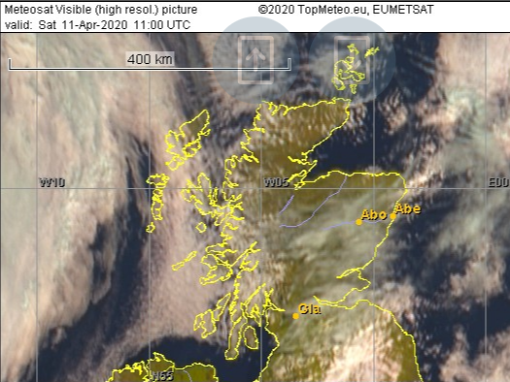
(1200L)
Topmeteo
Sat Photo 12:00L

Slide 19
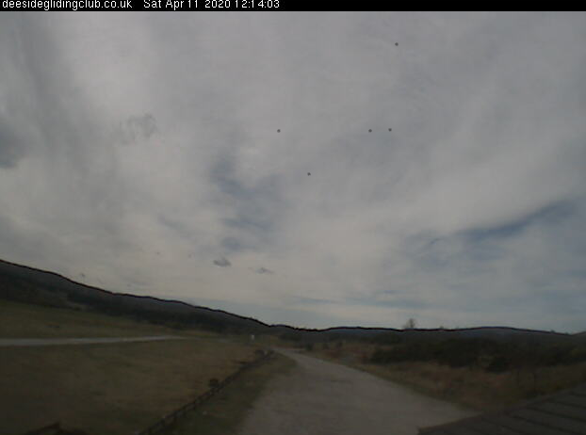
Deeside GC
Webcam 12.14L
Notes:
Slide 19
1200L: 277/30kts at 4000’ dropping to 270/25kts at 7500’ then increasing to 50kts at 20,000’

Slide 20
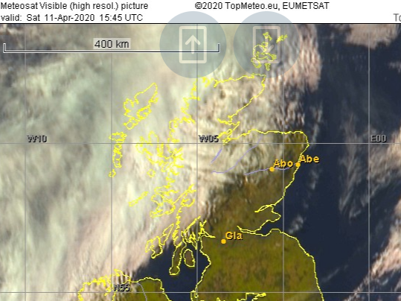
(1645L)
Topmeteo
Sat Photo 16.45L
Notes:
Slide 20
High topcover but still soarable

Slide 21
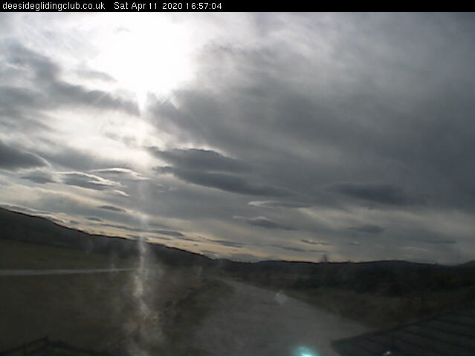
Deeside GC
Webcam 16.57L

Slide 22
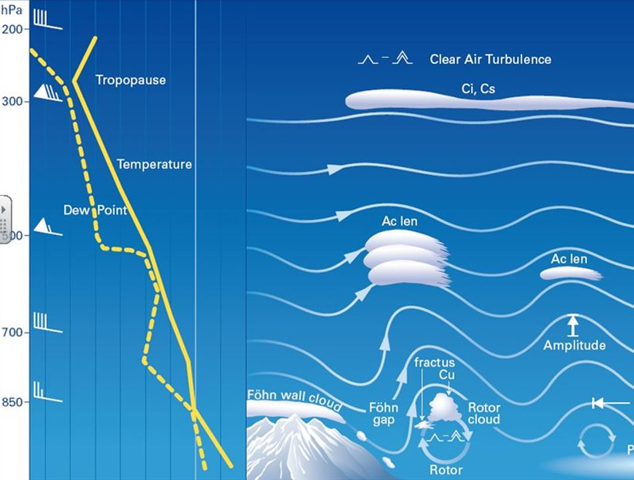
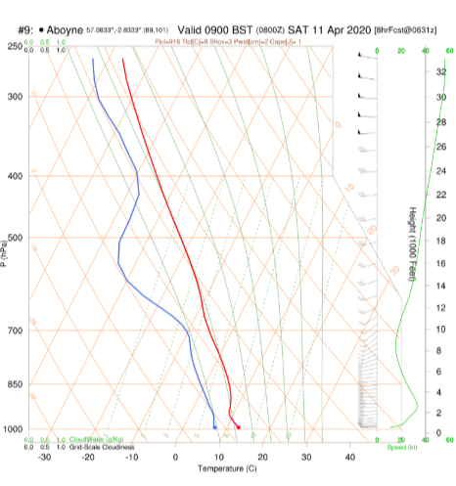
Notes:
Slide 22
Temperature on the ground 16°C
Inversion starts at 2000’

Slide 23
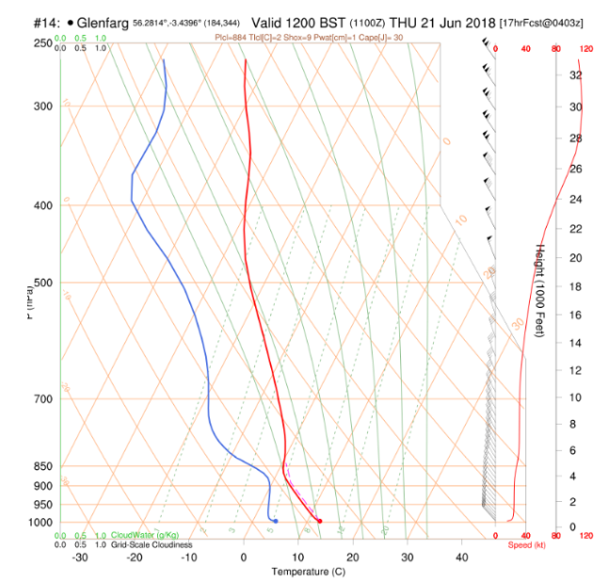
Notes:
Slide 23
Also potentially a good thermal day

Slide 24
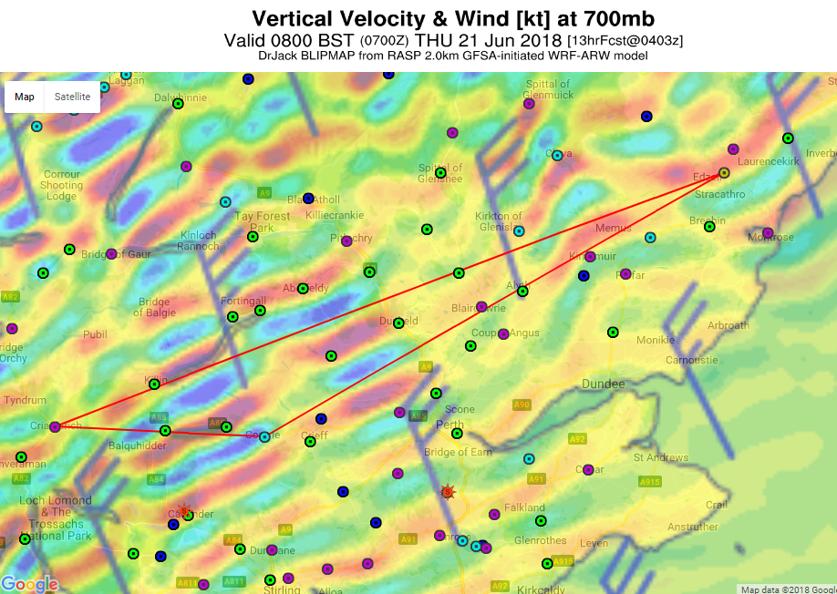
21 06 18
1554km (T) flown
Sunrise: 04.24L Sunset 22.05L: 18.44 available daylight
Airborne: 04.56L: First task started: 05.54L

Slide 25
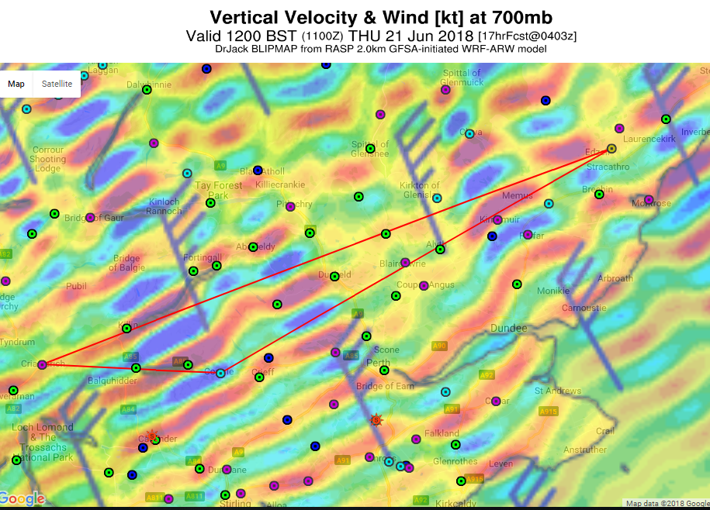
Note the number of wave bars to Comrie : 4
Notes:
Slide 25
Weak in the A9 valley

Slide 26
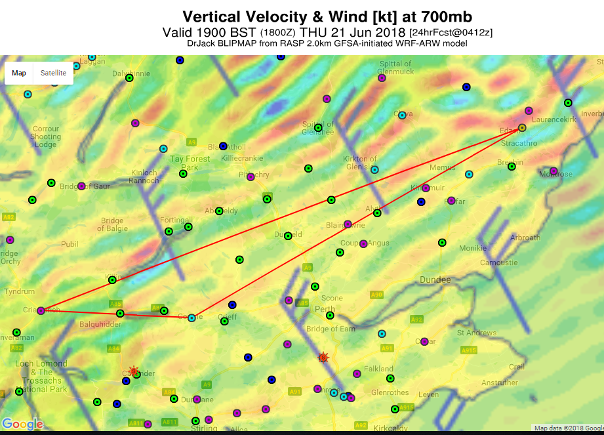
Last task finished 19.52: Landed 20.09 Total flight time 15.12
Notes:
Slide 26
Lift was fading to the east of Blairgowrie

Slide 27
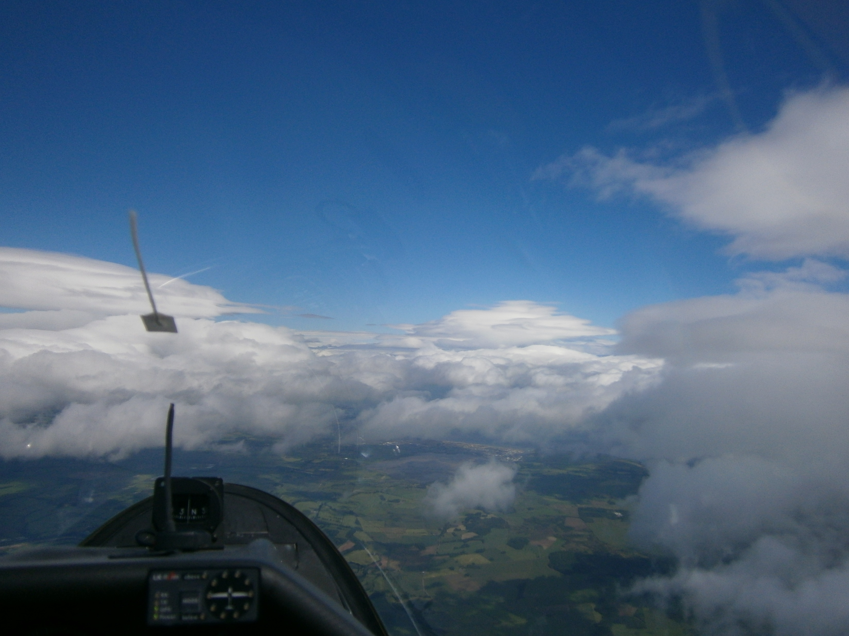
12.58L: Lap 2, leg 3 Looking up to Edzell (on left)
Wind Direction
Notes:
Slide 27
Slide 28
On lap 1 it was a lot more cloudy .
Had to route south of Edzell. Was getting trapped by the height of the wavebars and the bottom of the airway

Slide 28
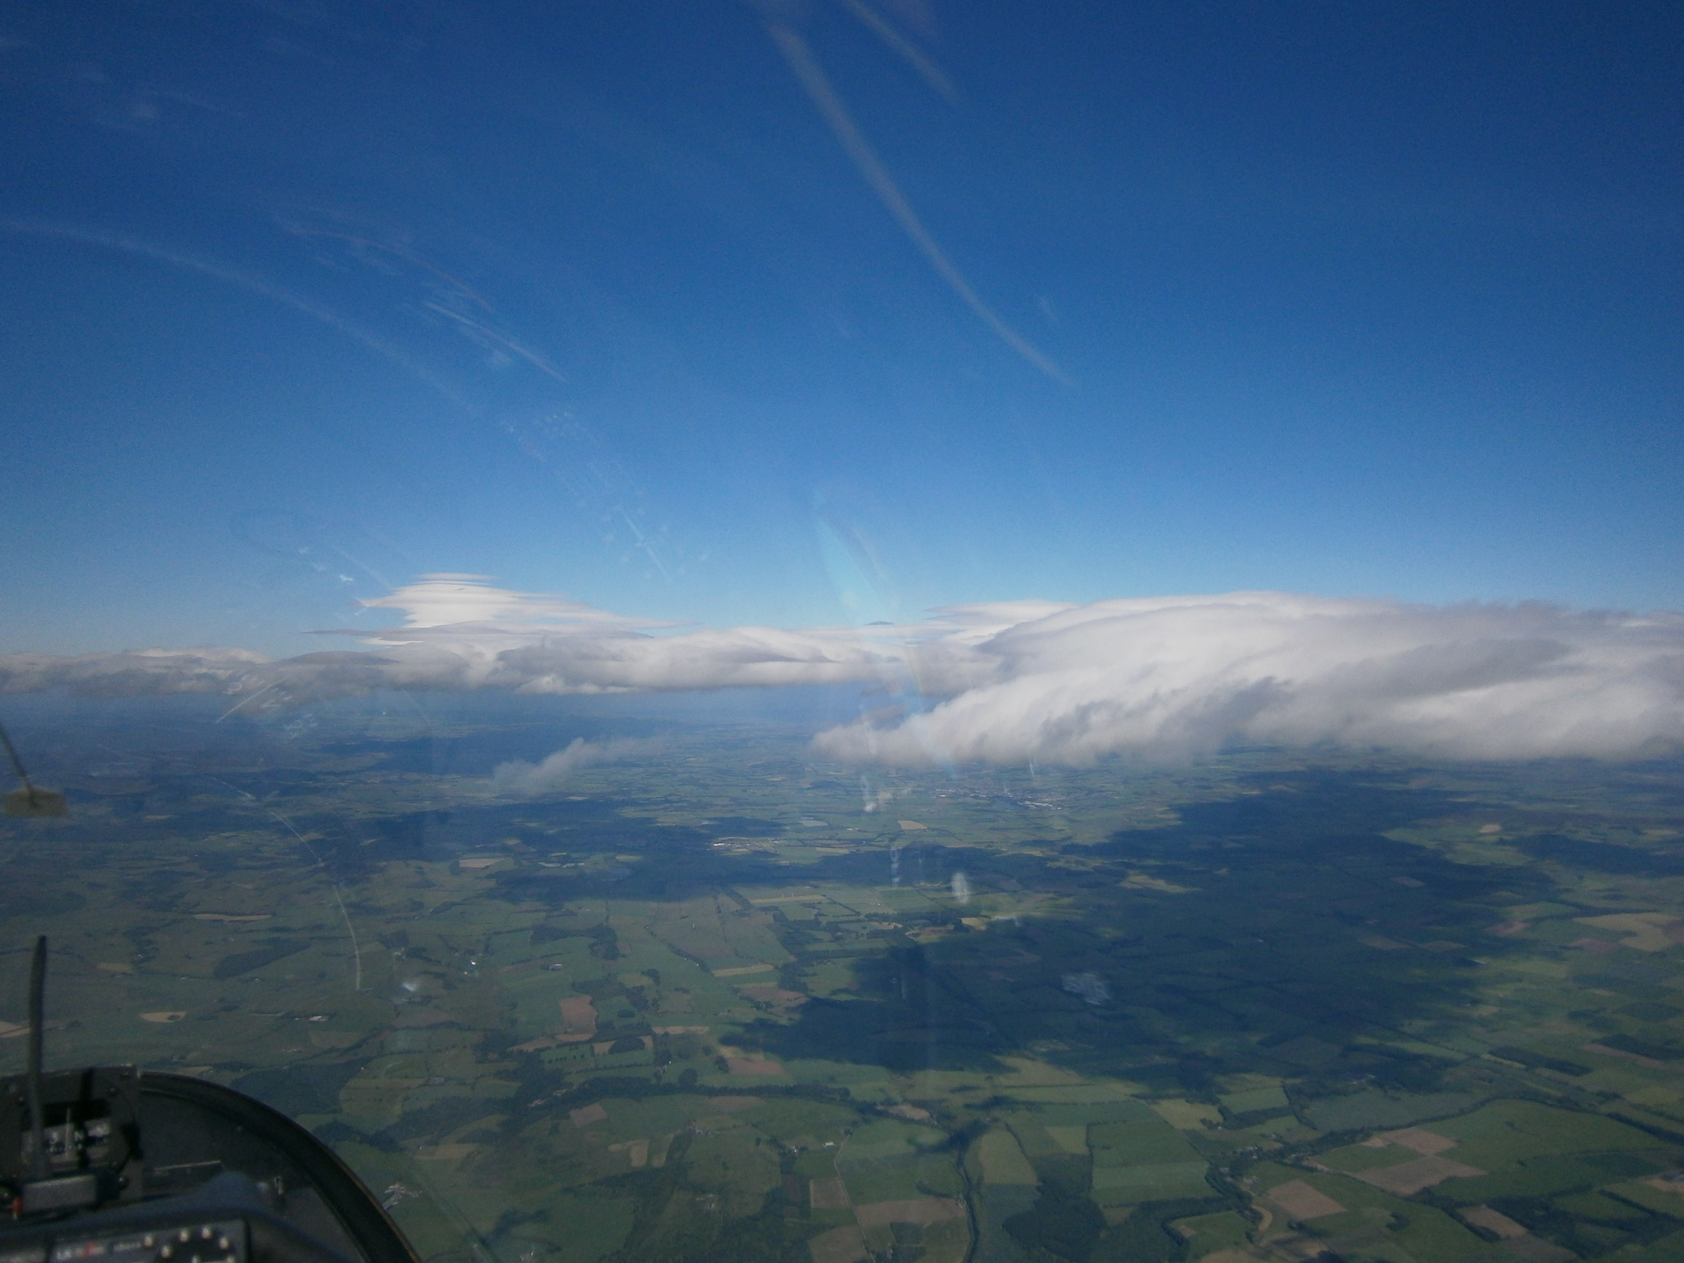
15.58: Lap 3, leg 1: Looking up to Montrose
End of Part 2
Performance & Met. Interpretation
Any Questions?
Notes:
Slide 28
Sky drying out.
Almost chucked it in at one point as the sky collapsed in the area North of Perth
Chucked it in on lap 3 as the sky had turned blue., the lift was weak and I was tired so I reduced the level of risk.

