Slide 1

The BGA Ladder
Sant Cervantes – 11th January 2021

Slide 2
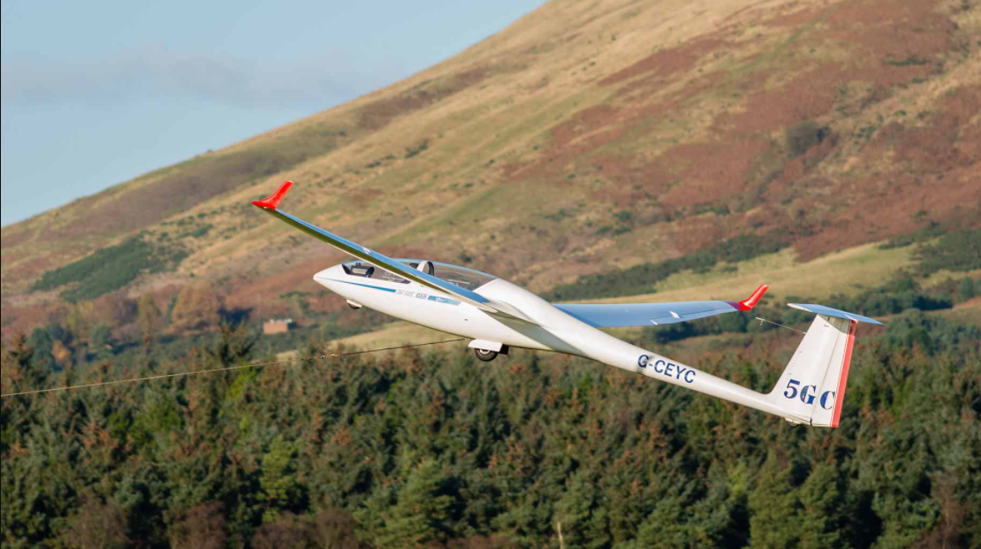
The BGA Ladder
Why do it?
The Start, Turnpoints & Finish
Shape & Speed
The JEDI Ladder
Declared & undeclared Tasks
The Ladder and using “Glana”
Notes:
2. The BGA Ladder
Why do it?
The Start, Turnpoints & Finish
Shape & Speed
The JEDI Ladder
Declared & undeclared Tasks
The Ladder and using “Glava”

Slide 3
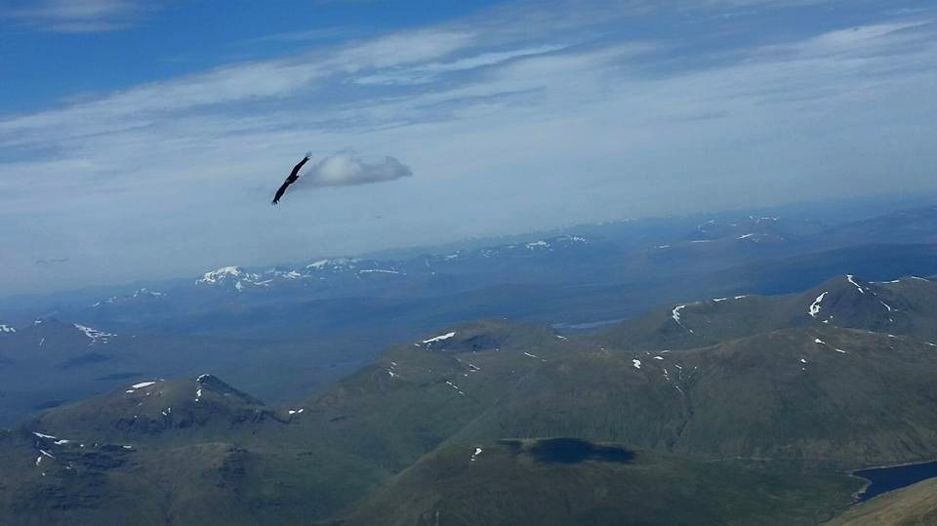
Why Do it?
Because it’s fun!!
Compare, improve and learn from your peers
See what the pundits are doing
Every flight counts for:
Statistical analysis, especially useful for our sport with regards to Airspace consultations
Notes:
3.Why Do it?
Because it’s fun!!
Compare, improve and learn from your peers
See what the pundits are doing
Every flight counts for:
Statistical analysis, especially useful for our sport in allocation of Airspace consultations
E.G. Edinburgh TMA, FL100 etc.

Slide 4
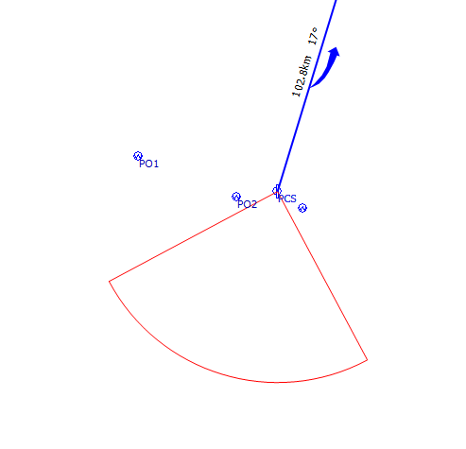
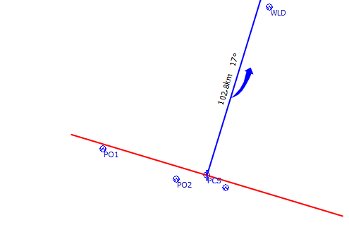
Start Points
5km
10km
Start Line
90° Sector (Infinite Size)
Notes:
4. Start Points.
Must cross the start line.
Usually only records the first start and not any restarts. Have to work out new restart.

Slide 5
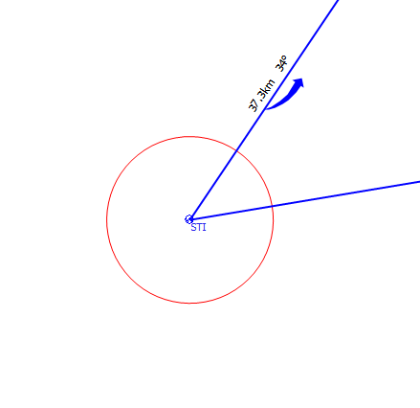
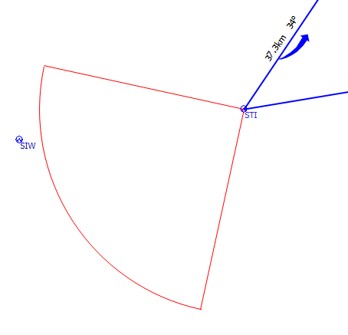
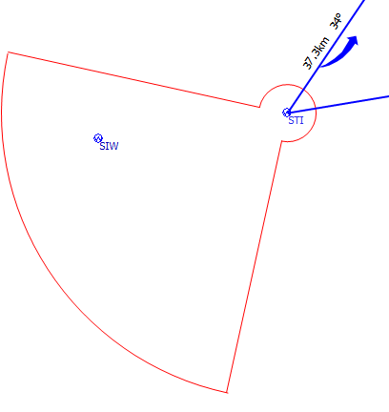
Turnpoints
90°Sector (Infinite Size)
Barrel
Thistle
0.5km
90°Sector of 20km size
0.5km
Radius
1km taken off task distance for any barrel or thistle turnpoint
Notes:
5.Turpoints
Thistles usually used in comps.

Slide 6
(Turnpoints)
Area Assigned Task
or Variable Sector
AAT’s will be scored as undeclared tasks and the sum of the radii used will be deducted from the task distance.
VS’s will only apply at comps or club task weeks but are scored as declared; otherwise the same.
Usually a Competition
selected radii
Notes:
6. Turnpoints
Usually both are used in competitions.
For AAT’s the declaration factor is .75 as the flight is considered undeclared.
For Variable sectors the declaration factor is .9

Slide 7
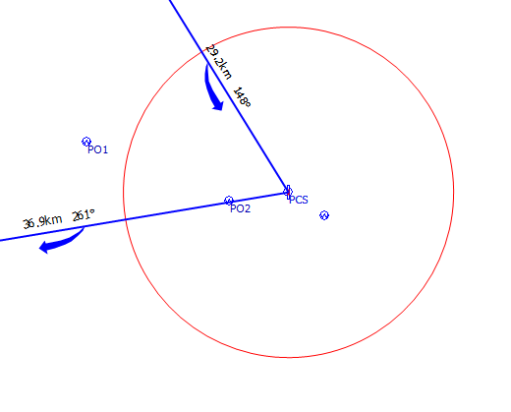
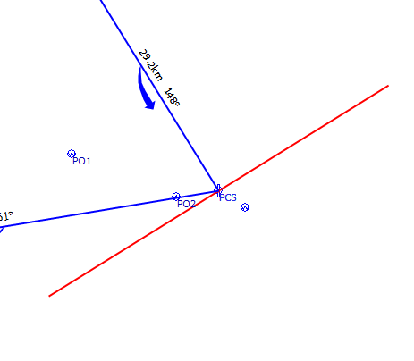
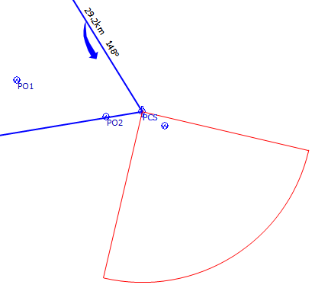
The Finish
Straight Line
(Normally 3km)
5km
10km
Finish Circle
(Can be any size)
90°
Can be of infinite size
Sector
Notes:
7. The Finish
Finish circles are usually used at comps now to avoid airfield congestion. Should be considered when flying from busy airfields.

Slide 8
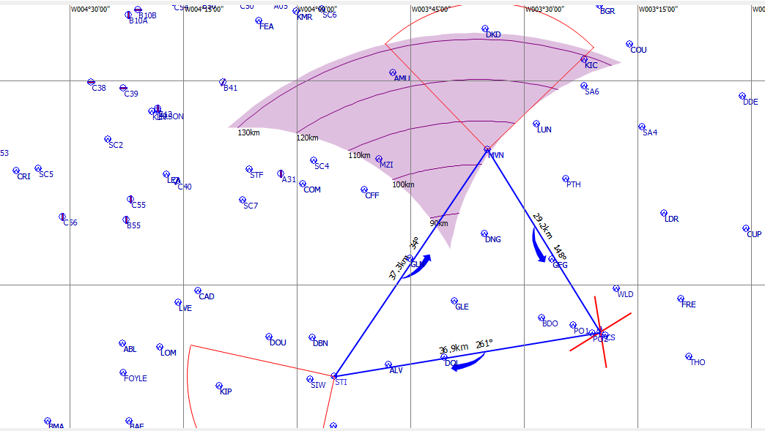
100km FAI Club
Triangle (103.4km)
PCS-STI-MVN-PCS
1000m Height Rule
Start/Finish
For 10m of height loss over 1000m, 1km will be deducted from the task distance
Notes:
8. The Club 100k Triangle- Getting into Shapes
Discuss use of the “Arc” 28% FAI triangle for records. Can have other FAI non record triangles

Slide 9
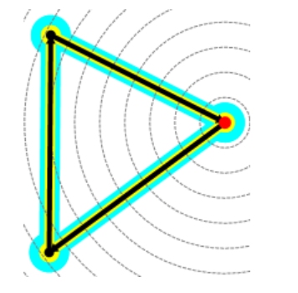
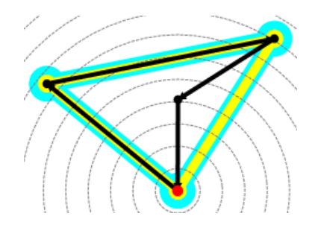
Scoring: Shape
The soaring weather & airspace takes priority
Max Shape Factor =1.08 (for the 28% FAI Triangle)
Can have a dog leg up to 5% greater total distance without a shape penalty
Can have up to 4 waypoints and a start plus a finish
( a total of 6)
Start/ Finish
Notes:
9.Shape 2
The most important thing is to decide the shape of the task to suit the weather and airspace restrictions
If the 500km 28% triangle was changed to ladder 525km “dog leg triangle” it could still be used for FAI 28% “record” triangle.
Cyan: hull which is the shape of the distance.
Yellow: FAI
Black : ladder task

Slide 10
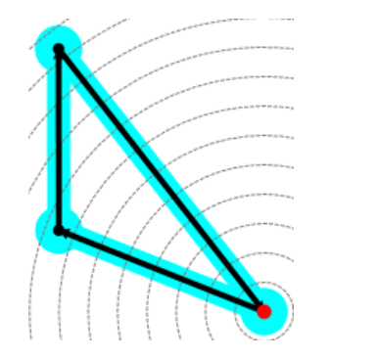
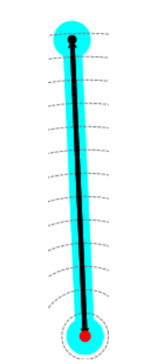
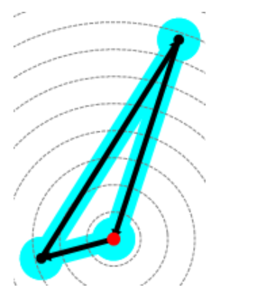
Shape – Normal
(shape factor 1.0)
Out and return
Note: A 25% - 45% triangle has a shape factor of 1.050
Worst shape is the double O & R & the Goal flight. SF: 0.82. Goal flights are not necessarily straight line, they can be dog legs for example.
Notes:
10. Shape – Normal
All shown will count for FAI badges Diamond Goal distance
Do not need to do a 28% triangle for a badge claim.

Slide 11
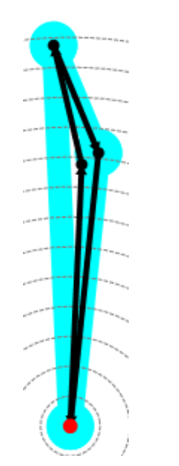
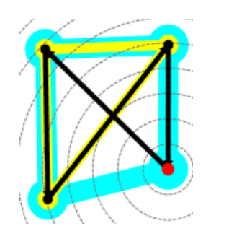
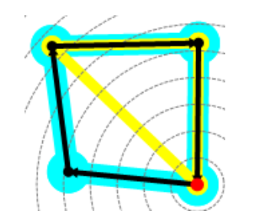
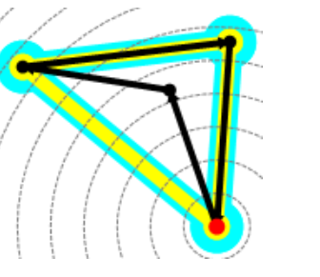
Concave quadrilateral
Out & return with doglegs
Convex quadrilateral
Bow tie
SF: 1.00
SF: 098
SF: 0.933
Black: Task
Yellow: FAI Triangle
Cyan: Concave/Convex hull
SF: 0.99
Speed Factor: Below 50kph is zero and above 100kph becomes increasingly significant.
Notes:
11, Shape 3
Cyan: Hull which is the shape of the distance
Yellow: FAI
Black : ladder task

Slide 12
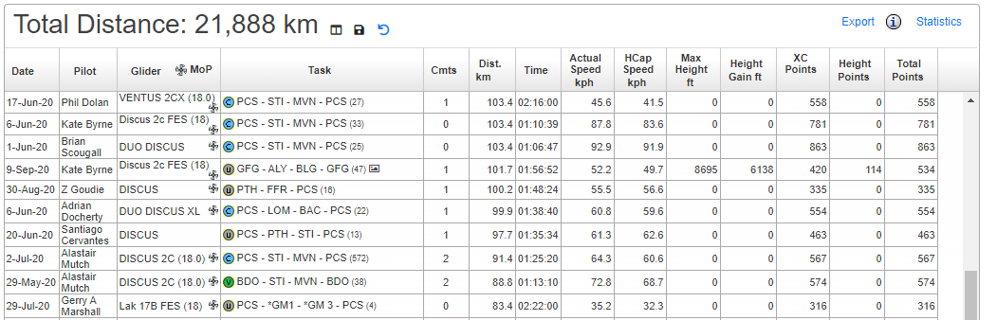
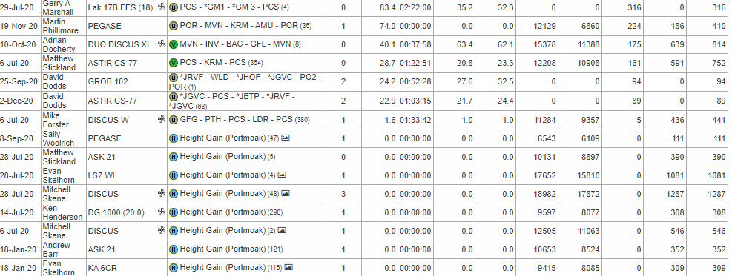
SGU
Jedi
Ladder
24 of the 99 Ladder Flights flown from
Portmoak where less than 105km
(i.e. less than 50k Out and Return)
Notes:
12. The SGU Just Effing Do It Ladder
Waypoints sorted by Sally Woolich & David Dodds

Slide 13
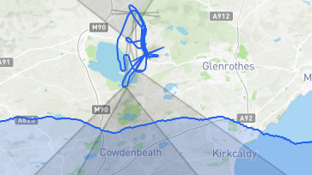
David Dodds 22.9/25.7km(HC): 89 points
*JGVC-PCS-*JBTP-*JRVF-*JGVC
*Glenvale Car Park-Portmoak Caravan Site-*Balgedie Toll Pub-*RSPB Vane Farm-
*Glenvale Car Park
Notes:
13.Taken from Glana
Are own created waypoints
Open to pilots who have not flown a 50k straight line distance flight from Portmoak in the last 3 years.
This is a poor example as it was only a ridge day.
The Jedi waypoints would have to be put in the My Info section

Slide 14
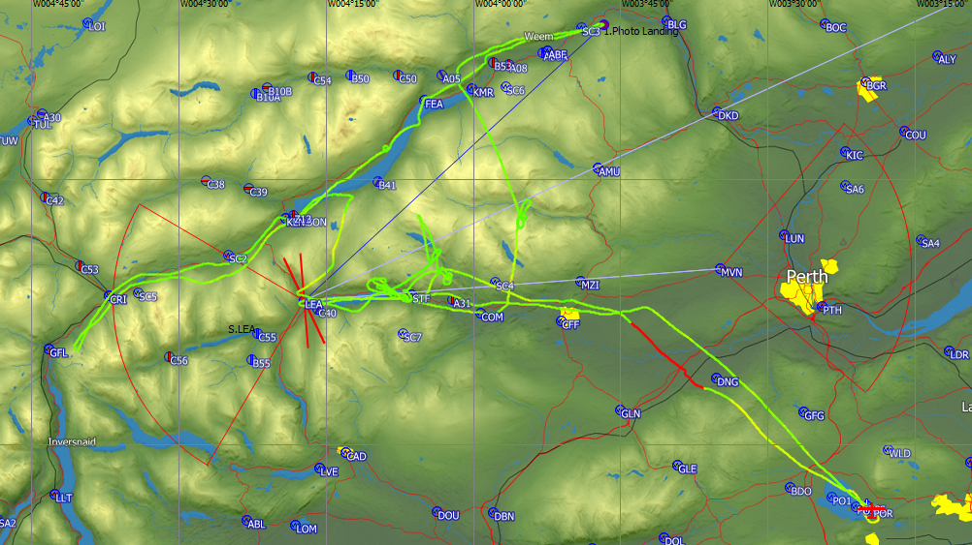
Declared Task Declaration:
LEA-EDZ-LEA-MVN-LEA: 314.9km
Flown: 86.76km:
Notes:
14. Declared task declaration
Tasks are made up of a variety of factors; distance, speed declaration, shape, handicap. completion bonus
Unable to do the declared task.
In a declared task you are allowed to miss out one turnpoint and still get scored for the task.
Will show that when using Glana
Logger will give co-ordinates of the photo landing as the point at which the task was abandoned

Slide 15
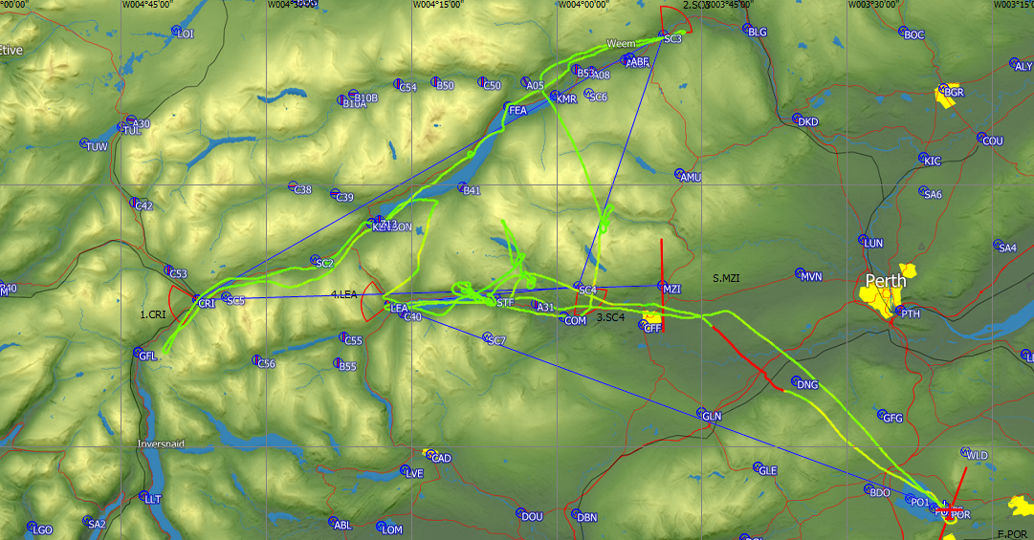
Undeclared task: 861 ladder points
MZI-CRI-*SC3-*SC4-LEA-PCS: 218.2km
Start, 4 waypoints & a finish
Notes:
15. Undeclared task.
Start, finish, & used the max 4 waypoints

Slide 16
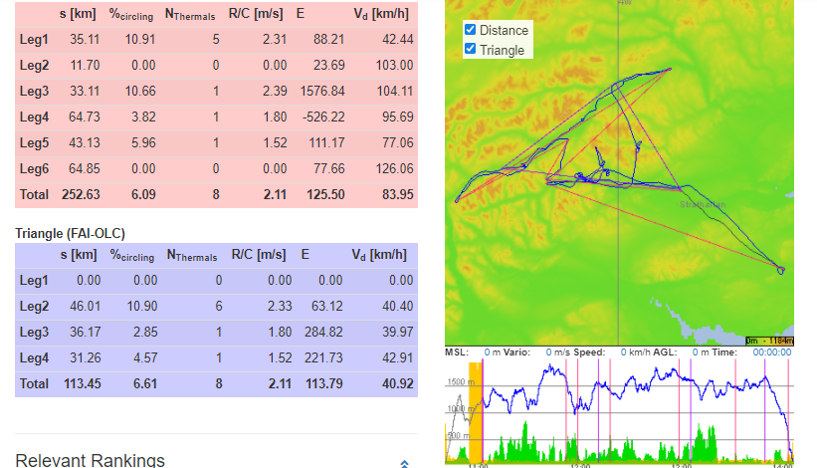
OLC: free distance: Up to 5 “free” TP’s + start & finish
OLOL
Notes:
16.OLC:
Free distance: Up to 5 “free” TP’s + start & finish

Slide 17
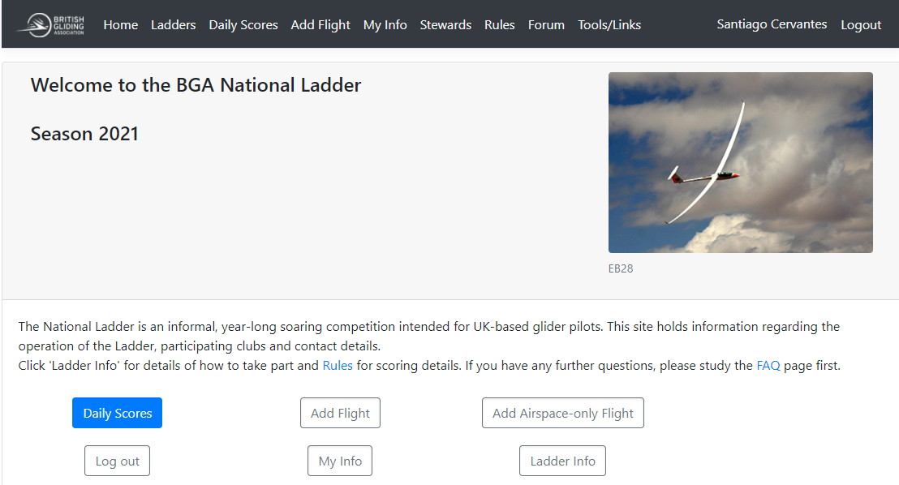
The BGA Ladder
Notes:
17. The BGA ladder
Will use the BGA ladder live
A. Ladders
1.Club SGU
2.Region Scottish & Borders
3.Ladders we are on “Club open” not National open
4.SGU open
5.Flights
Go to home.
GLANA
1.Daily Scores
2,Show filters
3.Season 2020
4. Launch point: click Portmoak
5.Month: November
6. Select multiple flights
7.Select flights
8.View flights
9.Go to settings
10.Select take off time
11. Select x 100
12. Select Sat Pic
13, Clear Settings
14. Play
GLANA is rather small on Flight Details. Much better screen size on Tools/links
Use flight of 01 01 21 in documents.
Select BGA ladder & My Info
Discuss edit flight & My Waypoints

Slide 18
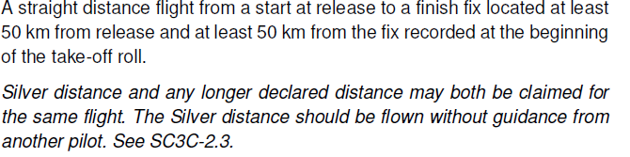
Rules for the FAI Silver C Distance
Notes:
18. Rules for the FAI Silver C Distance

Slide 19
Thank you for watching
See more of our winter talks on our youtube channel

Slide 21
