Slide 1
Sc Weekend X/C Training Group
Some basic X/C hints for new pilots

Slide 2
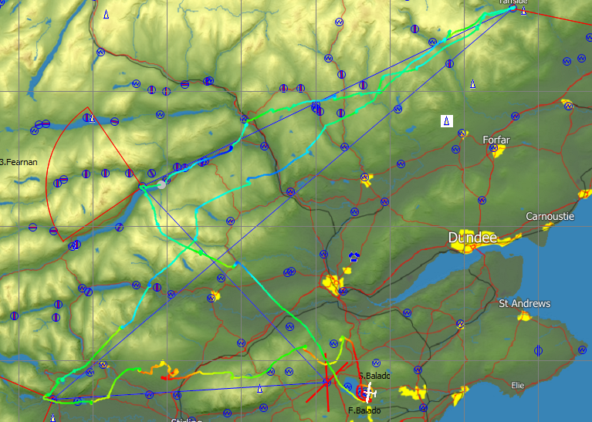
Task distance 323km
Task speed 70km/h
Time on task 4h 37min
Total flight time 5h 2min
Wind 200/07

Slide 3
OBSERVATIONS & HINTS (1)
Be thorough in your pre-flight preparation. Don’t assume, check (weather, NOTAMS, W&B, task, etc.)
Understand when soaring is likely to start and stop. Task accordingly, be realistic.
Have a clear idea of when and where you want to be towed to; take a high tow to good lift if necessary
Get a good climb before setting off. Get a feel for the thermals and take a good look along track.
Understand your start sector/line size and orientation. Don’t need to fly over the start point (or any waypoint)

Slide 4
OBSERVATIONS & HINTS (2)
On task, take more thermals in the early stage to settle in and gauge their strength. Always take good(?) lift unless close to cloudbase. Reject weak or broken lift unless low.
When nearing the top of a climb take a good look ahead on track to identify next lift before getting to cloudbase. Identify a distant feature to help leave in the right direction.
Your task speed is important even if you are not in a competition. XC speed is generally driven by selecting the best line and climbing well. Cruising speed is less important. Dolphin flying – no/maybe?

Slide 5
OBSERVATIONS & HINTS (3)
Get a feel for your glide performance
Use other gliders as a guide but always have your own plan.
Try not to wander too far off track. Can happen if deviating from a deviation but…
Significant deviations may be required to stay airborne
Don’t worry about getting low and or slow. Fly your own flight.
Keep going if conditions are ok but recognise when to quit and go home (or exercise a good land-out option)

Slide 6
OBSERVATIONS & HINTS (4)
Be able to turn at 45deg and 50 knots for a long time. Natural tendency to decrease bank.
Be proficient at turning left and right.
Always have the glider in trim.
Don’t constantly move the stick. The glider won’t respond that fast and you’ll lose the shape and “feel” of the thermal. Can happen when stressed. You should be able to thermal “hands-off” in some gliders.
Hold the stick high up (on the grip).
Oh…and keep a very good look-out (audio).

Slide 7
OBSERVATIONS & HINTS (5)
Develop soaring “stamina”. Mental workload is high and even a short flight can be tiring at first.
Sort out cockpit comfort
Sunglasses, sun cream, hat, etc., etc.,
Drink water and have a pee system worked out.
Eat stuff.
Read G Dale’s books or similar (Kawa..)

